Slide 1


COASTAL AND MARINE TOURISM (CMT)
Oceans Economy Symposium
(Port Nolloth)
16 – 17 OCTOBER 2024

Slide 2
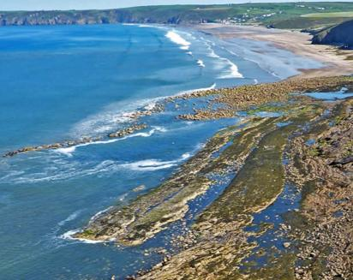
Coastal and Marine Tourism (CMT) focuses on recreational activities along the coastal zone and/or the marine environment
Marine tourism
Coastal tourism
Geographic definition
  Waters that are saline (salty) and tide-affected
  Areas of land which border the marine environment excluding dams and other inland waters
Ecosystems included
  Coral reefs, kelp forests, rocky reefs, continental shelves, sea-mounts, open oceans
  Estuaries, coastal dunes, rocky coasts, sandy beaches, coastal cliffs
Tourism activities
Marine wildlife tourism (e.g. BBWW¹, WSCD¹, seals, dolphins, turtles, birds etc.)
Coastal wildlife tourism (e.g. Land-based whale watching, Coastal avitourism, Marine turtles tours, etc.)
Recreational fishing (e.g. boat-based fishing, spear fishing, fishing competitions etc.)
Sand / Beach Sport (e.g. Kite-flying, beach combing, sand dune surfing etc.)
Scuba diving / snorkelling (e.g. shark cage diving)
Coastal Heritage and events (e.g. Local seafood and cultural tourism, cultural history etc.)
Sight seeing (e.g. Light house tourism, cycling, marathons, etc.)
Water sports (e.g. Big wave surfing, yachting, water skiing, kite surfing etc.)
Educational and scientific excursions(e.g. aquariums etc.)
  Ocean experience (e.g. Cruise tourism, marinas, island tourism, under water archaeology, etc.)
Spiritual experiences
  Events (e.g. marine competitions)
Pure recreational (e.g. dining out, shopping)
BBWW=Boat-based whale watching, WSCD=White shark cage diving
SOURCE: International Coastal and Marine Tourism Society

Slide 3
Coastal and Marine Tourism Implementation Plan (1)
The Department of Tourism in partnership with various tourism stakeholders is implementing the Coastal and Marine Tourism Implementation Plan.
The CMT work is one of the six Oceans Economy Work Streams in the country. Other work streams include:
  Marine Transport and Manufacturing activities;
  Offshore Oil and Gas Exploration;
  Aquaculture;
  Marine Protection Services and Ocean Governance; and
  Small Harbours.
The aim is to reduce poverty, inequality and unemployment, while contributing to sustainable livelihoods and development.
The CMT Implementation Plan is implemented in a nodal or cluster approach which prioritises destinations rather than individual tourism projects or products.
The identified nodes/clusters in the First Phase (0 - 5 years) encompass the following geographic areas:
  Node 1: Durban and surrounds (KwaZulu-Natal);
  Node 2: Umkhanyakude District including Umhlabuyalingana and surrounds (KwaZulu-Natal);
  Node 3: Port St Johns to Coffee Bay (Eastern Cape);
  Node 4: East London, Port Elizabeth and surrounds (Eastern Cape);
  Node 5: Cape Town and surrounds (Western Cape); and
  Node 6: West Coast and surrounds (Northern Cape).

Slide 4
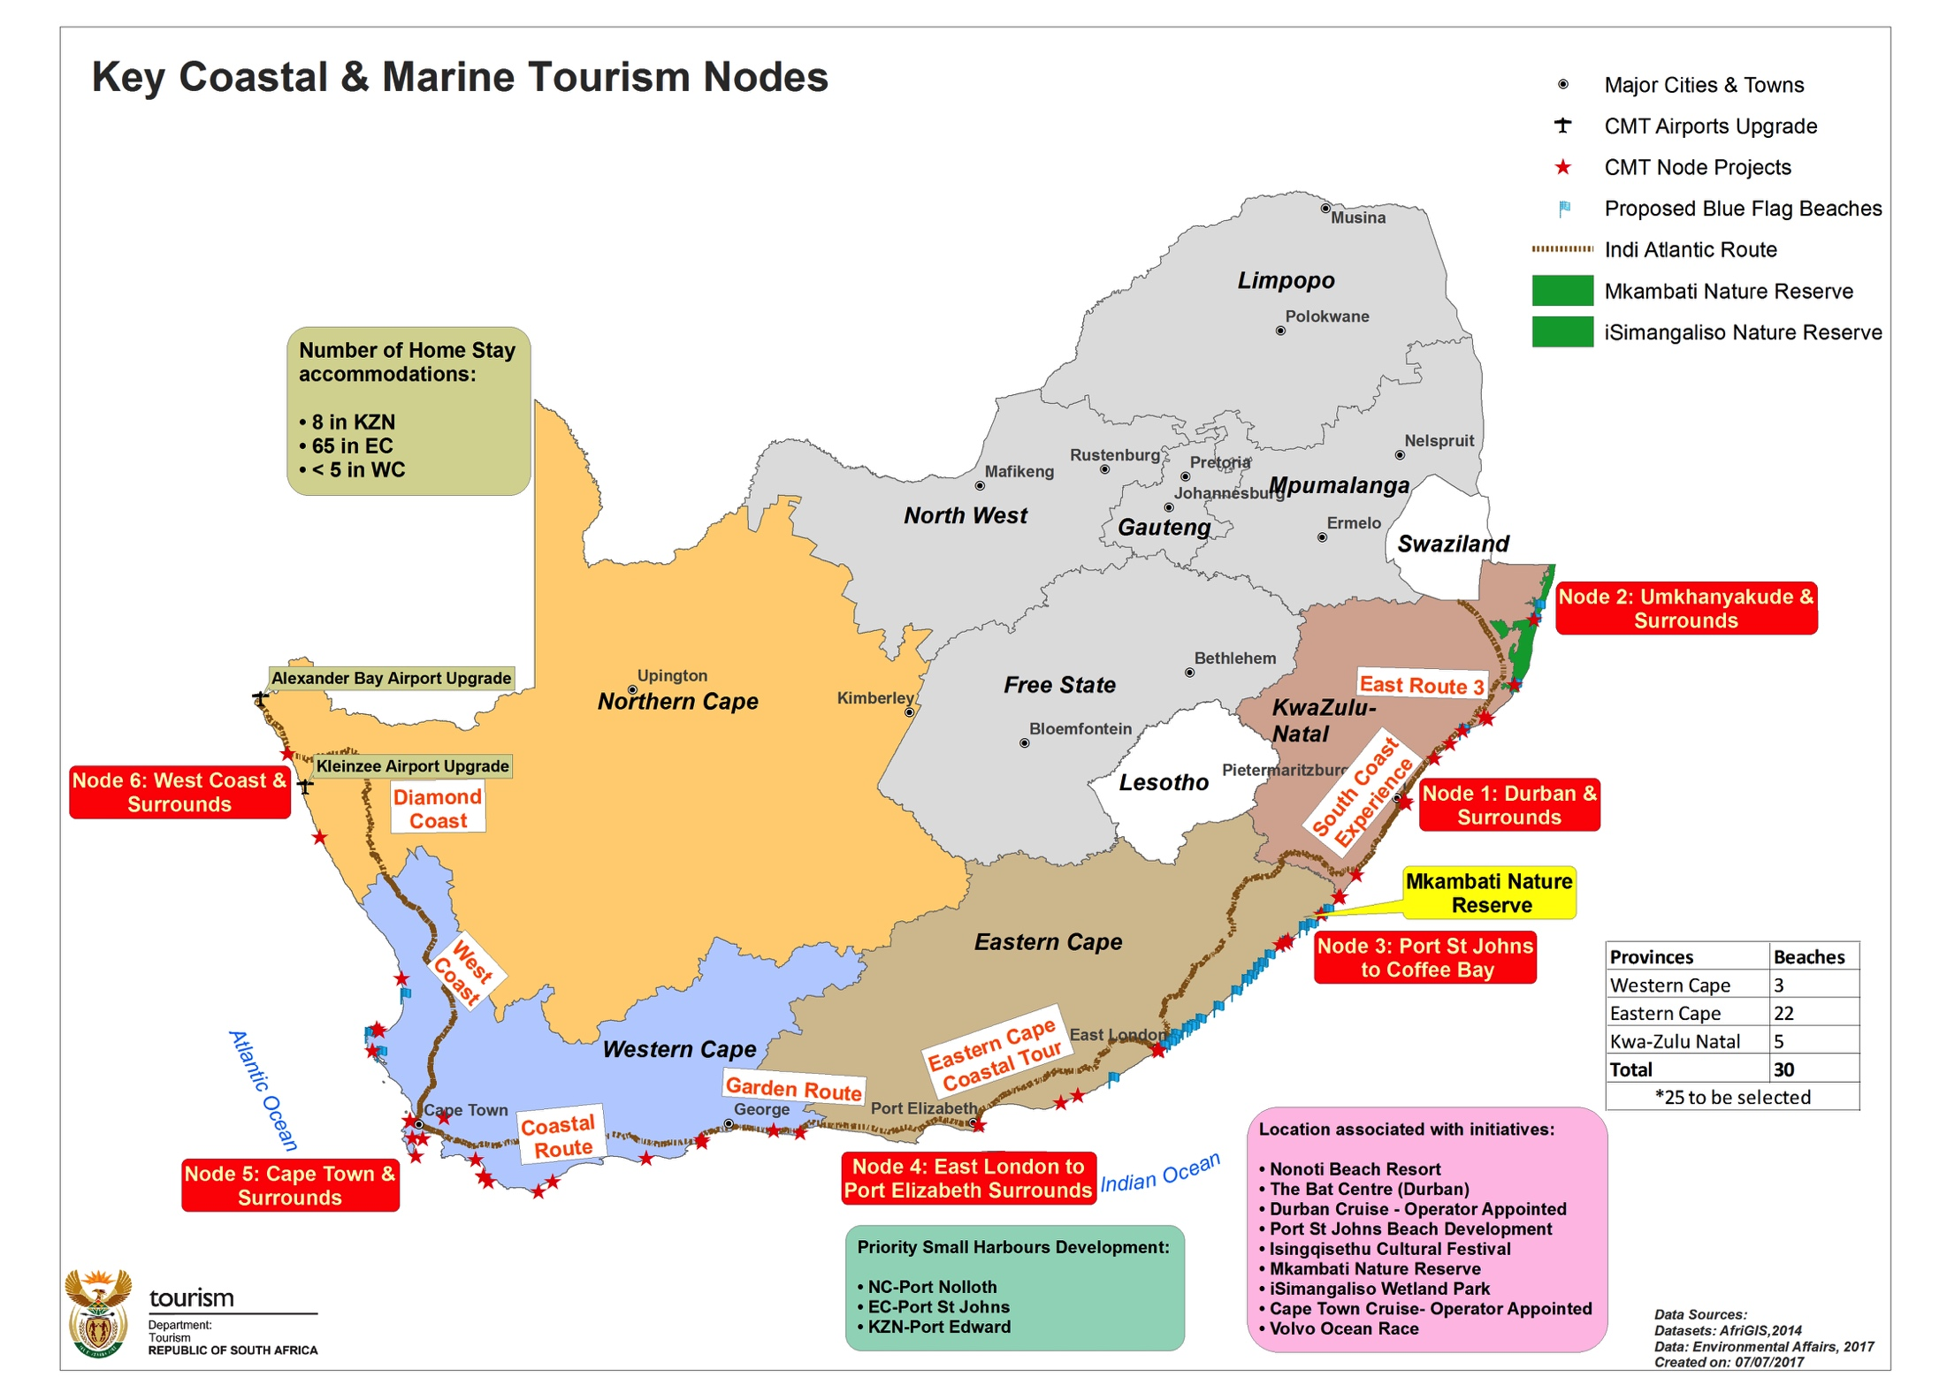
Coastal and Marine Tourism Nodes
Blue Flag Beaches

Slide 5
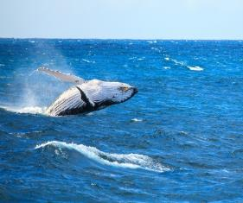
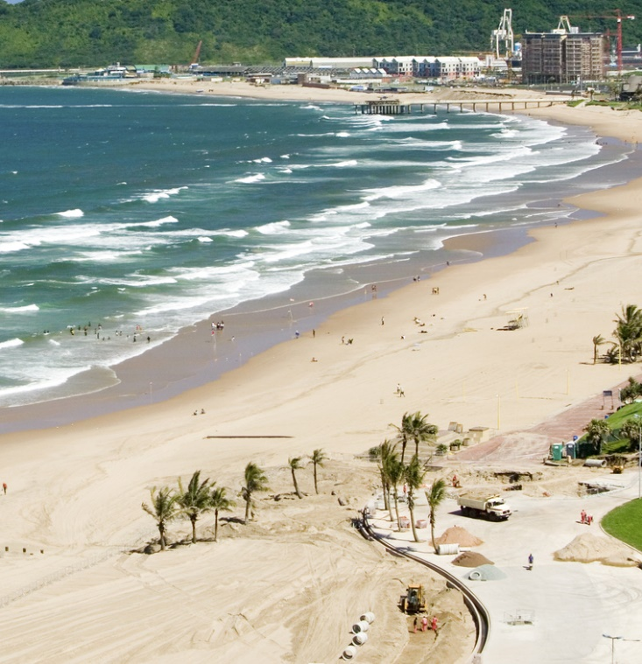
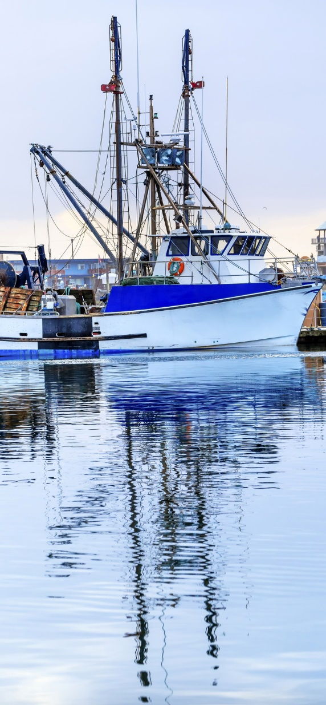
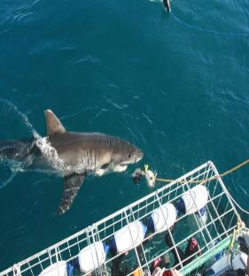
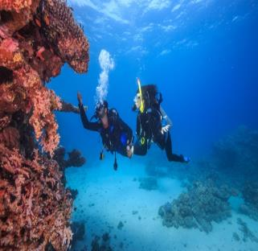
Vision Statement
Our vision is to grow a world class and sustainable coastal and marine tourism destination that leverages South Africa’s competitive advantages in nature, culture, and heritage
Estimated R21.4 billion direct contribution to GDP and approximately double the number of jobs to 116 000 by 2026.

Slide 6
Coastal and Marine Tourism Implementation Plan (2)
Initiatives in all of the nodes cover six thematic areas namely:
marketing, events and routes;
regulations and permitting;
research and spatial planning;
beach precinct development, tourism infrastructure and tourism safety;
maritime tourism (cruise tourism and seaports); and
skills development.
The Plan contains tourism projects integrated with the creative industries and cultural heritage. Opportunities include enterprise development such as local supplier development (arts and craft and beach front business), access to markets, skills development, and improved infrastructure).
The Plan has detailed actions regarded as three feet plans with budgets from both government (Department of Tourism, other Departments, government entities/ development agencies and private sector).
Working Groups are in place to oversee the above six thematic areas.
The Department has set up a dedicated delivery unit to oversee the implementation of the CMT Plan.
An Oceans Economy Committee meets every month to oversee the above work.

Slide 7
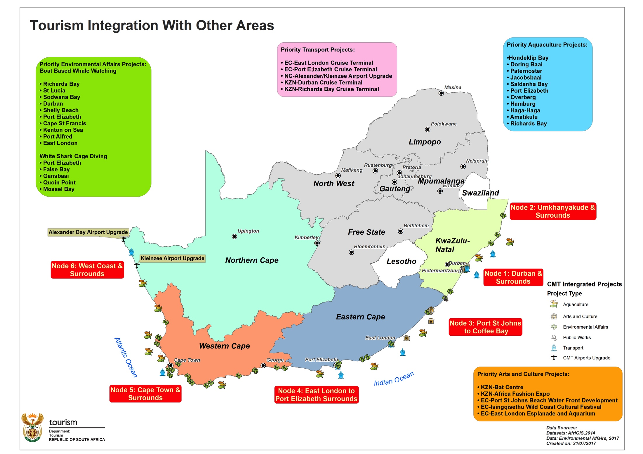
Tourism integration with other areas
Blue Flag Beaches

Slide 8
  Institutional arrangements
Presidential Operation Phakisa Issue Resolution Committee
DPME / DFFE (Phakisa Unit -Secretariat
Operation Phakisa Sector Ministerial Committee
Lab Coordinating Committee
DT Delivery Unit
Marketing, Events & Routes WG
Regulations & Permitting WG
Research & Spatial Planning WG
Beach Precinct Dev, Tourism Safety and Maritime Tourism WG
Skills Dev WG

Slide 9
Northern Cape - Project information
Name of the project | Implementing Agent | Project description | Progress
Orange River Mouth as part of the Indi-Atlantic Route | DBSA | Tourism infrastructure | Project at Design stage. Professional Service Provider (PSP) finalising the drawings. Completion of Design stage anticipated by 31 October 2024.
Kamiesberg project | DBSA | Construction of chalets, kitchen, restaurant and pool. | Design Development stage underway. Environmental and survey studies have been completed. Design report anticipated at the end of October 2024.
Platfontein Lodge | DBSA | Construction of | Project at Design stage. Designs finalised and awaiting approval by the Department of Tourism.
McGregor Museum | DBSA | Product enhancement | Implementation underway in all four sites (Magersfontein, Wonderwork cave, Wildebeest Kuil and McGregor Alex with progress at approximately 86%. Practical completion anticipated by the end of November 2024.

Slide 10
Northern Cape - Project information
Name of the project | Implementing Agent | Project description | Progress
Tankwa Karoo | SANParks | Maintenance of existing infrastructure. | Maintenance work completed in March 2023. Close - out processes concluded.
Augrabies National Park | SANParks | Maintenance of existing infrastructure. | Maintenance work completed in March 2023. Close - out processes concluded.
Kgalagadi Transfrontier National Park | SANParks | Maintenance of existing infrastructure. | Maintenance work completed in March 2023. Close - out processes concluded.
Namakwa National Park- | SANParks | Maintenance of existing infrastructure. | Maintenance work completed in March 2023. Close - out processes concluded.
Richtersveld National Park- | SANParks | Maintenance of existing infrastructure. | Maintenance work completed in March 2023. Close - out processes concluded.

Slide 11
Northern Cape - Project information
Name of the project | Implementing Agent | Project description | Progress
Doornkloof Nature Reserve | DBSA | Maintenance of existing infrastructure | Final completion achieved. Preparation for Final account underway.
Rolfontein Nature Reserve | DBSA | Maintenance of existing infrastructure | Final completion achieved. Preparation for Final account underway.
Goegap and Witsand Nature Reserve | DBSA | Maintenance of existing infrastructure | Final completion achieved. Preparation for Final account underway.

Slide 12
Northern Cape - Project information
Name of the project | Implementing Agent | Project description | Progress
Khomani San Interpretative Centre and Narrative Development | SANParks | The implementation of the exhibition and refurbishment of the interpretative centre and narrative development. | Project completed in March 2023 and launched on 19 July 2023.
Square Kilometre Array (SKA) Visitor Interpretation Centre (co-funded with the Department of Science and Innovation | South African Radio Astronomy Observatory (SARAO) | Construction of the Carnarvon Science Exploratorium | Site studies and detailed concept are done. Procurement processes for appointment of construction Contractor underway.
 | SANParks | Maintenance of existing infrastructure. | Maintenance work completed in March 2023. Close - out processes concluded.

Slide 13
Northern Cape Job Opportunities
Project Name | Number of Work Opportunities created as at August 2024
 | Jobs created | Youth | Women | People with disability
Orange River Mouth | 0 | 0 | 0 | 0
Kamiesberg project | 0 | 0 | 0 | 0

Slide 14
TOURISM planning documents

Slide 15
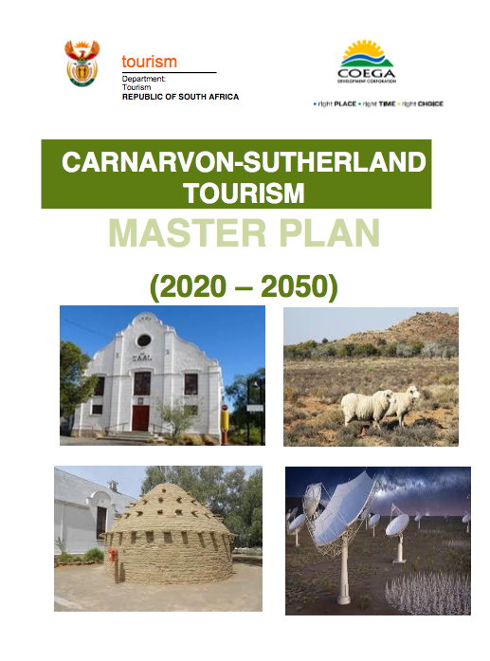
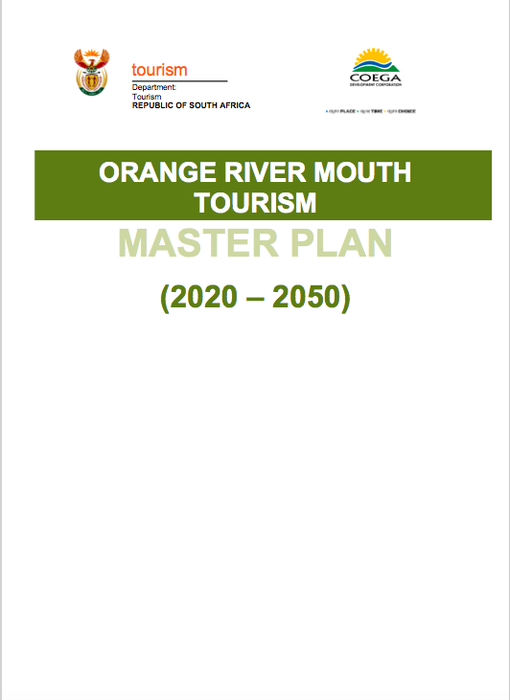
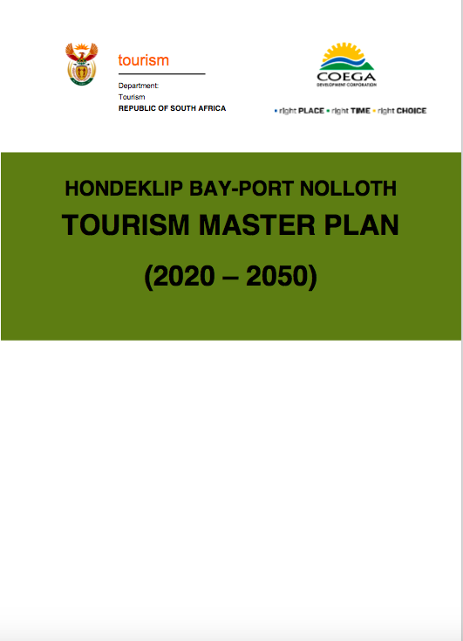
Northern Cape Master Plans
Namakwa District
Namakwa District
Pixley kaseme District

Slide 16
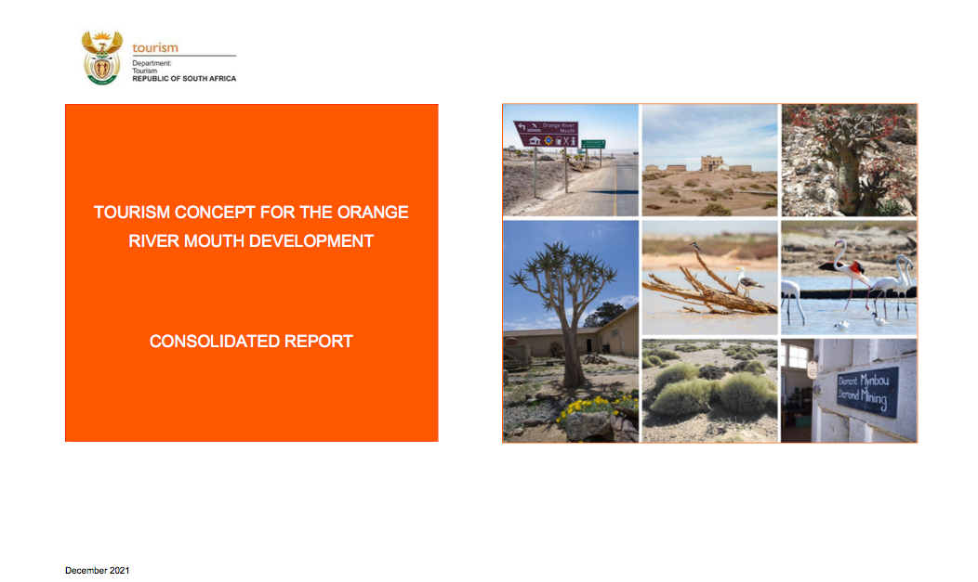

Slide 17
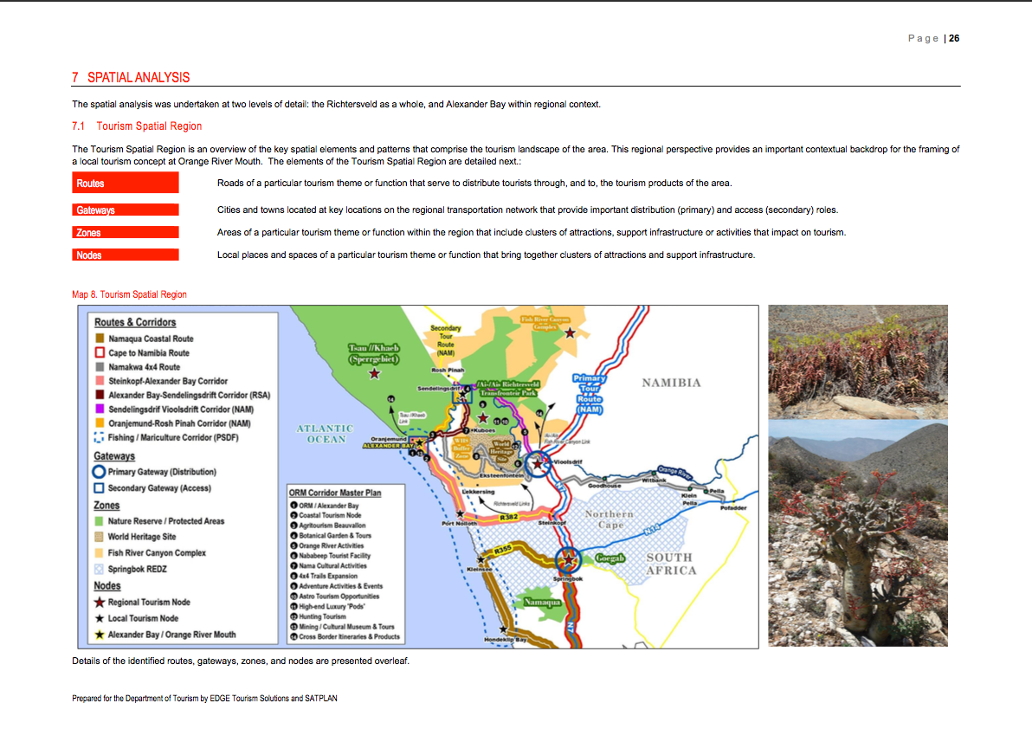

Slide 18
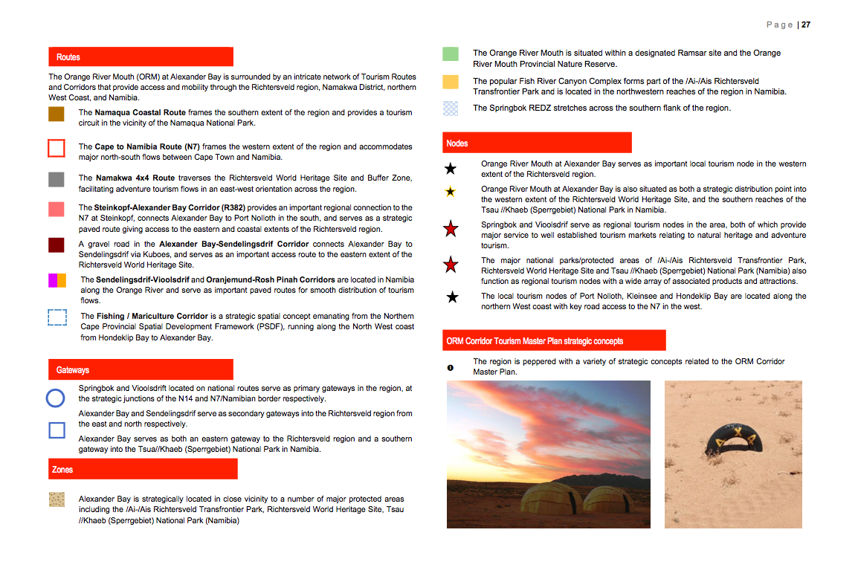

Slide 19
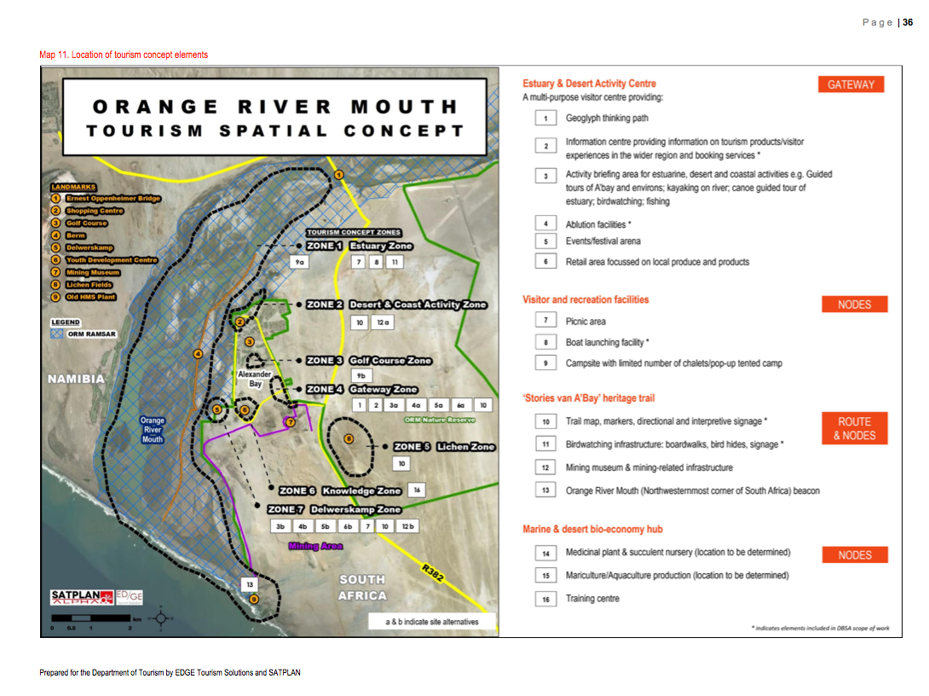

Slide 20
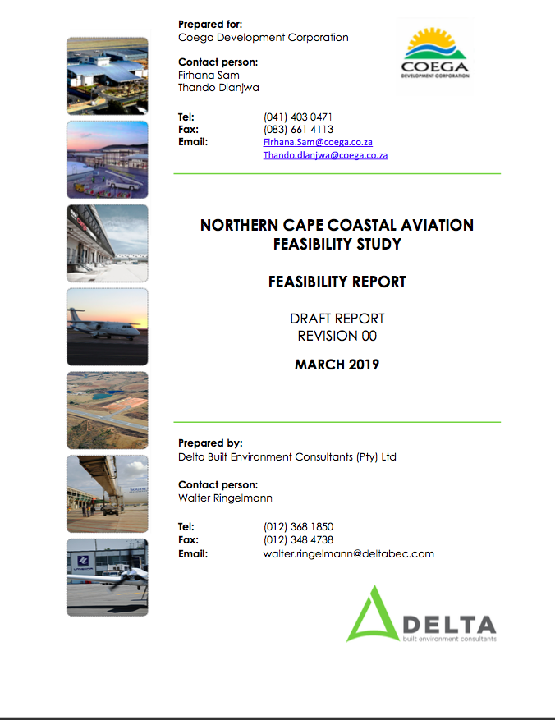
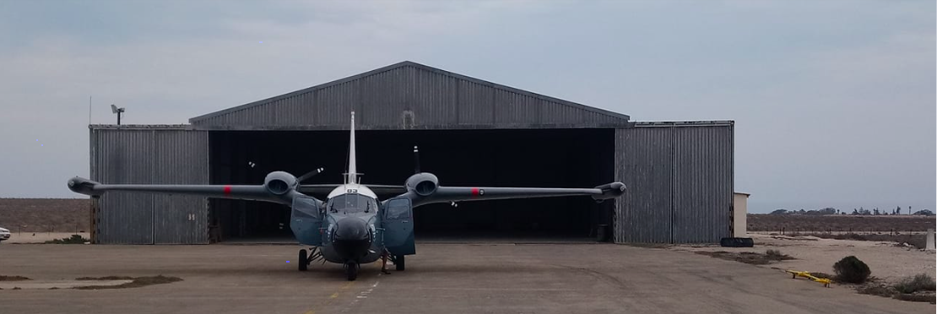
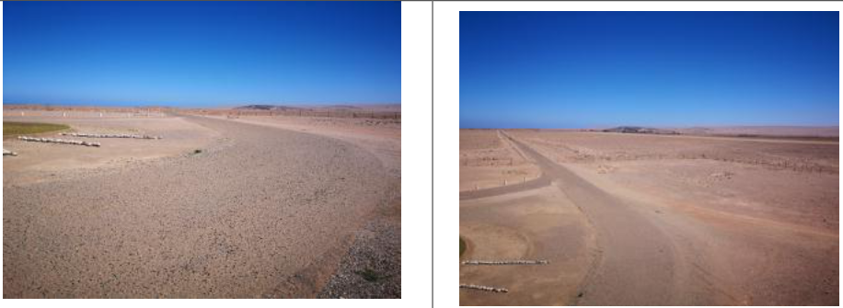
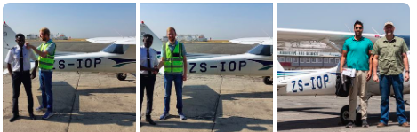
Kleinzee Airport
Alexander Bay Airport
Springbok Airport

Slide 21
Thank You
Xolani Dlamini
Department of Tourism
012 444 6568
079 491 4197
xdlamini@tourism.gov.za

