Slide 1
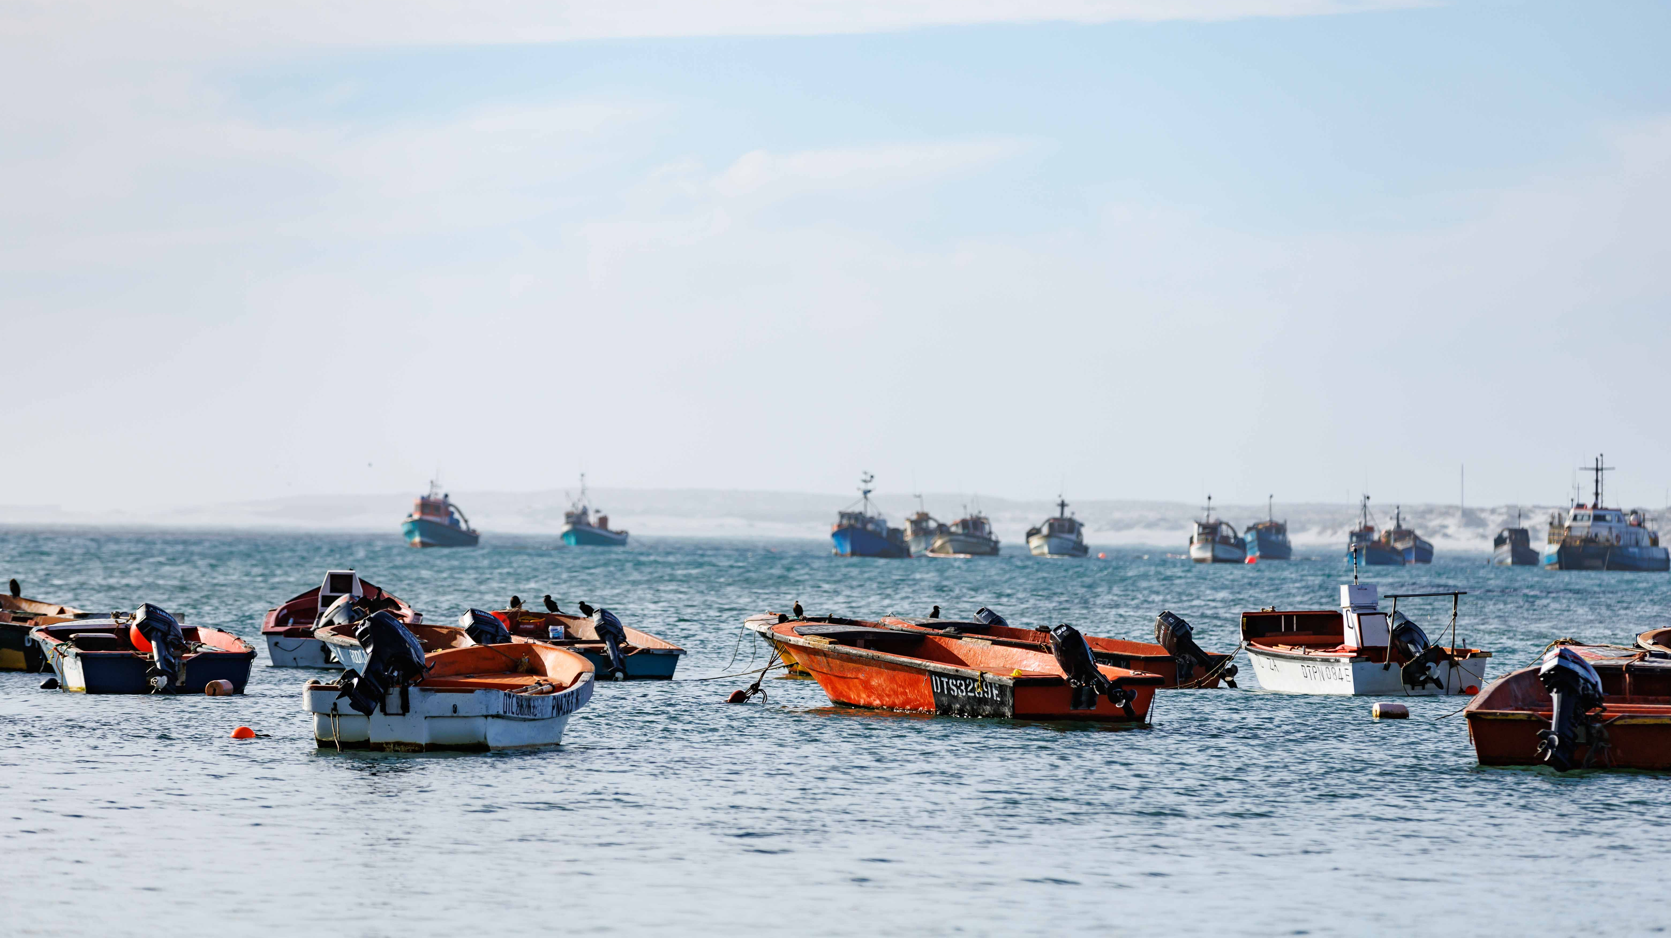


Blue Heritage:
Cultivating Wellbeing and Sustainable Tourism along the Northern Cape Coast
Dr. Jessica Thornton
Ocean Cultures and Heritage
Institute for Coastal Marine Research
Nelson Mandela University
Jessica.Thornton@mandela.ac.za

Slide 2
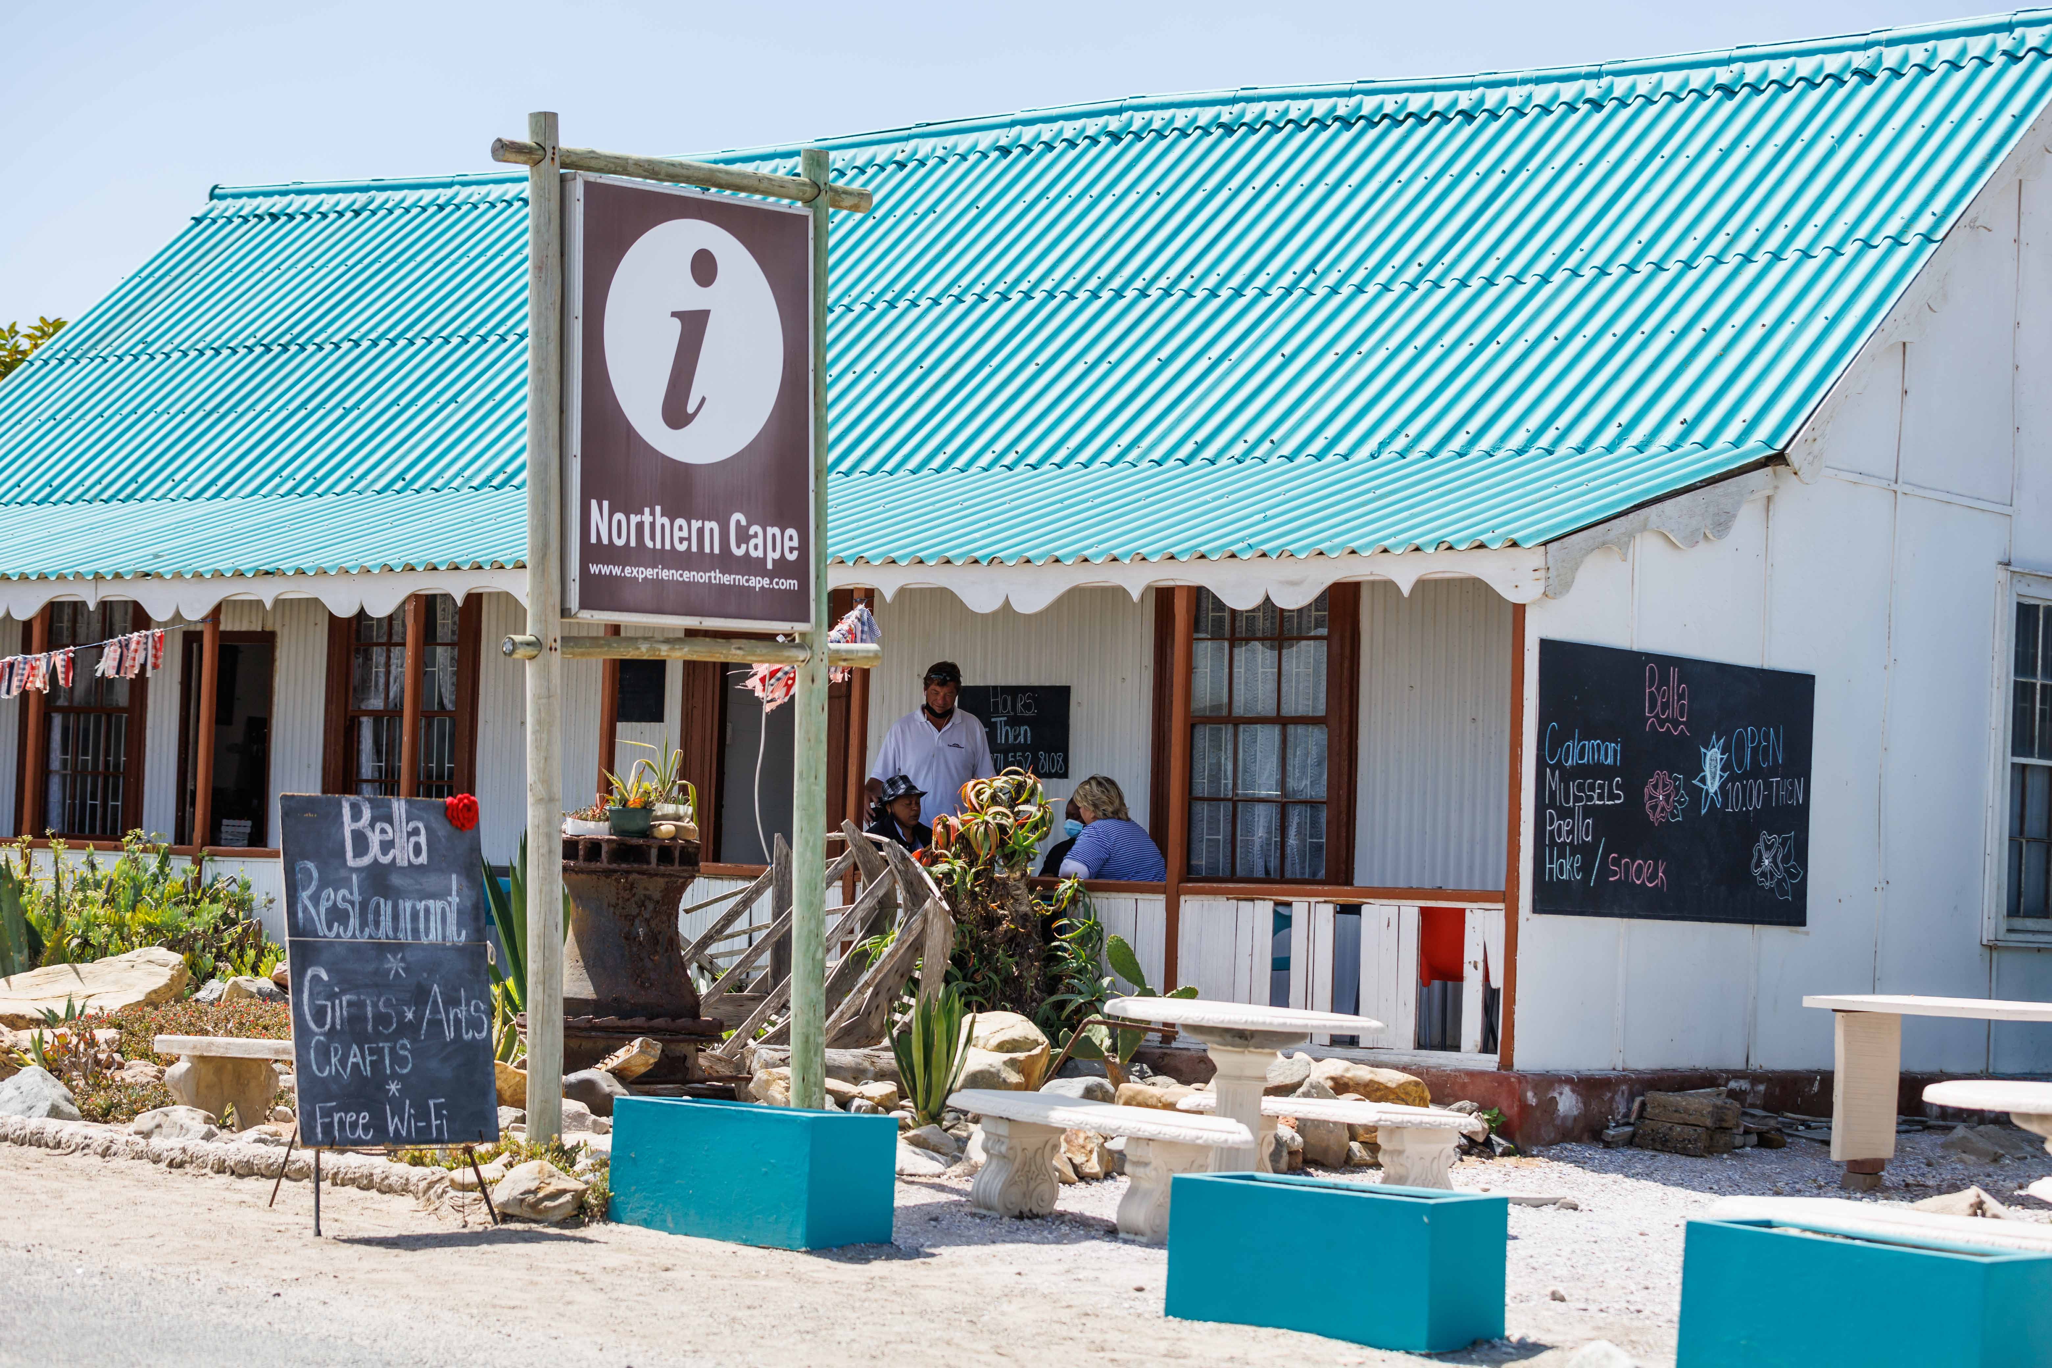
Cultural and Heritage Tourism
Highlighting Local Heritage
Healing Tourism and Storytelling
Community Engagement in Tourism Planning
Blue Spaces for wellbeing
Gendered Perceptions of the Ocean

Slide 3
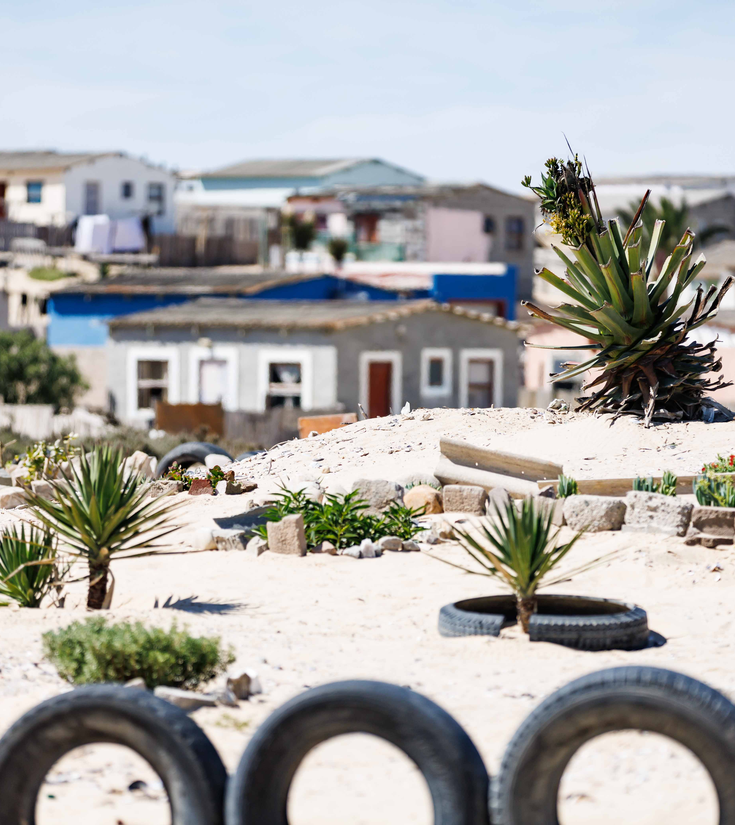
Sustainable Tourism and Conservation
Aligning Development with Sustainability:
  Eco-Tourism through MPAs
  Involving Communities in Conservation Efforts
Promoting Sustainable Practices:
  Adopt low-impact tourism models
  Integrate green practices

Slide 4
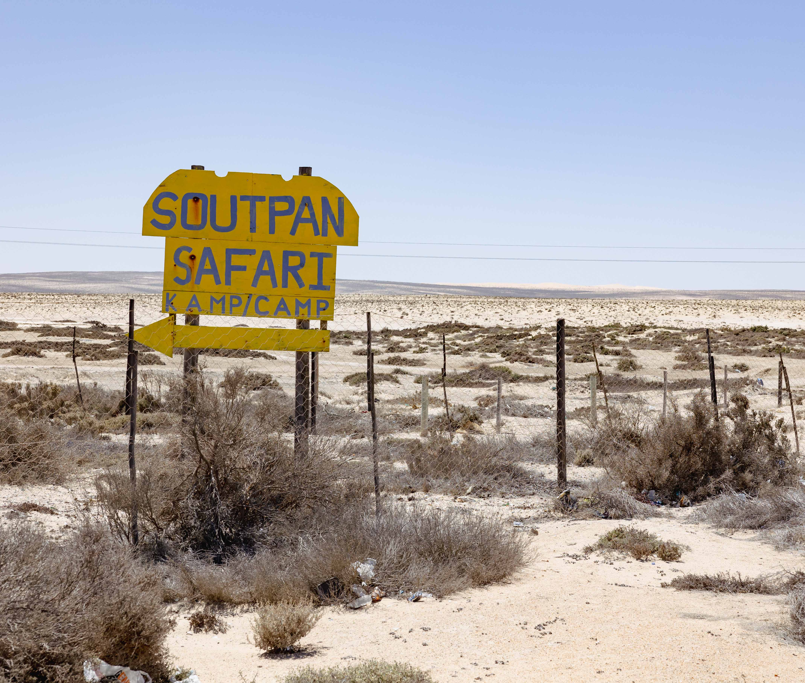
Investment Attraction and Infrastructure
Attracting Investment for Tourism Infrastructure:
  Public-Private Partnerships
  Leveraging International Markets
Implementing the 2017 Tourism Strategy:
  Tourism hubs at places like Port Nolloth and Alexander Bay
Participatory tourism development:
  Involving Communities in Tourism Planning-
    Co-management frameworks
    Job Creation and Training

Slide 5
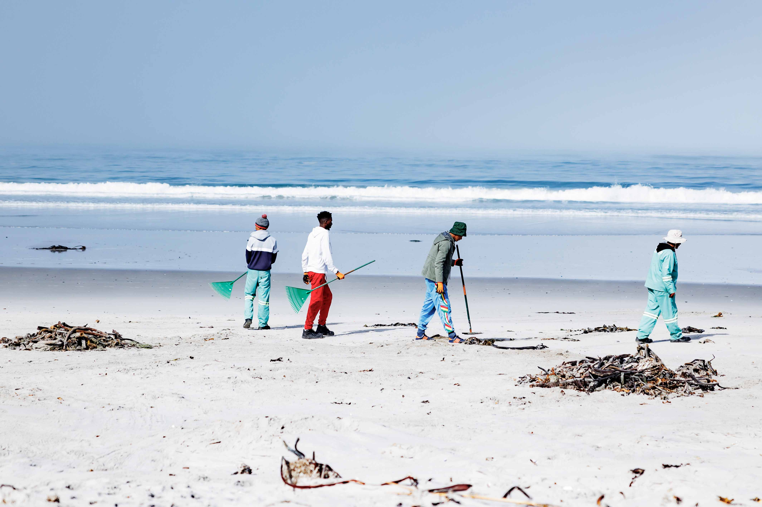
Quality Assurance and Visitor Satisfaction
Ensuring Quality and Safety in Tourism Experiences:
  Develop standards for hospitality, guided tours, and eco-tourism activities
  Regular monitoring and evaluation of tourism initiatives
Promoting Safety and Wellbeing:
  Establish safety protocols and visitor education to mitigate risks and provide peace of mind for tourists.
Marketing and Promotion:
  Developing a Marketing Strategy-
    Targeted marketing campaign
    Digital platforms
Storytelling as a Marketing Tool:
  Stories about fishing communities, Nama traditions, and healing rituals will resonate with audiences seeking authentic travel experiences.

Slide 6
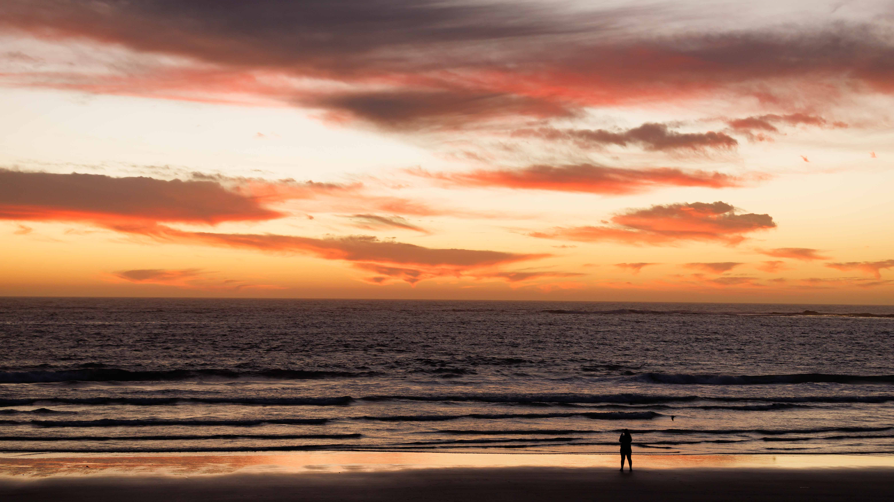
Conclusion
Sustainable tourism, community engagement, and wellbeing
Ensuring communities benefit and heritage is preserved for future generations.
Thank you!

