Slide 1

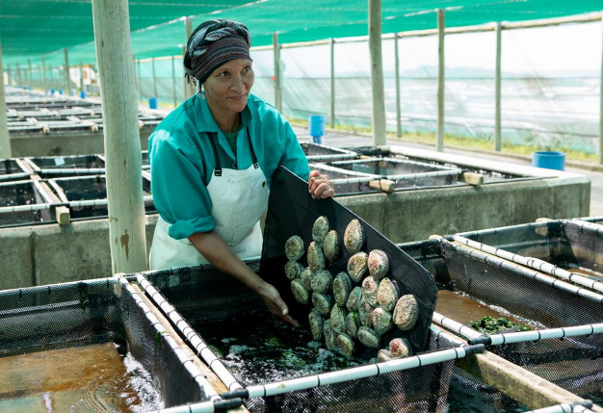
AQUACULTURE OVERVIEW
Department of Forestry, fisheries and the Environment (DFFE)
Branch: Fisheries Management
Mrs Michelle Pretorius
Aquaculture Advisor (DFFE)
Sustainable Ocean Economy Symposium
Port Nolloth
16 - 17 October 2024

Slide 2

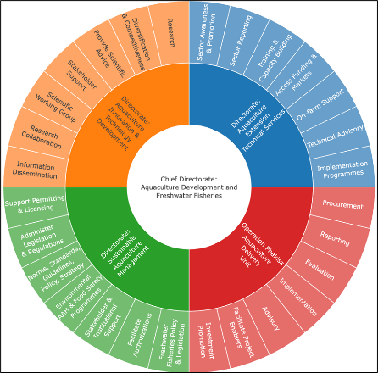
Content of Presentation
What is Aquaculture
Economic Growth
Regulatory Frameworks
Research and Innovation
Investment Attraction
Aquaculture support services

Slide 3
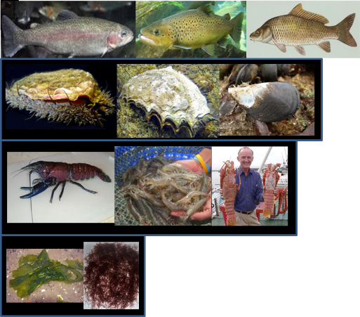
What is Aquaculture?
Aquaculture is the farming of aquatic organisms, including crocodiles, in a controlled aquatic environment including marine, brackish or freshwater. Involving enhanced production and individual or corporate ownership of the stock being farmed, this includes ranching and stock enhancement.
Fish
Molluscs
Crustaceans
Seaweeds

Slide 4
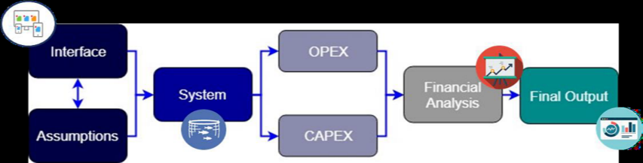
Economic growth
Generic Feasibility studies
Trout
Tilapia (Nile and Mozambique)
Mussels
Oysters
Abalone
Catfish
Marine Finfish (Kob and Salmon)
Freshwater and Marine Ornamental fish
Marron crayfish
Feasibilities studies help:
Determining the financial viability of a specific aquaculture project
To gain insight into the minimum viable design capacity for each species-system combination.
The model can:
Provide an estimate of the project cash flow
Consider different funding options and market prices
Calculate sensitivity and economies of scale
Determine financial ratios and the duration and return on investment
Highlight specific species requirements

Slide 5
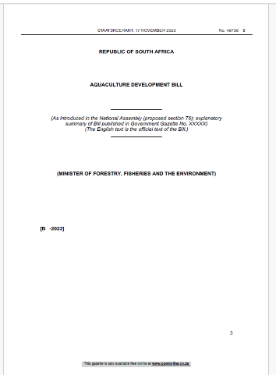
Regulatory Frameworks
Currently Marine Aquaculture is managed under the Marine Living Resources Act of 1998.
Freshwater Aquaculture is managed under numerous pieces of legislation and is fragmented.
To solve this issue the DFFE undertook a process to develop the Aquaculture Development Bill to be a holistic piece of legislation for the management of the aquaculture sector.

Slide 6
Aquaculture Development Bill
promote responsible aquaculture development;
promote the development and management of an aquaculture sector;
promote coordination of aquaculture research and development activities;
enable the aquaculture sector to be regulated more effectively;
promote transformation of the aquaculture sector;
promote investment into the aquaculture sector;
promote aquaculture as a farming activity; and
make provision for appropriate support services.
For more information contact Mr Tshepo Sebake TSebake@dffe.gov.za

Slide 7
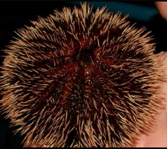
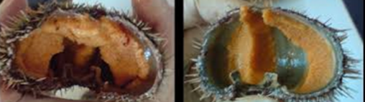
Research and Innovation
Targeted research and development:
Coordinated research in partnership with universities and other key institutions.
Diversification and competitiveness - new species; genetics; production systems; technology transfer and pilot/demonstration projects; nutrition and feed development; and markets and post-harvest technology
South Africa testing commercial production of local Sea Urchin, Tripneustes gratilla, which is showing promising results

Slide 8

Factors to consider for an Aquaculture project
What does the market require?
Where is the target market (local/international) ?
What is the size of the market?
Is there scope to enter the market?
What competition is there in the sector?
Price, what are my competitors' price; what is my identified market willing to pay?
What is my competitive advantage?

Slide 9

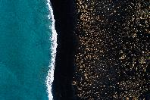

Factors to consider for an Aquaculture project
Do you have the required technical skills?
Do you have the business skills?
Have you identified a market and established a sale price?
Do I have access to appropriate land and water?
How robust is your planning? Sensitivity analysis
Have I allocated enough time?
How will I finance the proposal?

Slide 10





Site Selection Criteria
Is there access to land of sufficient size?
Is there water on site (quality/quantity)?
Is there access to electricity?
Is the site accessible?
How will the proposed project impact on the environment and how will the environment impact on the project?
What species should be considered?

Slide 11
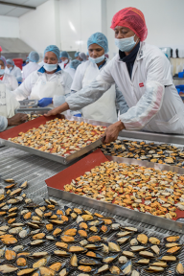
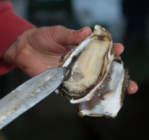
Aquaculture Support Services
Business Plan Review and Guidelines
Feasibility studies advisory
Site suitability assessments
Awareness on markets
Operation Phakisa catalyst project registration
Advisory services:
  Species suitability and identification
  Land identification
  Funding identification and facilitation
  Networking and partnership facilitation
for more information contact
MS Michelle Pretorius Mpretorius@dffe.gov.za
Mr Kishan Sankar KSankar@dffe.gov.za

Slide 12
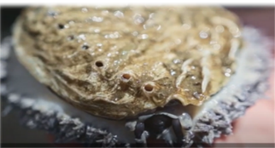

Awareness material & resources
Marketing videos available
Trout - https://youtu.be/kh_CsOt6LXU ​​
Tilapia - https://youtu.be/jlaHBjZjQ8Q ​​
Mussels - https://youtu.be/Q-2tDrWfRJI ​
Oysters – https://youtu.be/8V0u9t6V4p0
Abalone - https://youtu.be/wDlFgVnRnyY
Catfish - https://youtu.be/ocUBPctcovQ
Sector promotion videos available (research):
Gariep Aquaculture Technology Demonstration Centre: https://www.youtube.com/watch?v=koyehFSo3R0
Aquaculture Research and Development: https://www.youtube.com/watch?v=AOi7iZGlsQs
Aquaculture Development Zone (ADZs): https://bit.ly/3WXwE7U
Publication available:
The Aquaculture Operation Phakisa workstream Year Eight Review publication was completed and available: https://www.dffe.gov.za/FisheriesManagementPublications

Slide 13
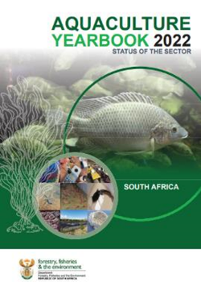
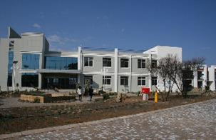
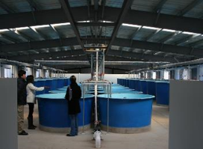
Material & resources
Aquaculture Annual Yearbooks
Kelp value chain analysis, market assessment and roadmap for development of kelp farming in South Africa, 2023
https://www.dffe.gov.za/FisheriesManagementResearchreportsandresearch%20projects

Slide 14

THANK YOU!
Ms Michelle Pretorius
Operation Phakisa Delivery Unit
Chief Directorate Aquaculture Development & Freshwater Fisheries
Branch; Fisheries Management
Department of Environment, Forestry and Fisheries
Tel: 021 402 3413 | Mobile: 066 471 1318
Website: http://www.dffe.gov.za
Address: The Environment House, 473 Steve Biko Road, Arcadia, Pretoria, 0083

