Slide 1
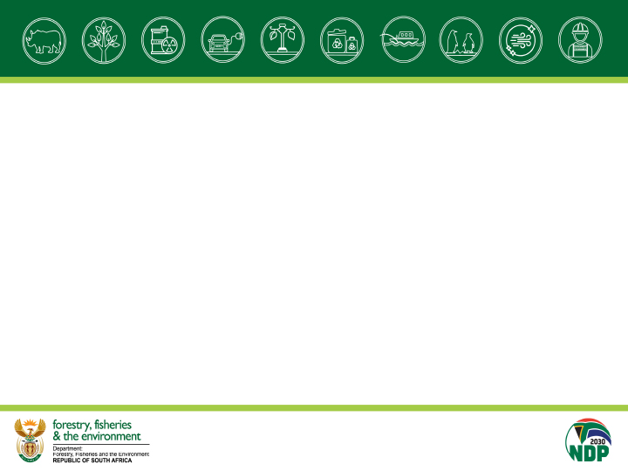
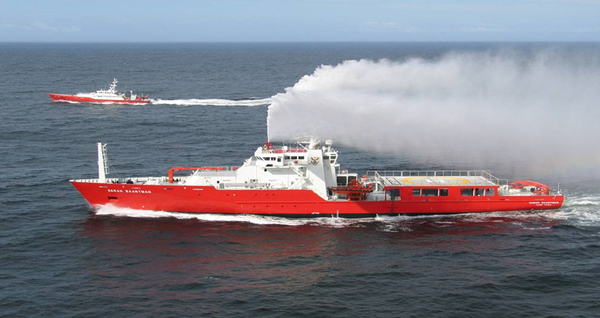
DEPARTMENT OF FORESTRY, FISHERIES and the ENVIRONMENT
BRANCH FISHERIES MANAGEMENT
NORTHREN CAPE - PHAKISA OPERATION
SAPS – PORT NOLLOTH
20 JUNE 2024

Slide 2
FISHERIES MANAGEMENT
CD: Aquaculture
& Economic
Development
D:
Aquaculture
Technical Services
D: Sustainable
Aquaculture Management
D: Small Harbours
CD: Monitoring, Control &
Surveillance
D: Compliance
D: Fisheries
Protection Vessels
D: Monitoring & Surveillance
CD: Marine Resources
Management
D: Offshore &
High Seas Fisheries
D: Small Scale Fisheries
D: Inshore Fisheries
Management
CD: Fisheries Research
& Development
D: Research Support
D: Aquaculture Research
D: Ecosystem
Research
D: Resources Research

Slide 3
THE LEGISLATION
The MARINE LIVING RESOURCES ACT (MLRA) 18 (1998) provides for the conservation of the marine ecosystem, the long-term sustainable utilization of marine living resources and the orderly access to exploitation, utilisation and protection of certain marine living resources in a fair and equitable manner to the benefit of all the citizens of South Africa; and to provide for matters therewith.
Section 13 Permits
Section 18 Fishing Rights and Exemptions
Section 51 Powers of FCOs
Regulations R1111 of 2 September 1998
Permit conditions

Slide 4
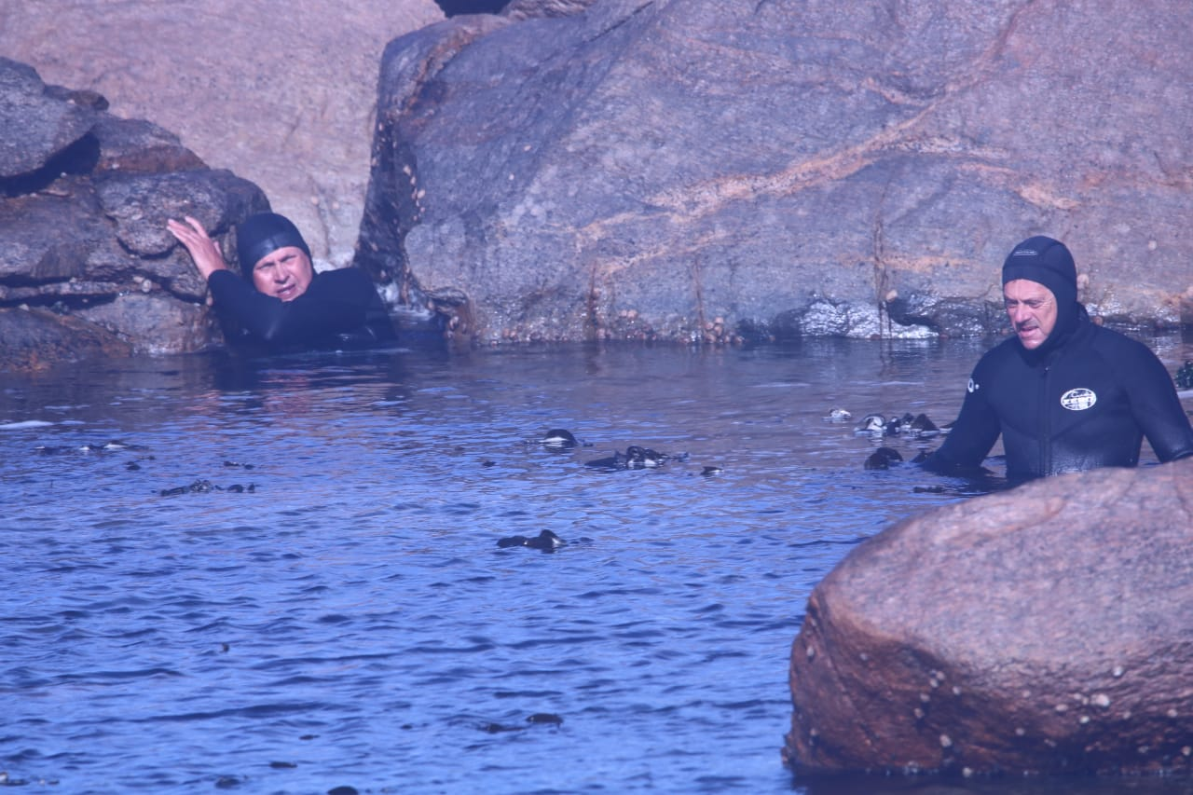
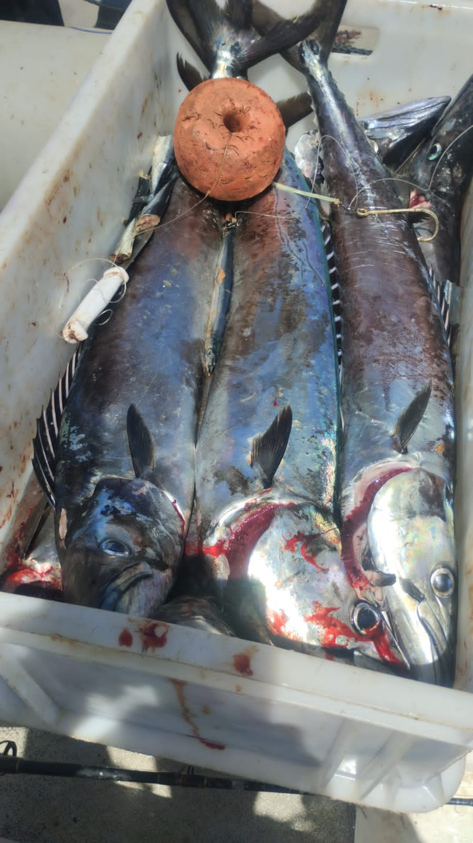
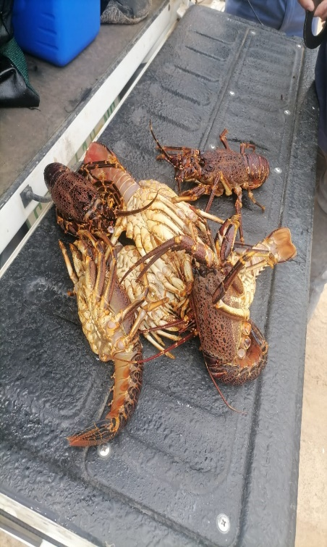
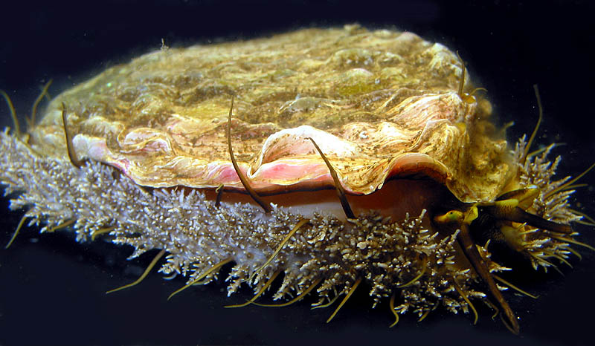
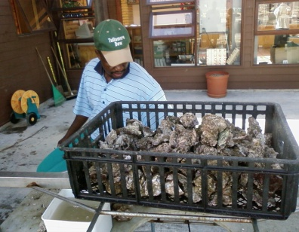
MLRA cont’d
Section 13 (1) MLRA
No person shall exercise any right granted in terms of section 18 or perform any other activity in terms of this Act unless a permit has been issued by the Minister to such person to exercise that right or perform that activity.
Section 18 (1) MLRA
- No person shall undertake commercial fishing or subsistence fishing, engage in mariculture or operate a fish processing establishment unless a right to undertake or engage in such activity or to operate such an establishment has been granted to such a person by the Minister

Slide 5
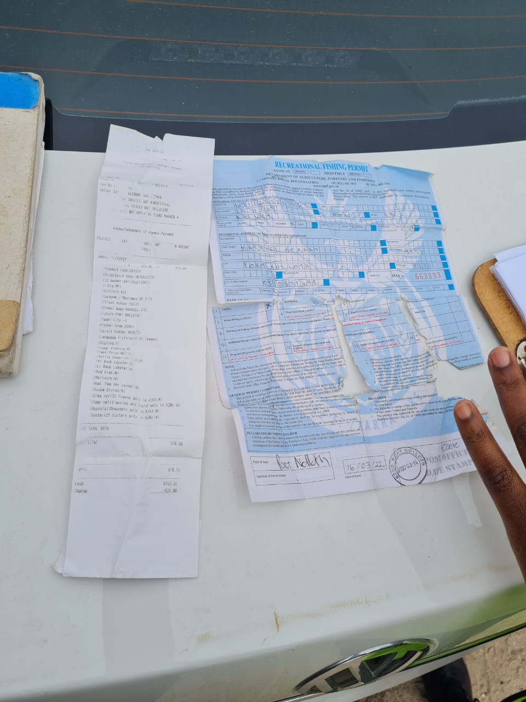
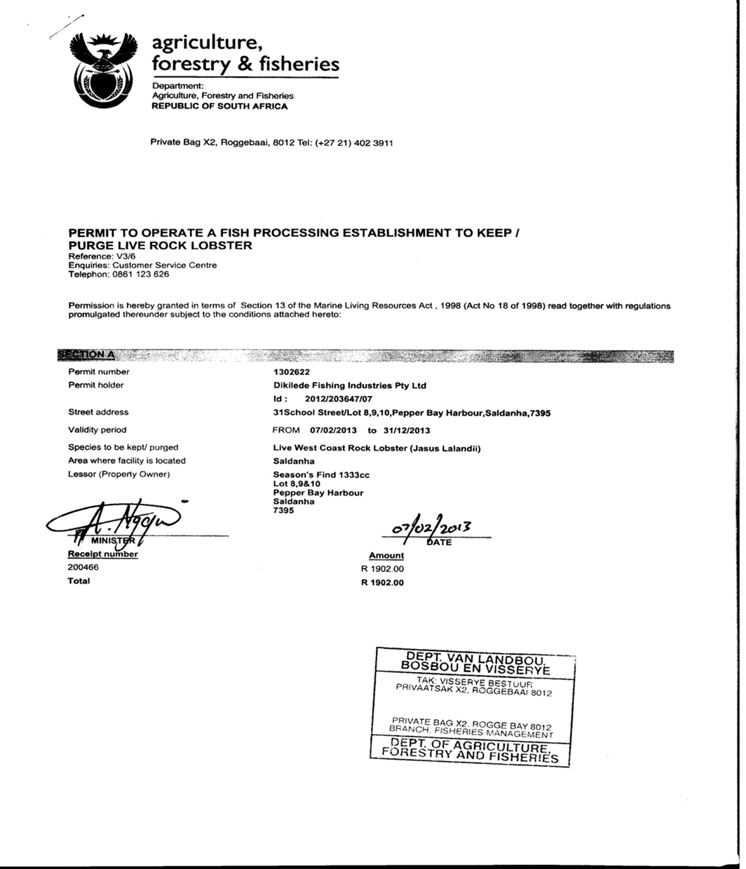
MLRA cont’d

Slide 6
4 Fishery Control Officers
5 Honorary Marine Conservation Officers
5 Catch Data Monitors
Coastal Area to be covered is from Alexanderbay to Groenrivier, Land Borders (Exports/Imports of fish) .
Vessel Inspections at landing sites/slipways
FPE’s, Restaurants, Fishshops, and Shops
Monitoring Aquaculture Ranching Farms
Land based coastal patrols and inspections
Commercial, Recreational and Small-Scale Fishers
Sea Fishery Regulations: Shells or Shellgrit
NEM:ICMA 4X4 Regulation (ORV)
KZN/Robben Island Deployments
Anti-poaching Operations
VCPs and Roadblocks
COMPLIANCE
Port Nolloth

Slide 7
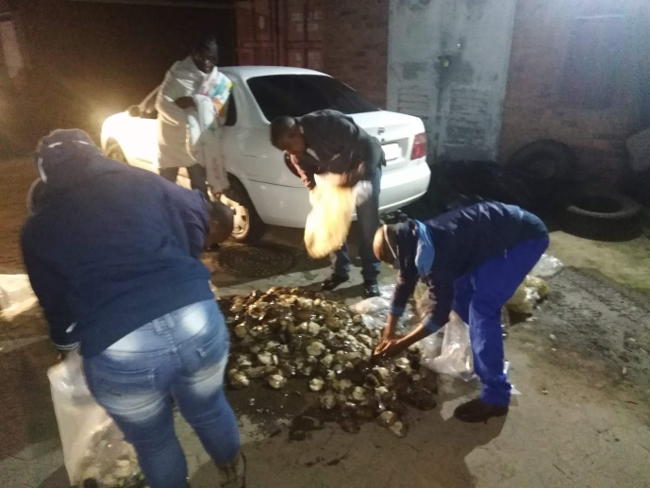
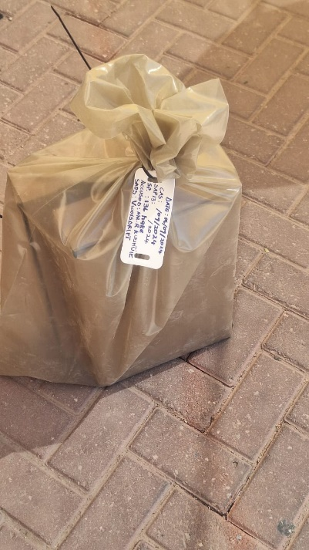
SAP13- EXHIBITS
All exhibits confiscated are booked in at SAPS 13 and booked out from SAPS 13 for further storage to DFFE- FISHERIES storage facilities.
Powers to release items confiscated under the Act (MLRA18/1998) lies with the Court or Minister of DFFE not with SAPS.
Section 64- treatment of things detained or seized.
Section 68- Forfeiture orders by court.
Section 69 – Disposal of forfeited and discharge of forfeited orders
COMPLIANCE
Port Nolloth

Slide 8
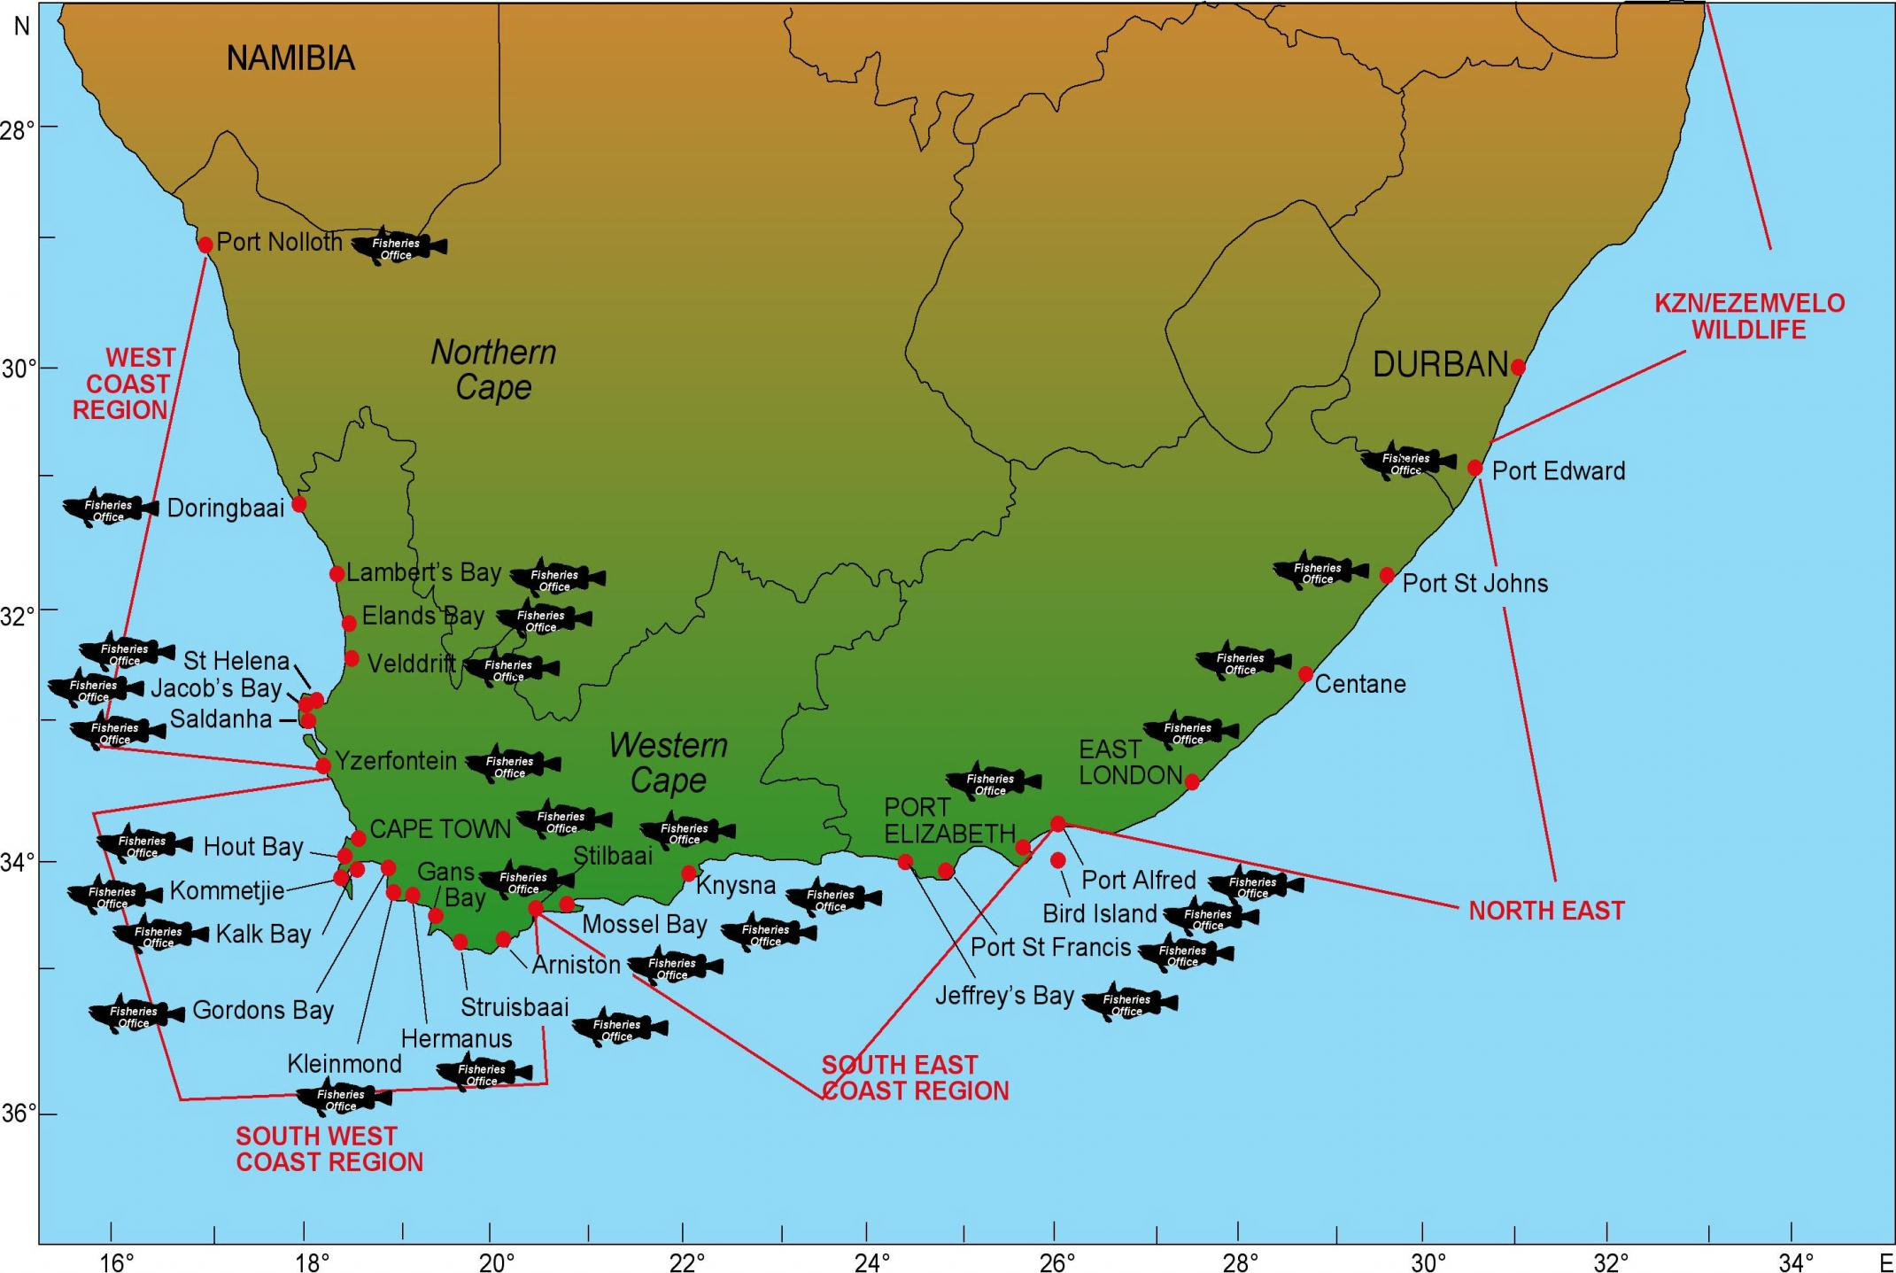
KZN

Slide 9
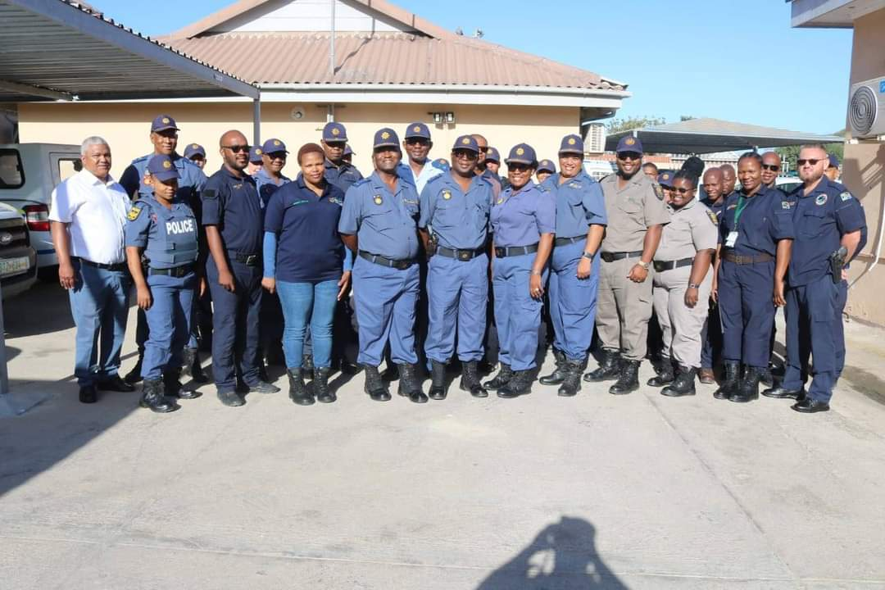
PARTNERS/STAKEHOLDERS/COLLABORATIONS
SAPS
NPA
SANParks
SANDF
NGOs
SARS
SAMSA
COASTAL COMMUNITIES

Slide 10
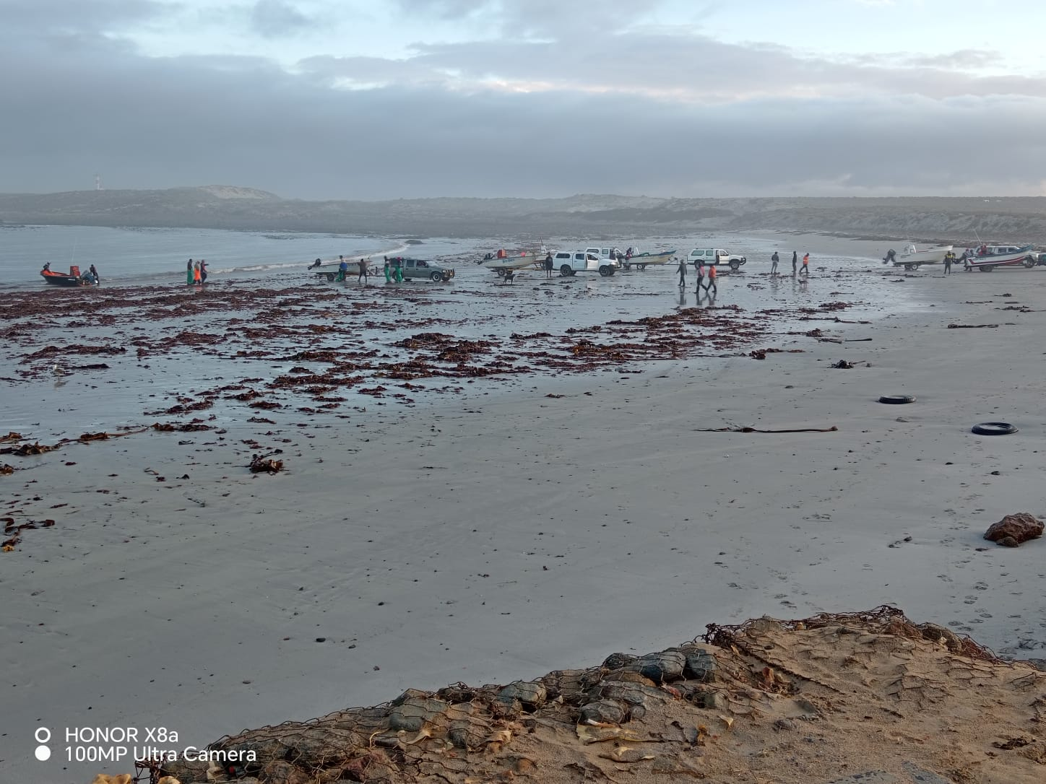
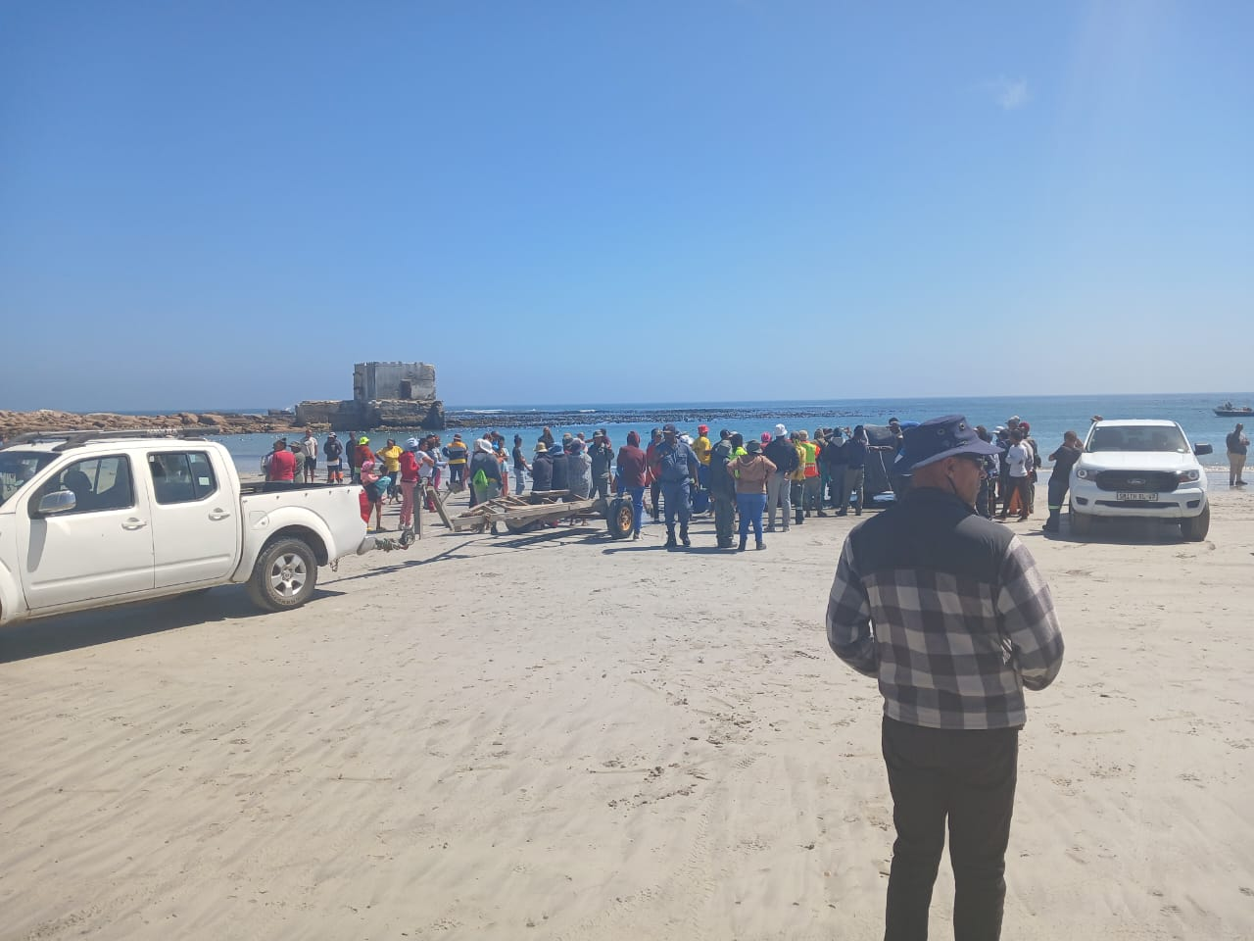
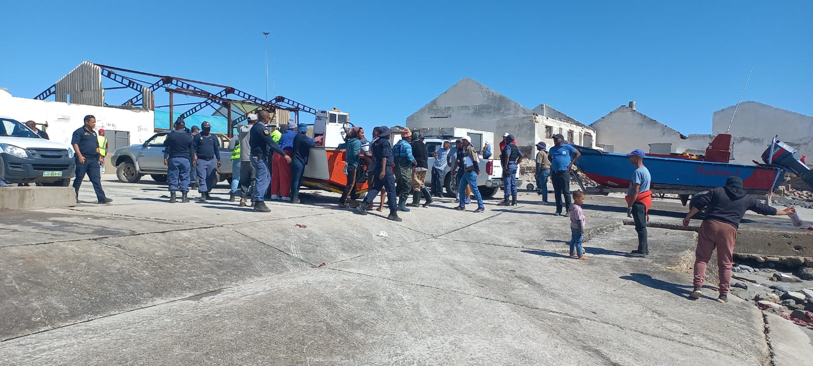
VESSELS INPECTIONS ON LANDING SITES: Linefish

Slide 11
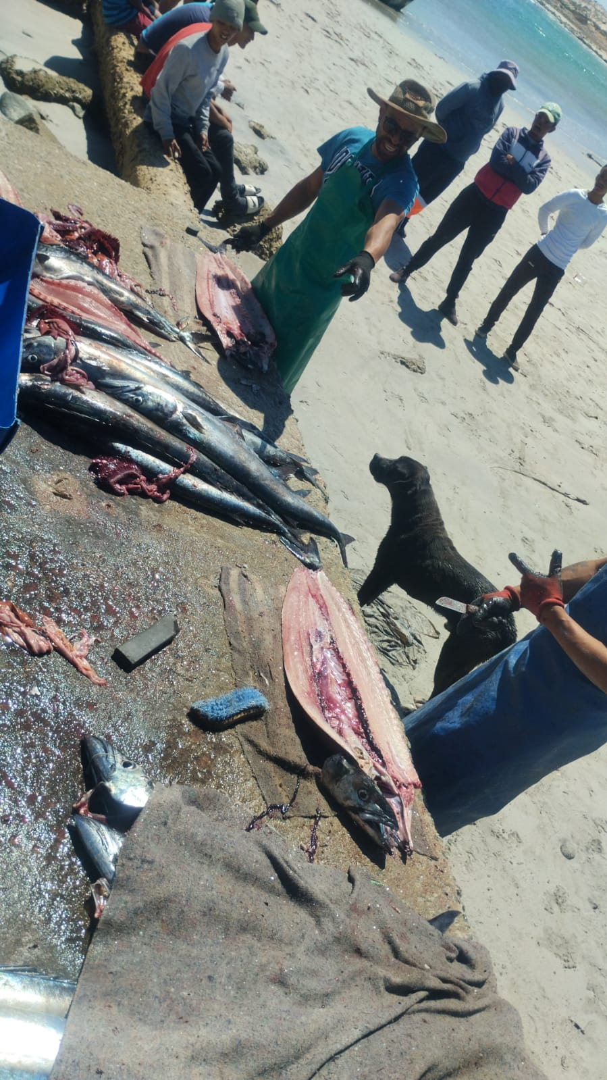
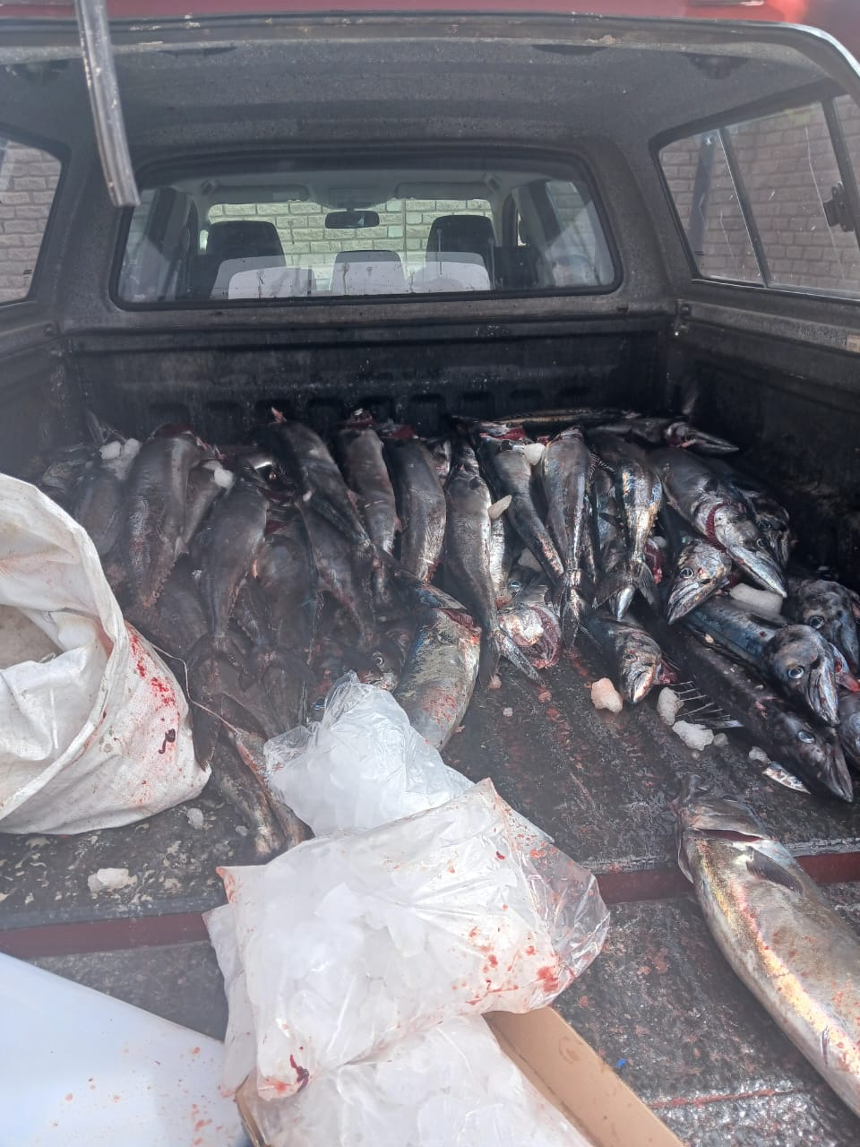
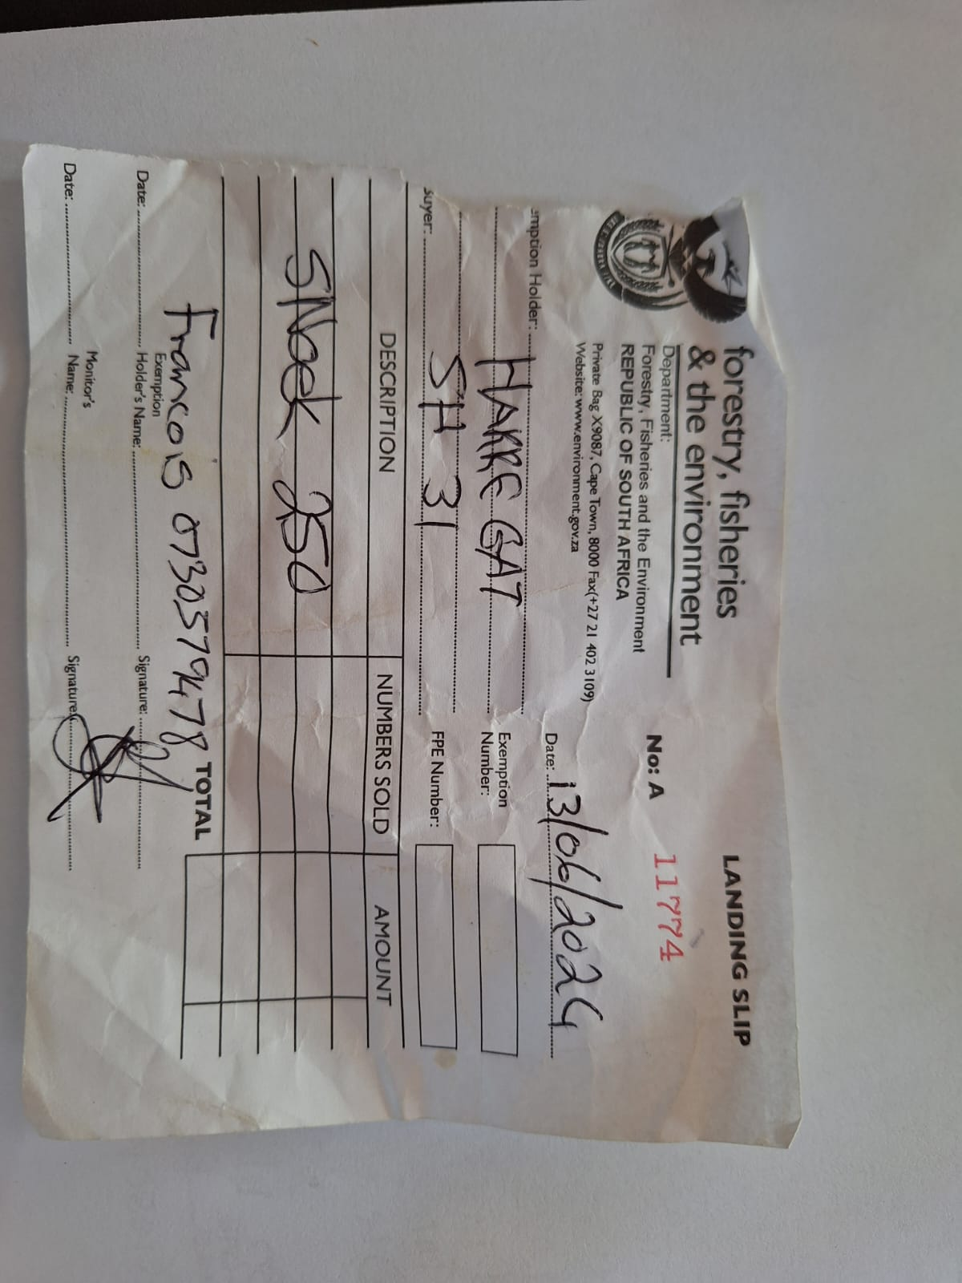
VESSELS INPECTIONS ON LANDING SITES: Linefish

Slide 12
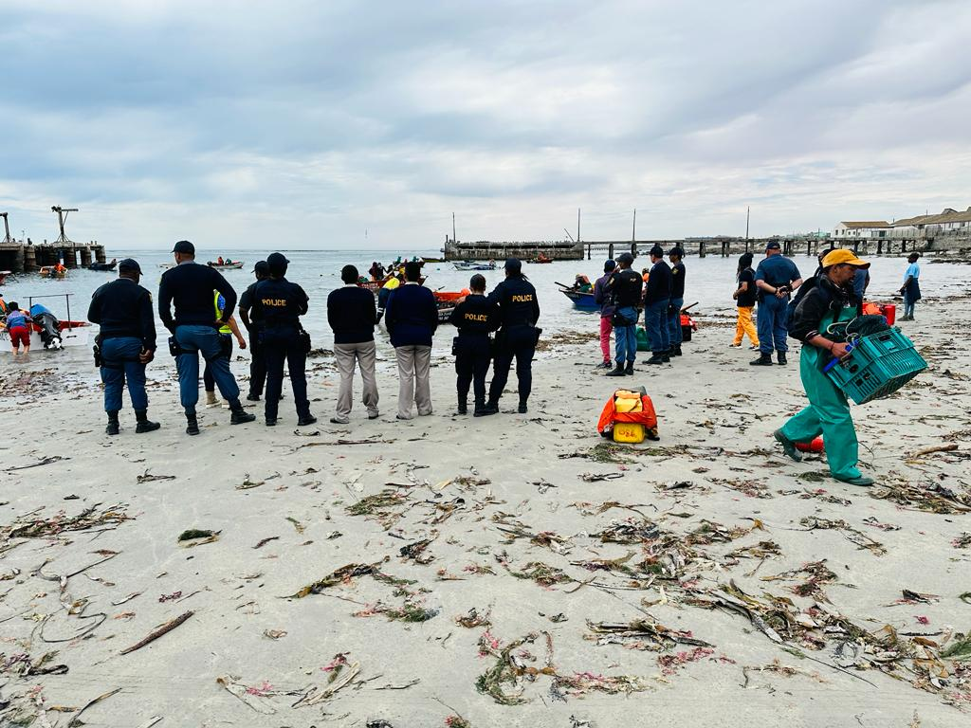
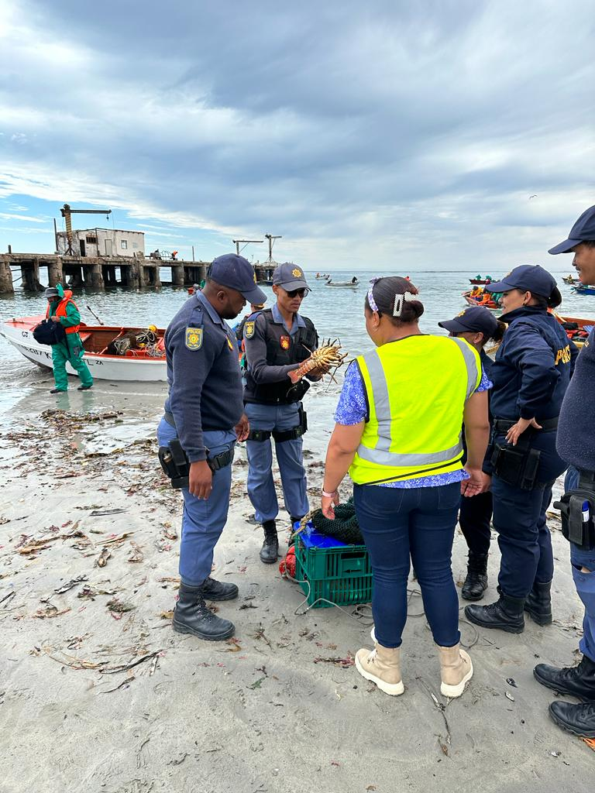
VESSELS INPECTIONS ON LANDING SITES: WCRL

Slide 13
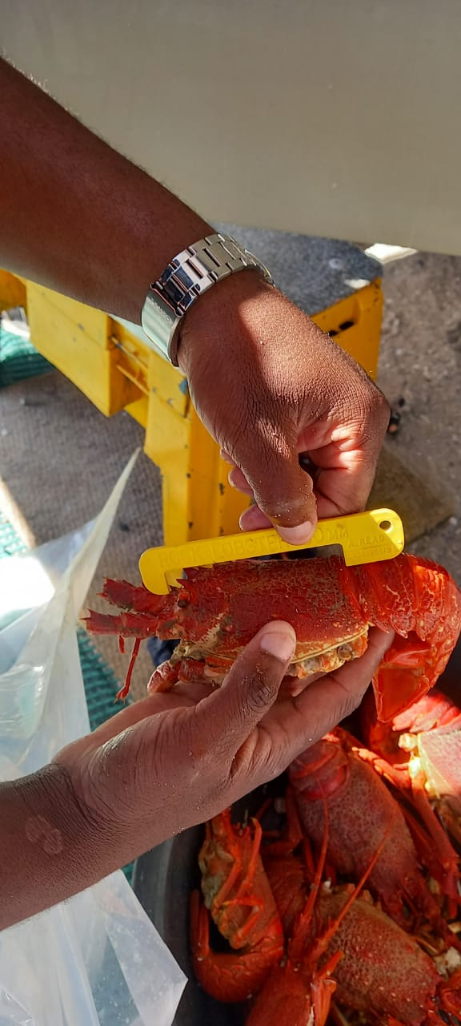
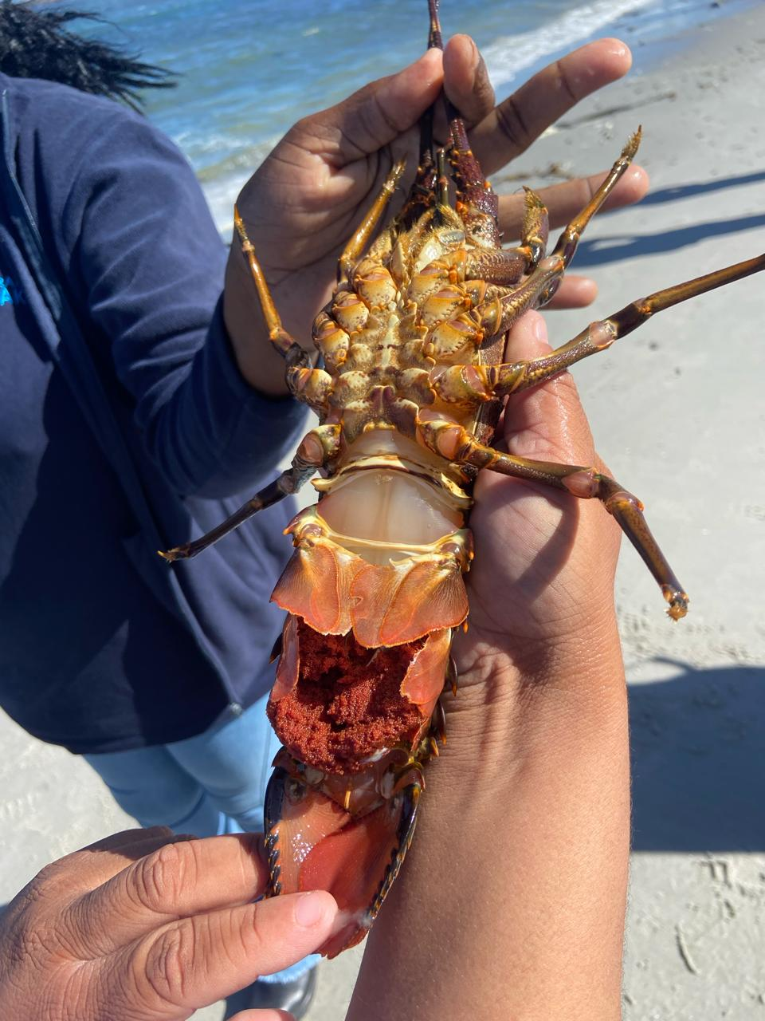
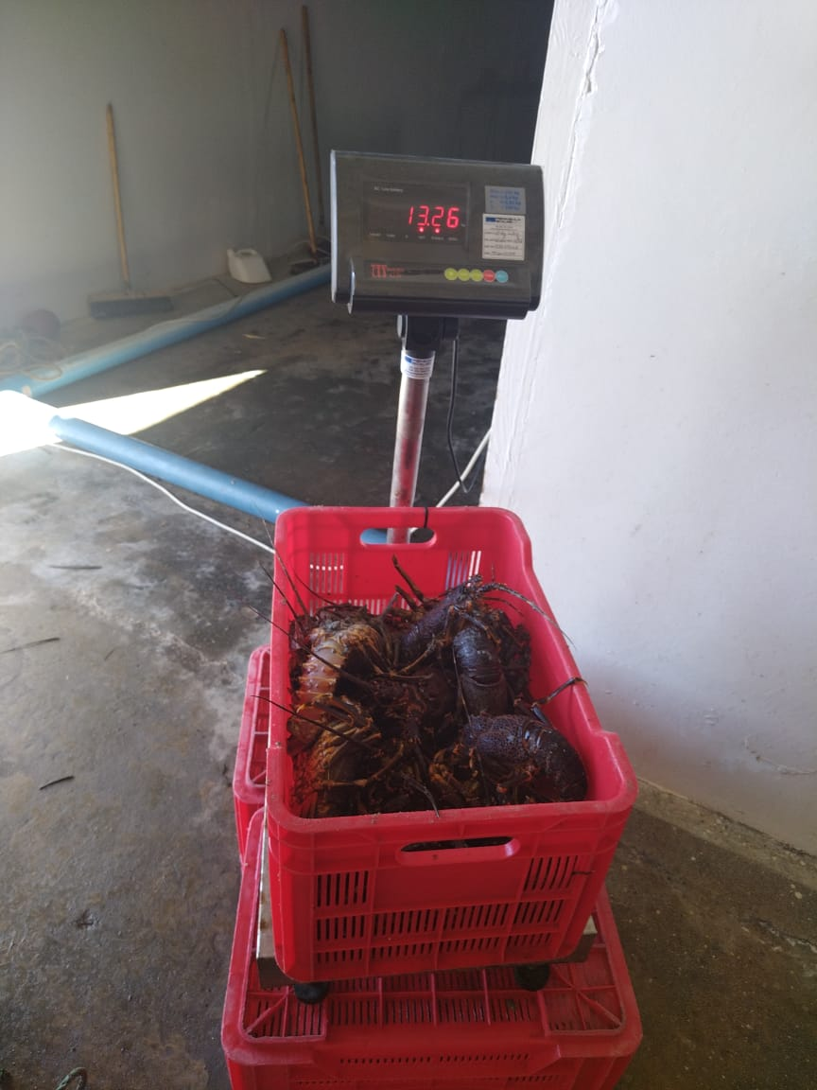
VESSELS INPECTIONS ON LANDING SITES: WCRL

Slide 14
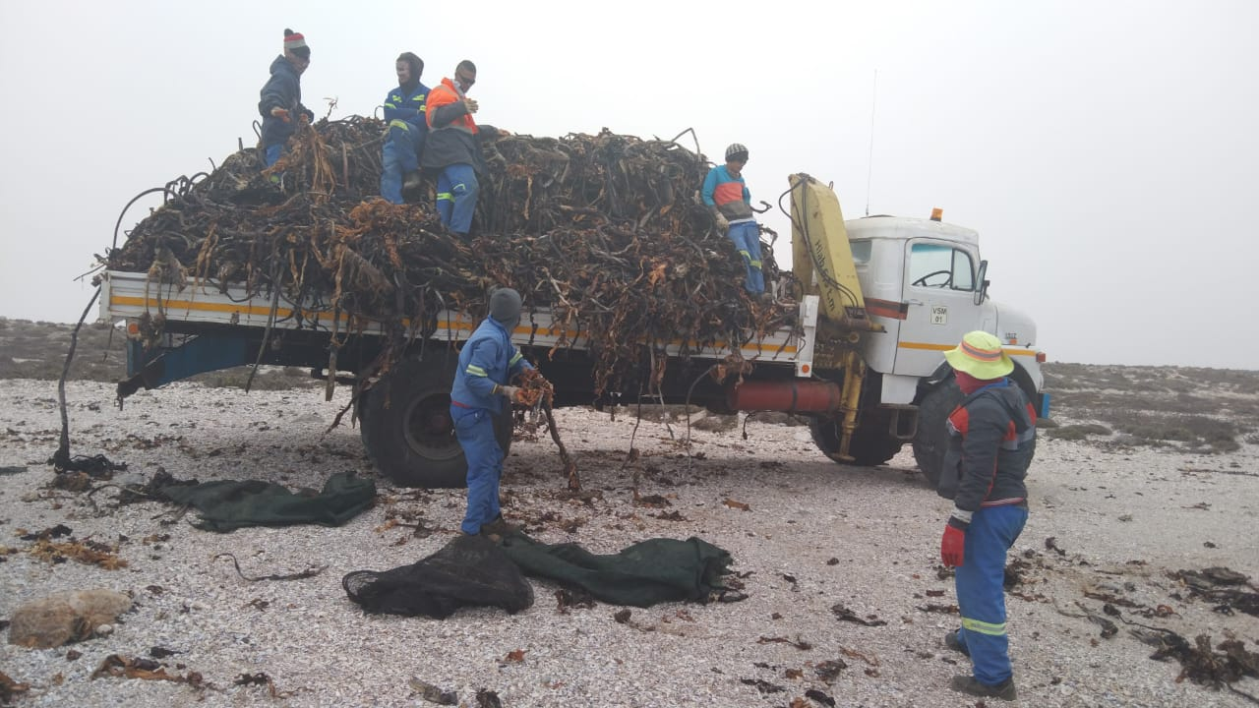
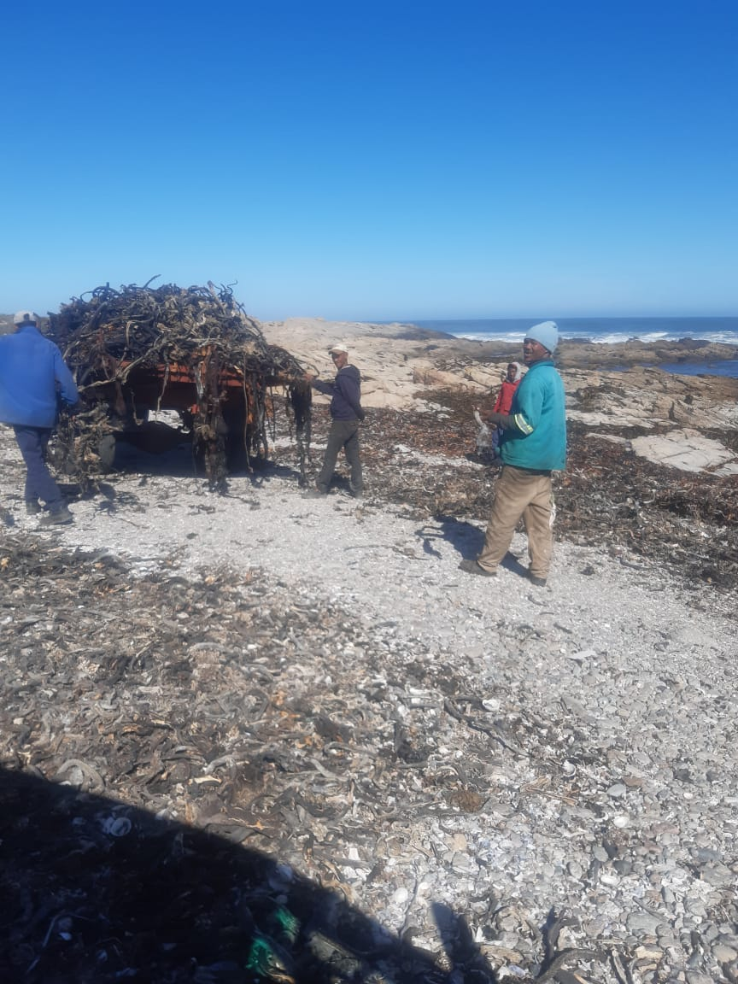
Fish Processing Establishment (FPEs): Seaweed

Slide 15
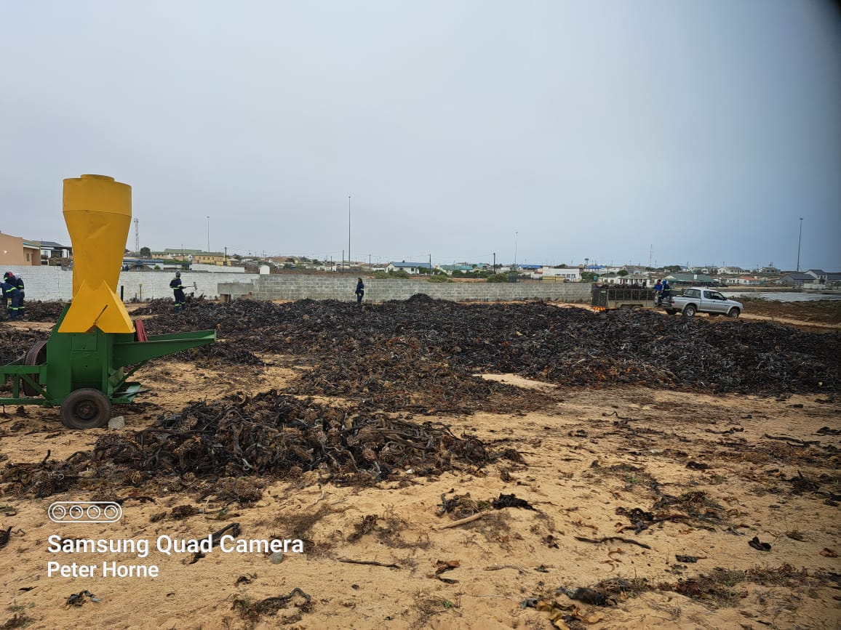
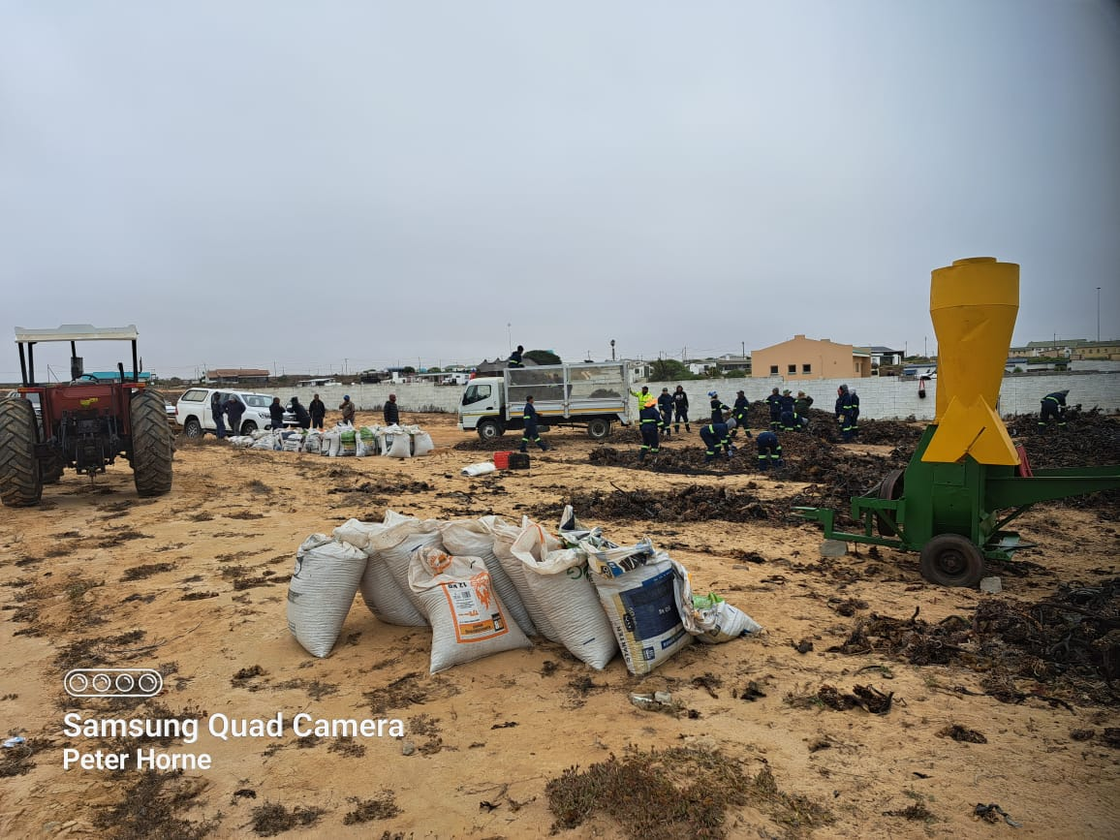
Fish Processing Establishment (FPEs): Seaweed

Slide 16
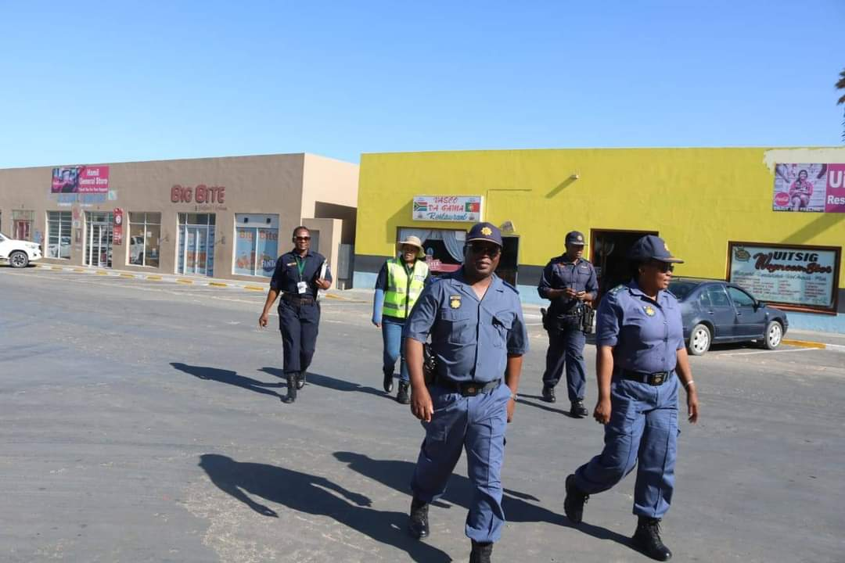
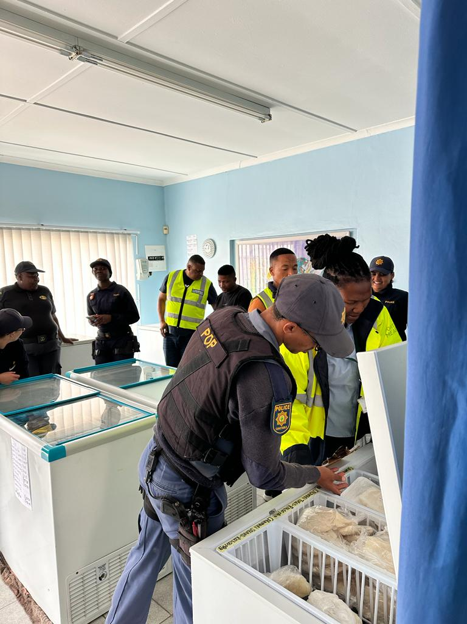
Shops and Restaurants Inspections

Slide 17
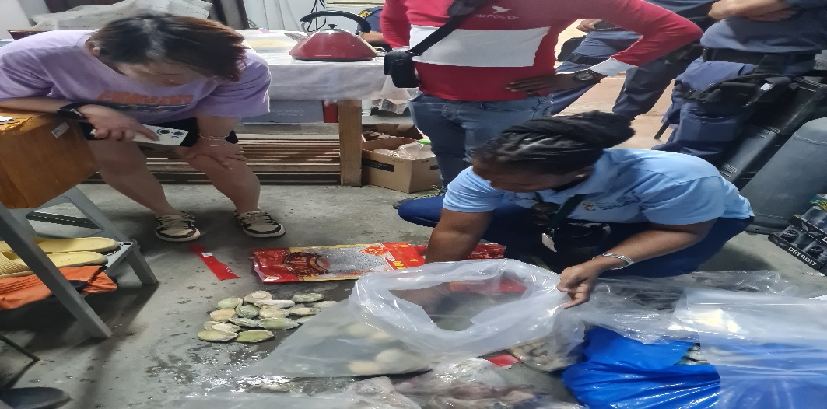
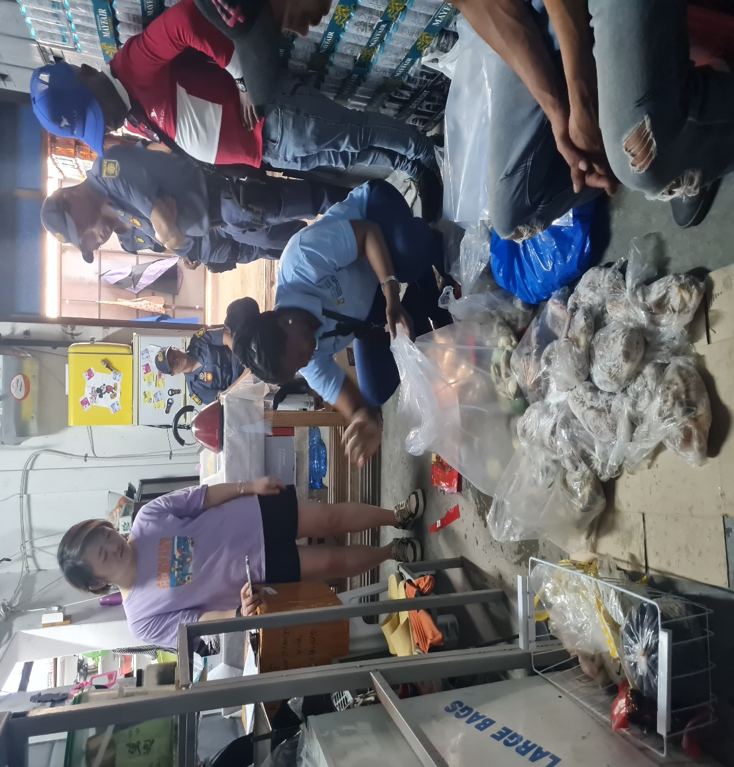
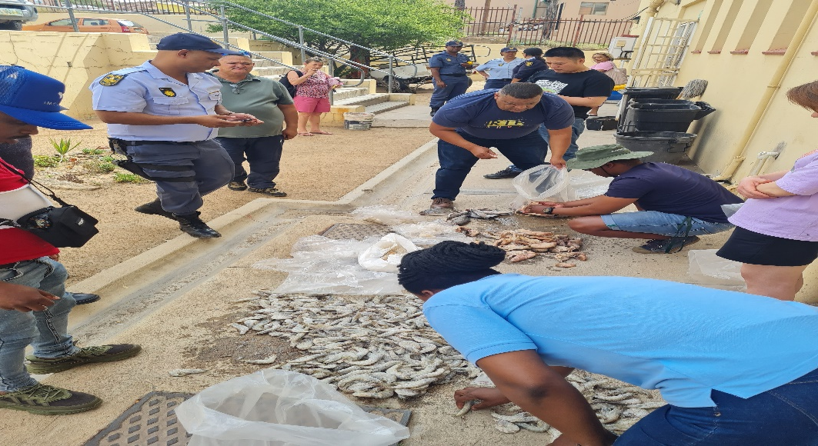
Shops and Restaurants Inspections

Slide 18
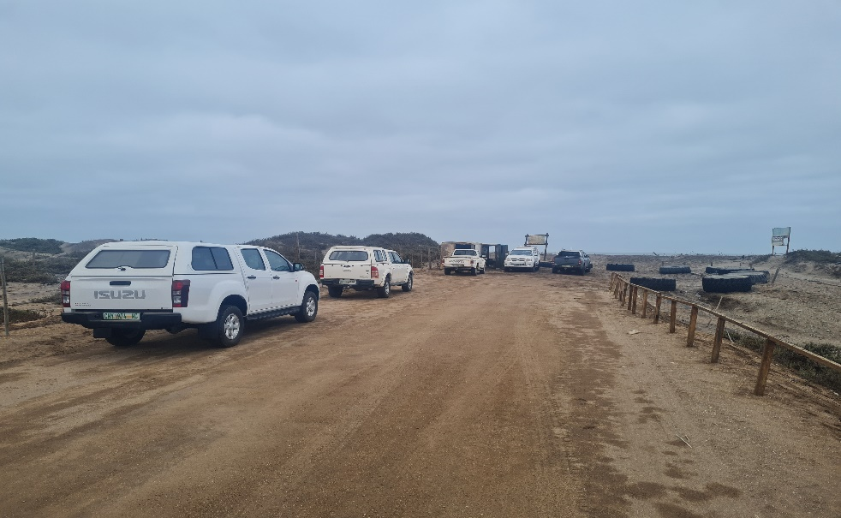
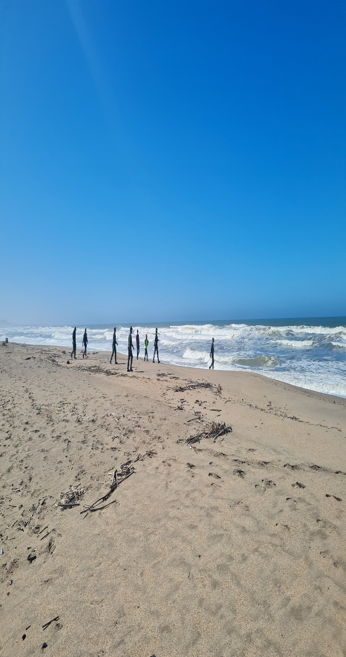
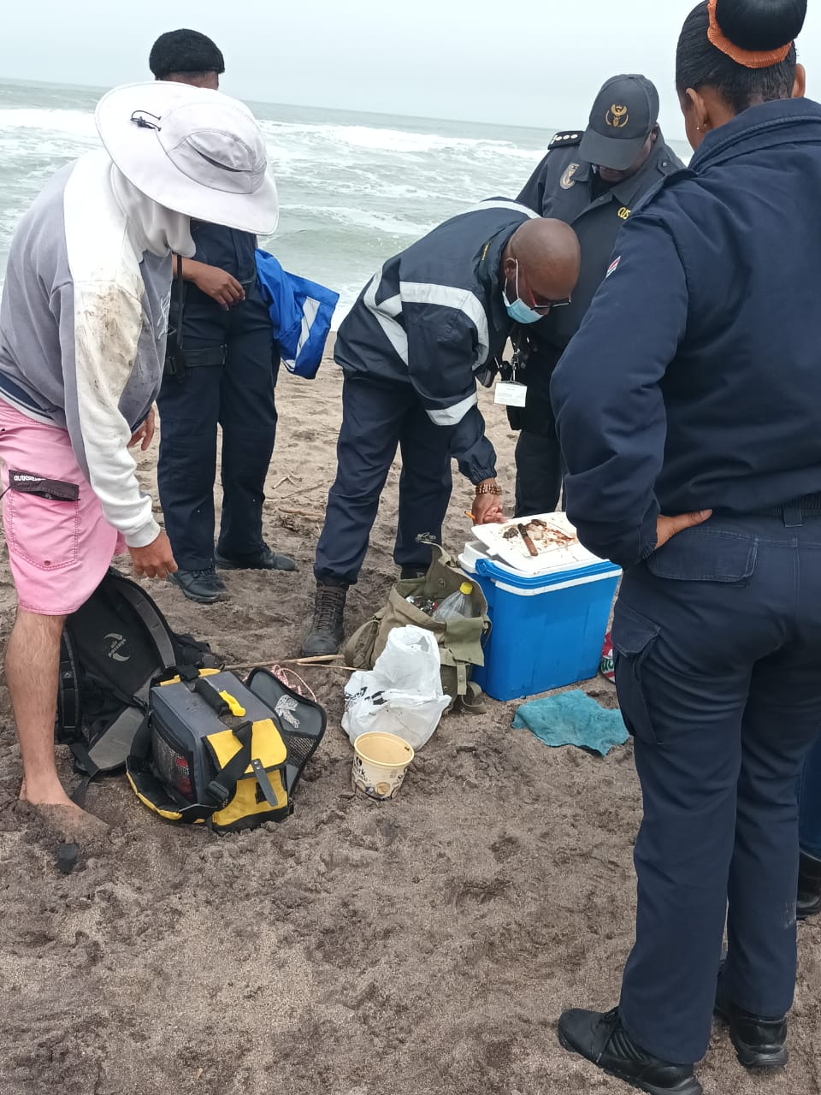
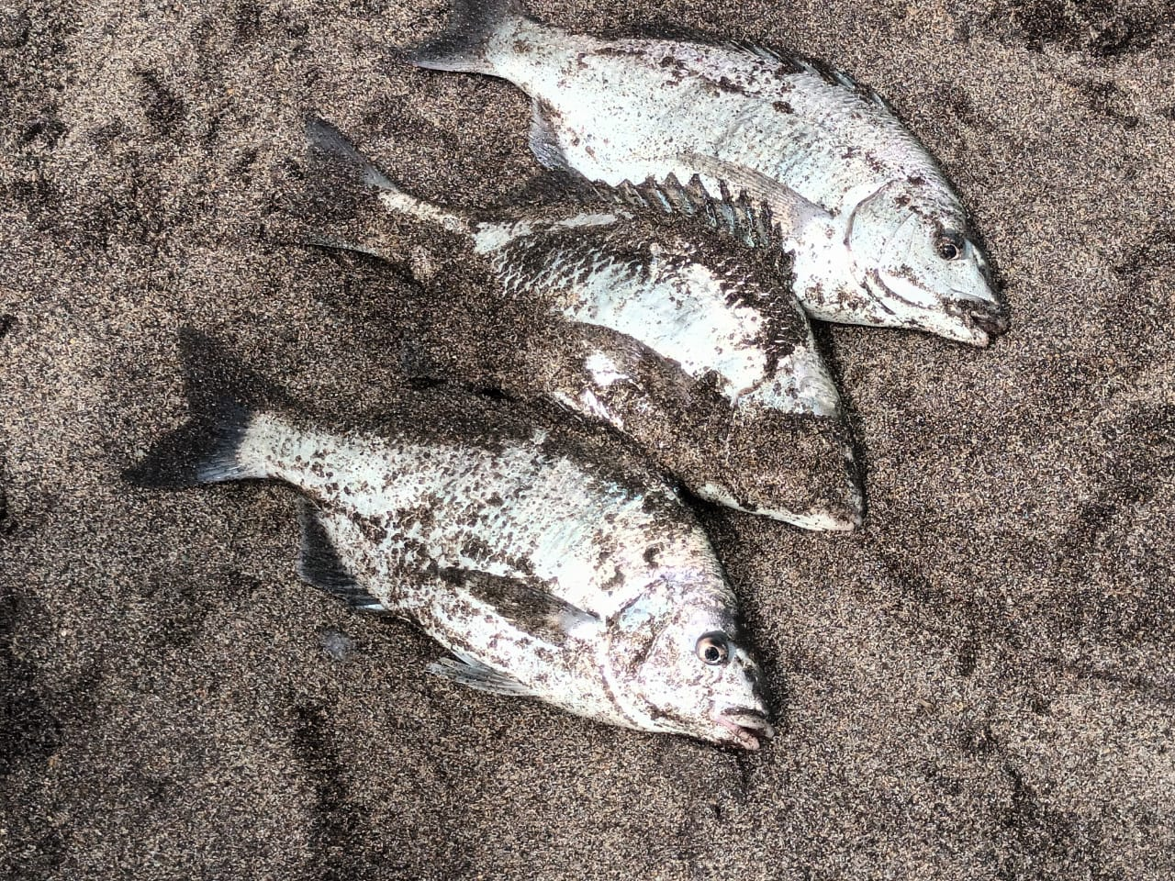
Coastal Patrols:- Alexanderbaai

Slide 19
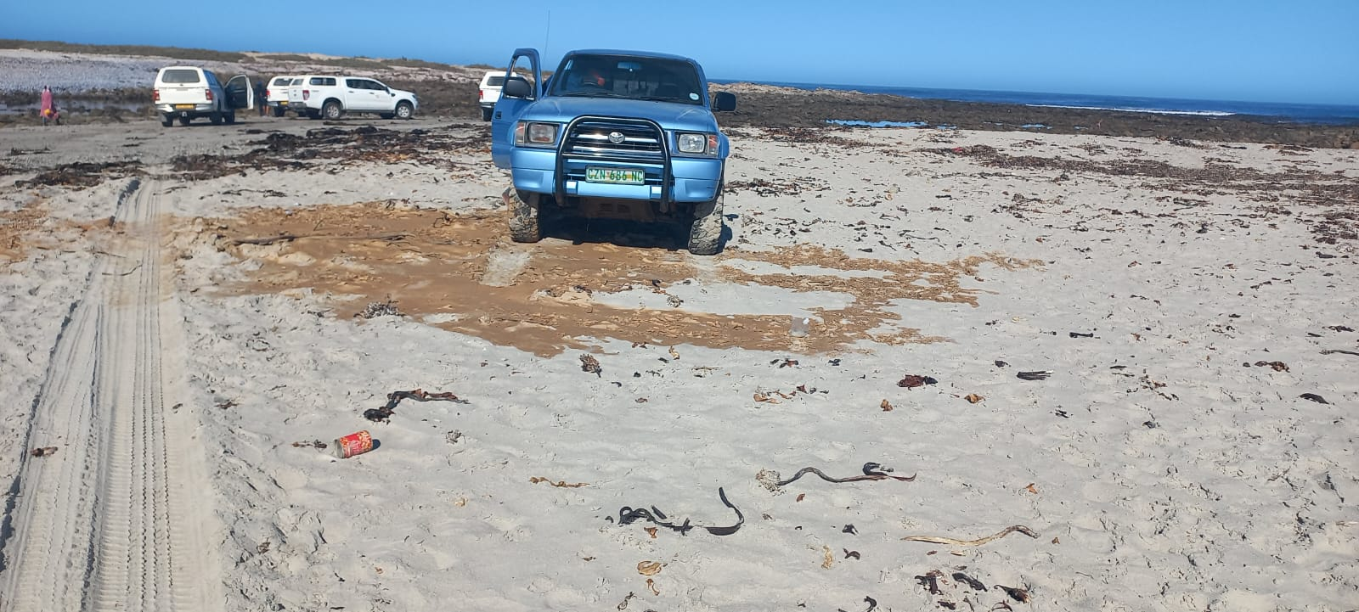
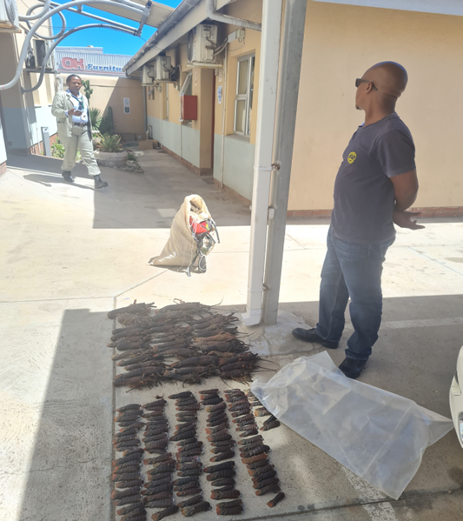
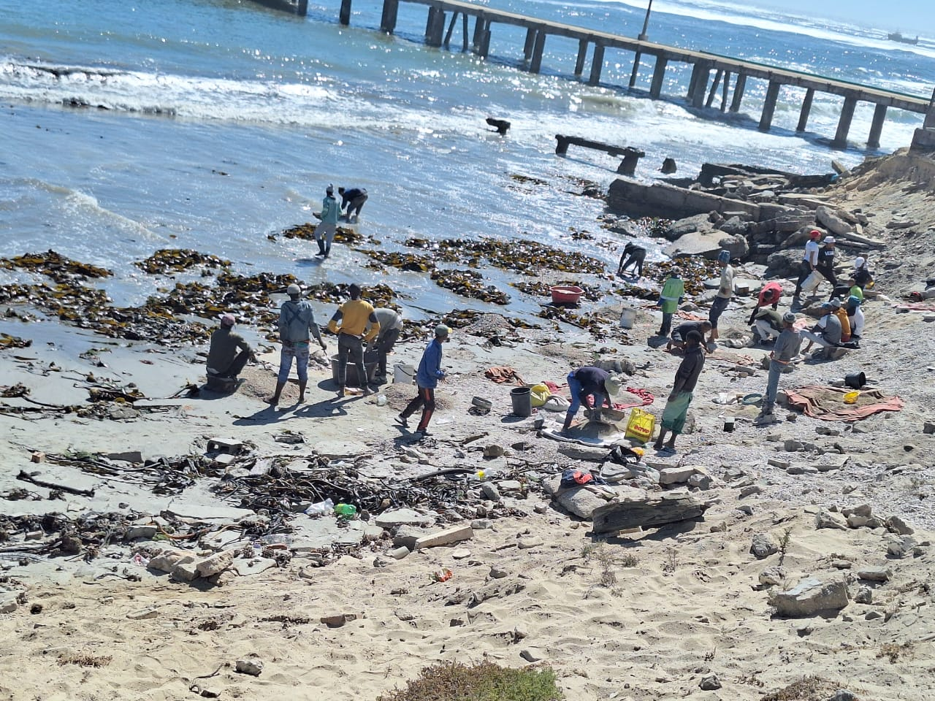
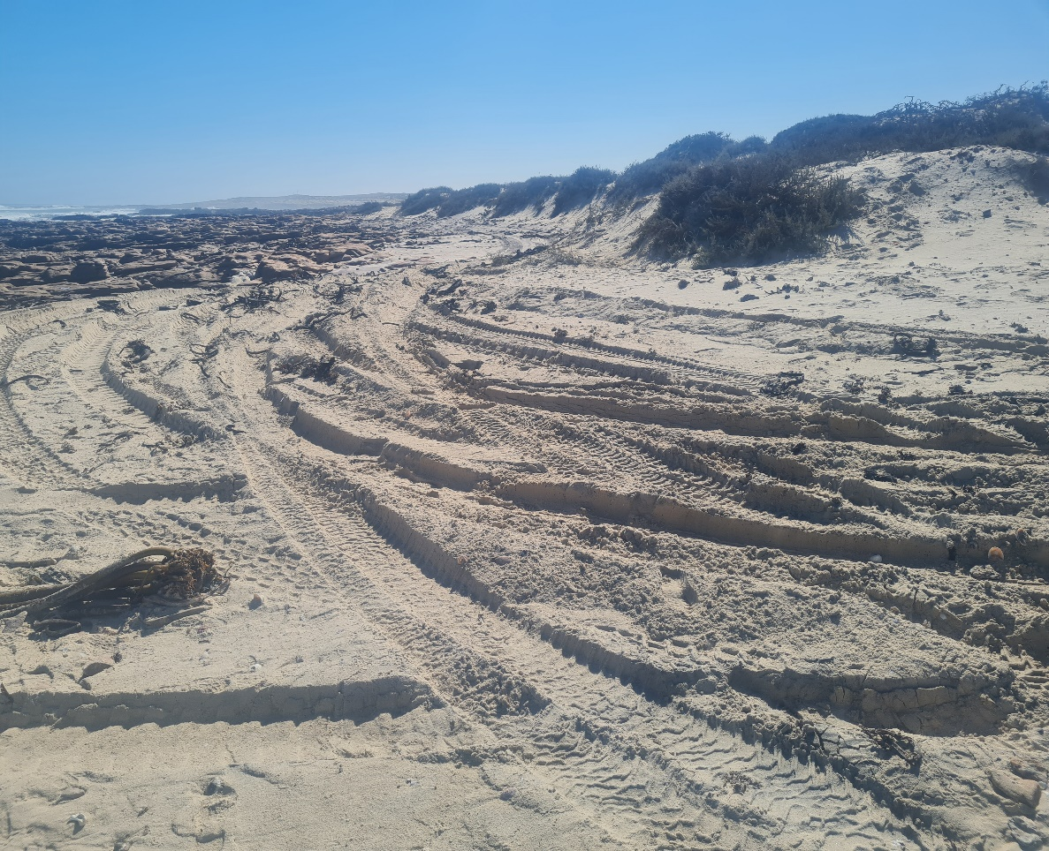
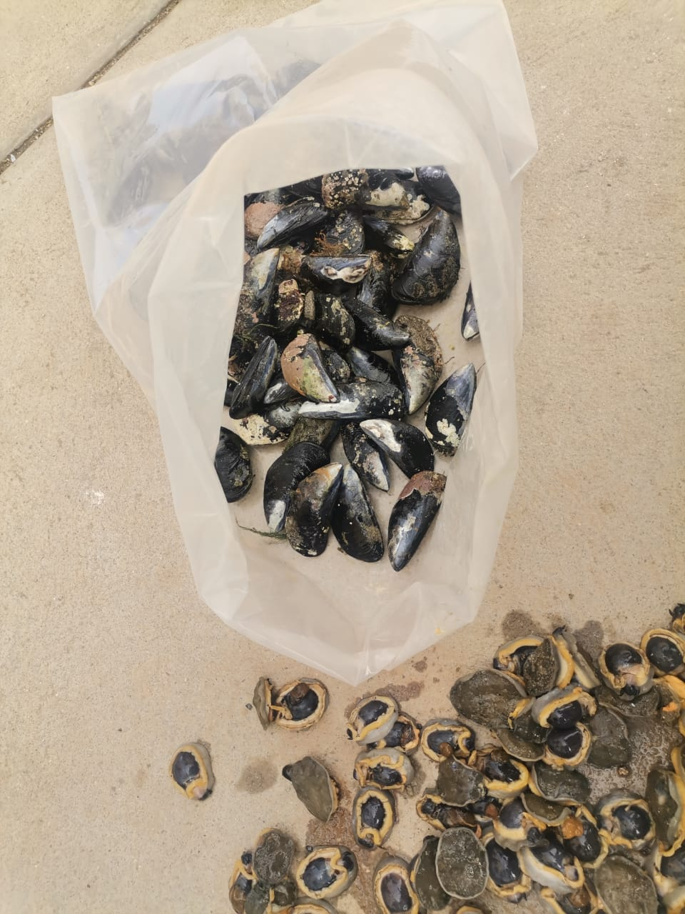
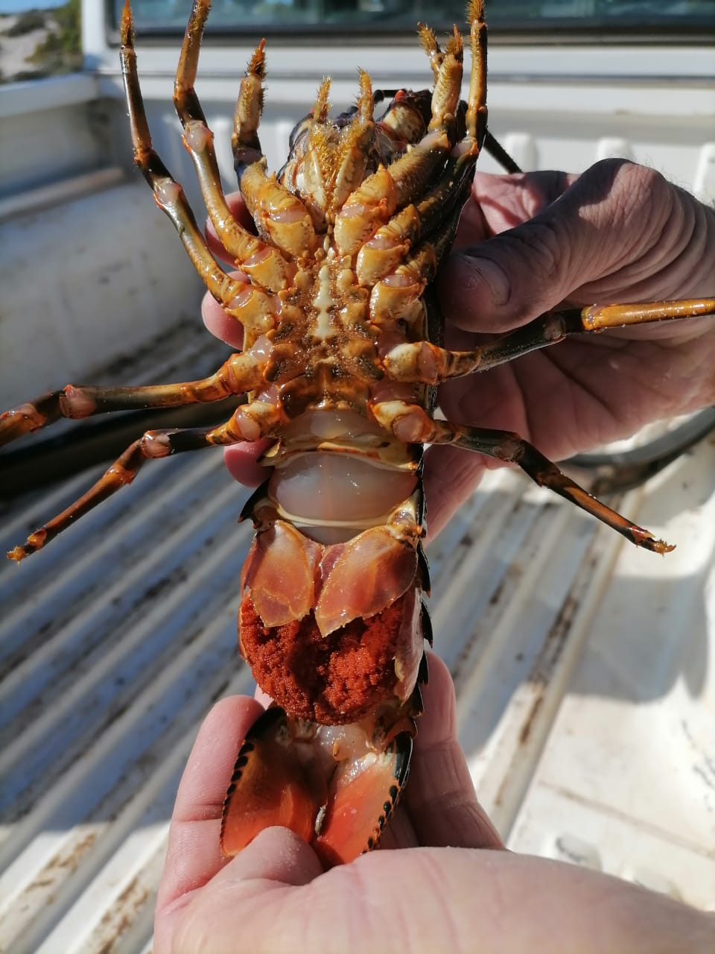
Coastal Patrols:- Port Nolloth

Slide 20
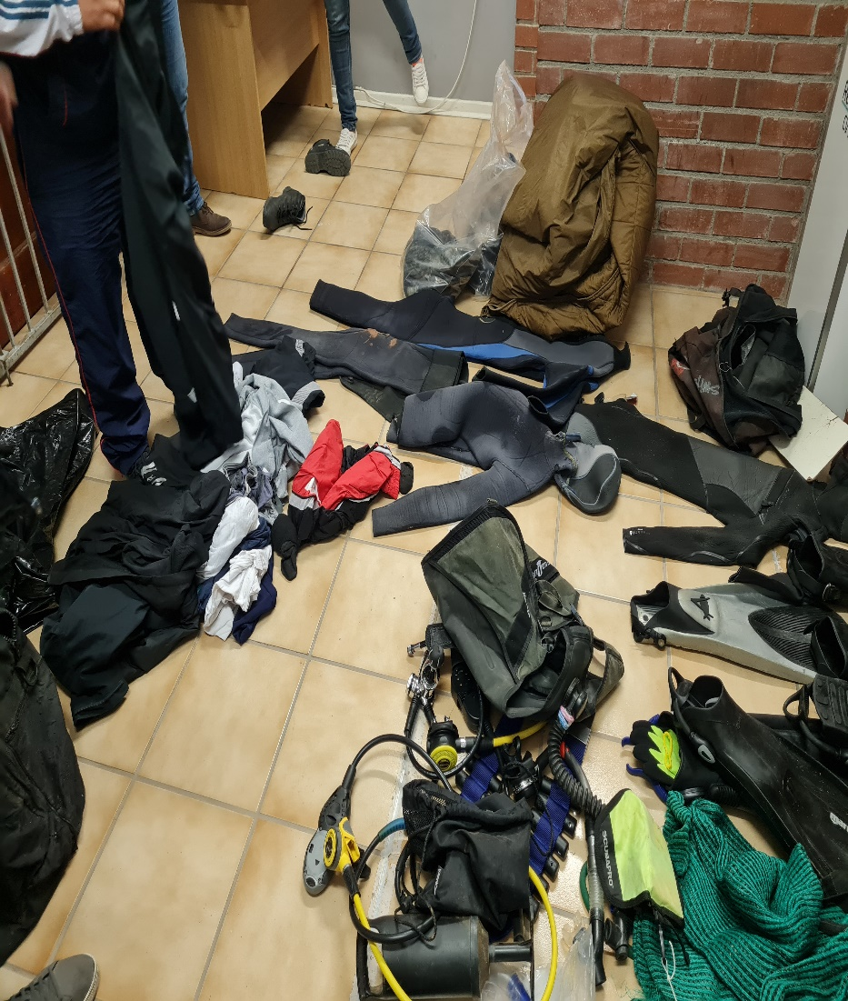
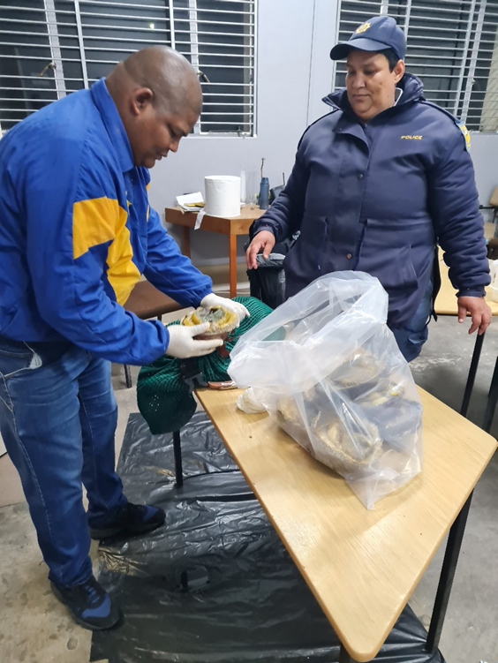
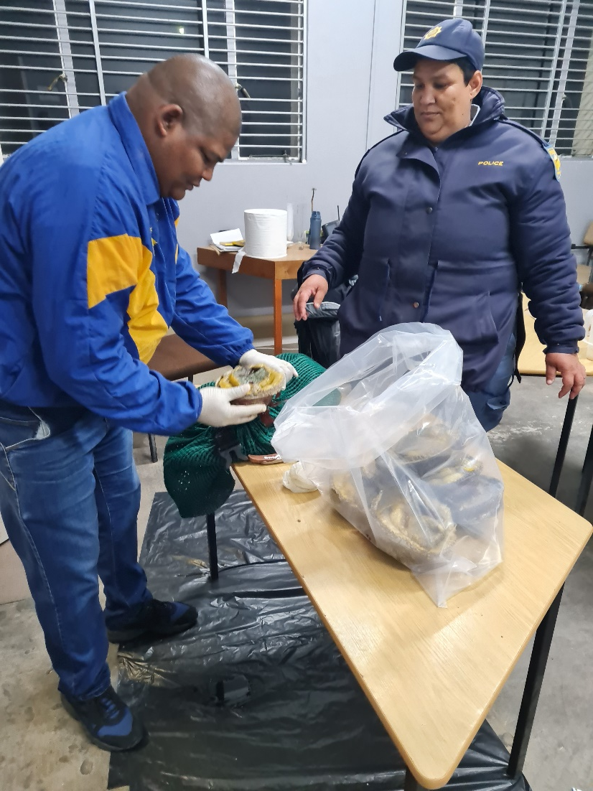
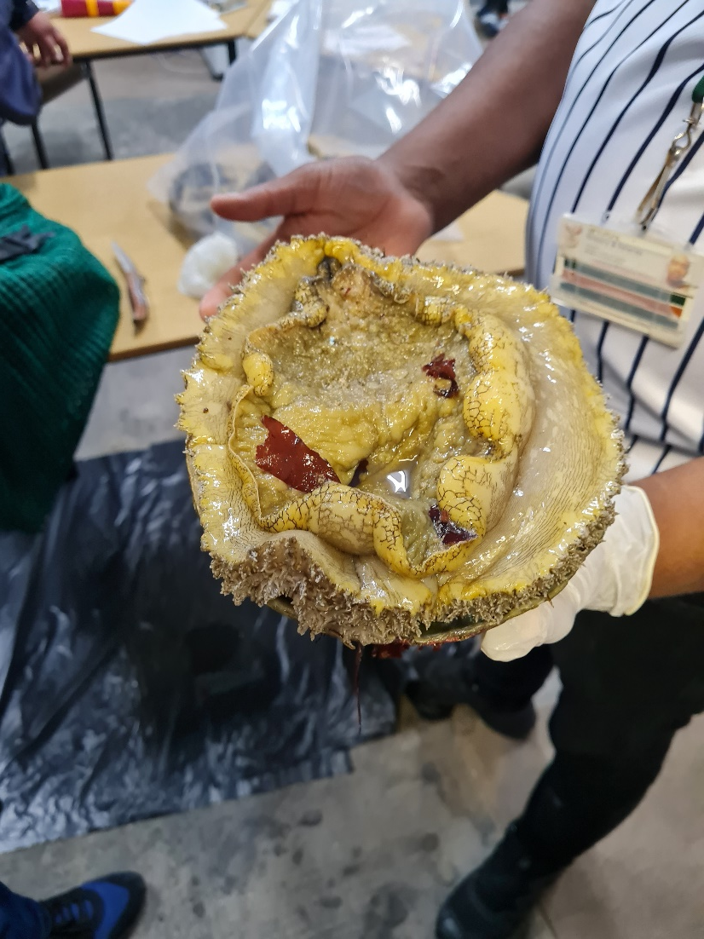
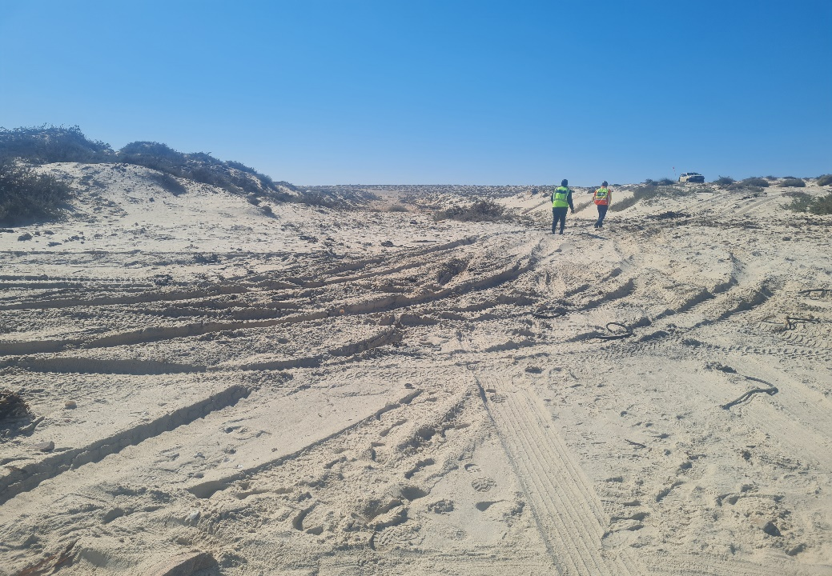
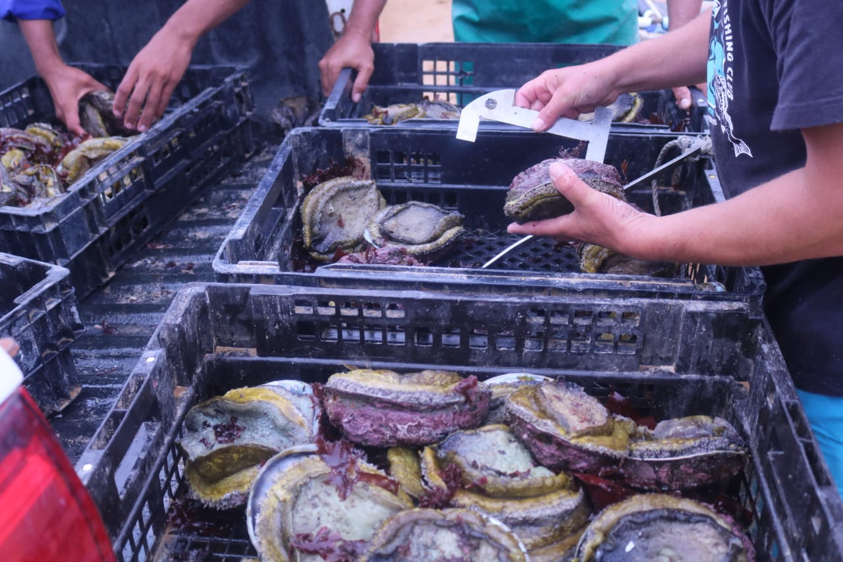
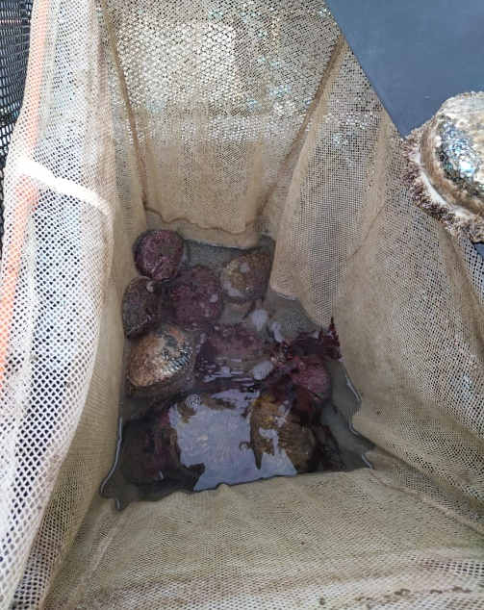
Coastal Patrols:- Kleinzee

Slide 21

Coastal Patrols:- Groenrivier (Brandsebaai)

Slide 22








Coastal Patrols:- Hondeklipbaai

Slide 23







Collaborative with efforts

Slide 24



PAST

Slide 25

THANK YOU
Notes:
25

