Slide 1
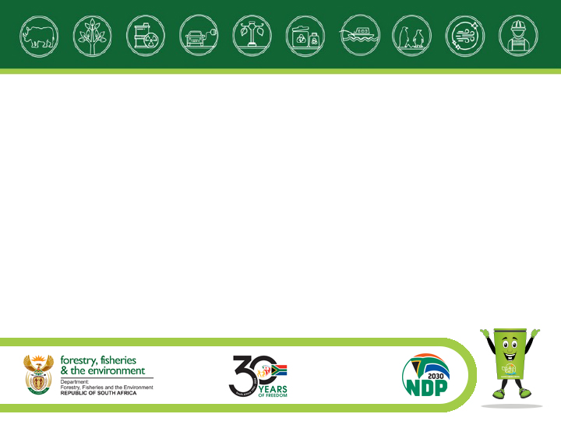
AQUACULTURE IN SOUTH AFRICA
Potential of the Northern Cape
Department of Forestry, fisheries and the Environment (DFFE)
Branch: Fisheries Management
Mr Kishan Sankar
Aquaculture Advisor (DFFE)
Sustainable Ocean Economy Symposium
Port Nolloth
16-17 October 2024

Slide 2
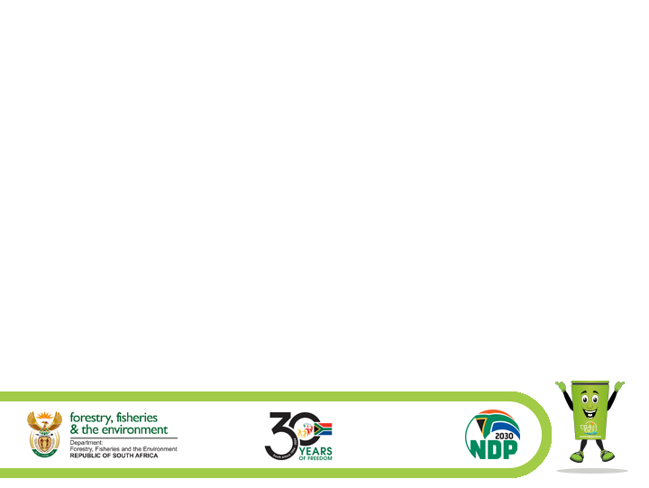
Content of Presentation
Status of Aquaculture Globally
South Africa’s Aquaculture sector growth
South Africa’s Aquaculture sector production
Northern Cape Potential

Slide 3
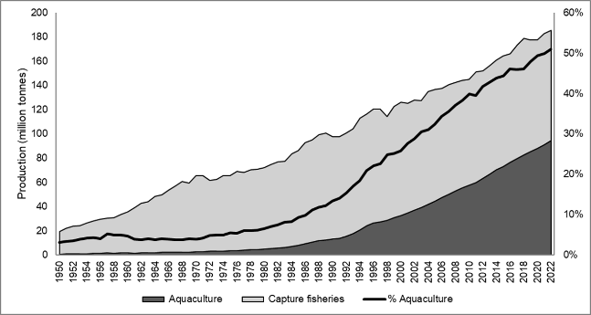
Status of Aquaculture in Globally
The global aquaculture industry has experienced significant growth in recent years and is now the world’s fastest growing agri-food system according to the FAO. Aquaculture plays an important role in food and nutrition security, income generation and economic development, and can provide other benefits including ecosystem services (e.g., carbon sequestration, biodiversity conservation, and climate change mitigation) (World Bank, 2024).

Slide 4
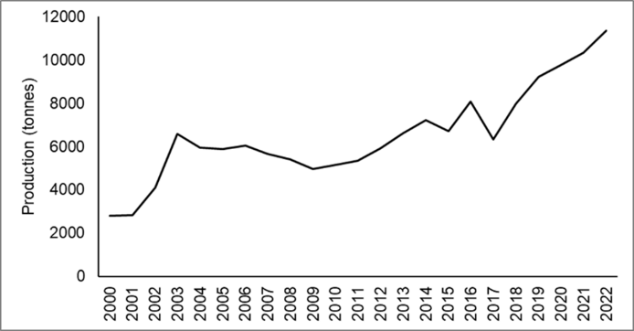
SA’s Aquaculture sector growth
The South African aquaculture sector has shown considerable growth over the last twenty-two years. Total aquaculture production in South Africa in 2022 was 11 377 tons, of which 67% (7 678 tonnes) comprised aquatic animals and 33% (3 699 tonnes) comprised algae (DFFE, 2024).

Slide 5
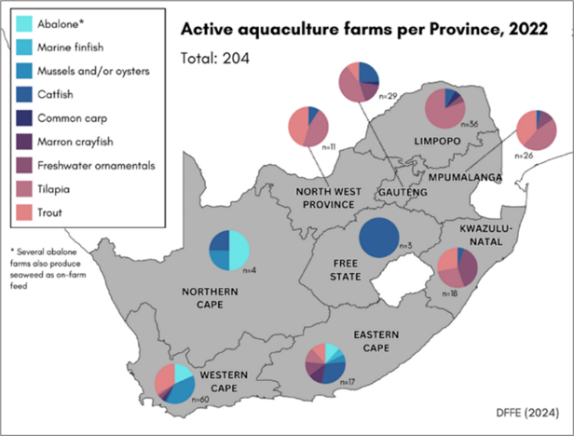
Aquaculture farms per province
In 2022, there were 204 operational aquaculture farms in South Africa, comprising 41 marine farms and 163 freshwater farms.

Slide 6
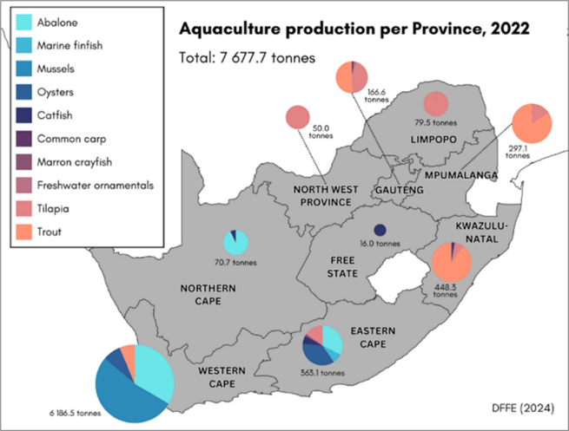
Aquaculture production per province
In 2022, there were 204 operational aquaculture farms in South Africa, comprising 41 marine farms and 163 freshwater farms.

Slide 7
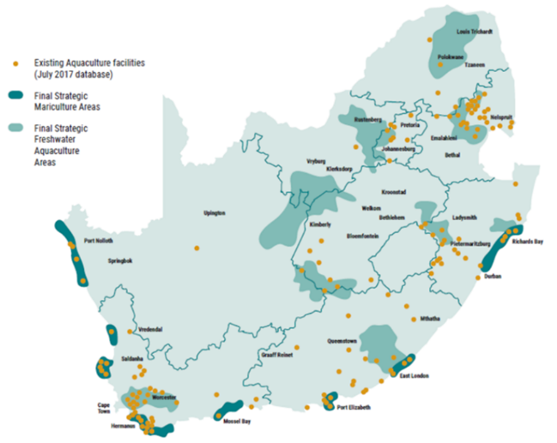
Aquaculture Potential of the Northern Cape
Map indicating the findings of the Aquaculture Strategic Environmental Assessment https://aquasea.csir.co.za/sea-report/

Slide 8
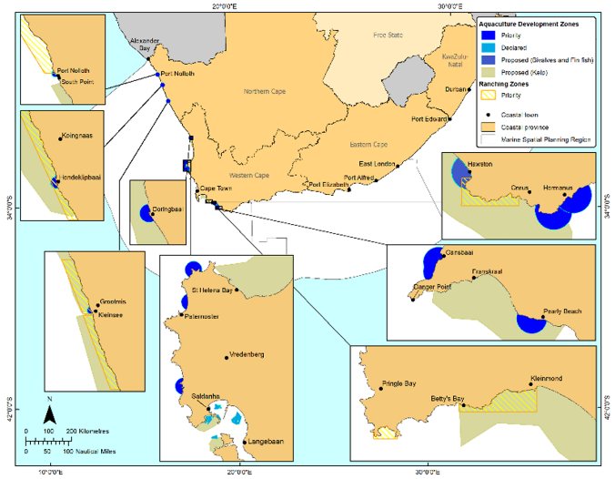
Priority Aquaculture Areas

Slide 9
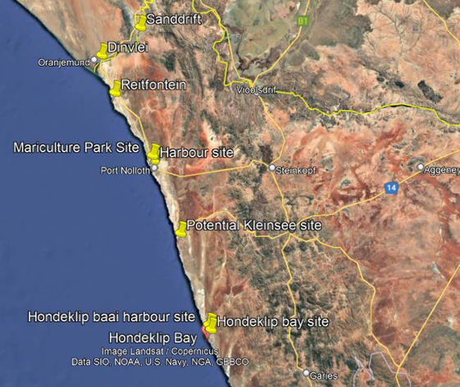
Aquaculture Potential based on a site visits conducted in 2022

Slide 10
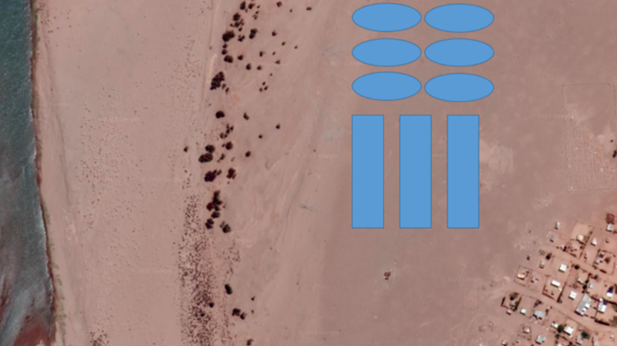
Proposed site in Sanddrift

Slide 11
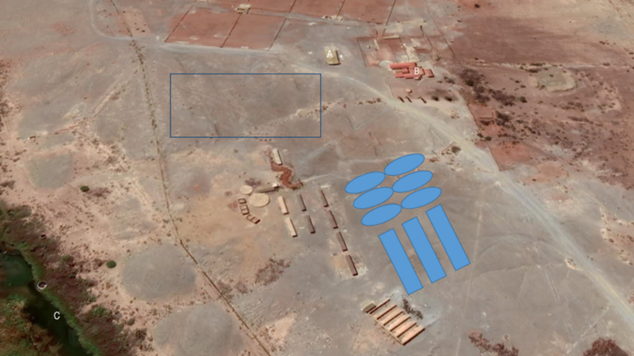
Proposed concept for Dinsvlei

Slide 12
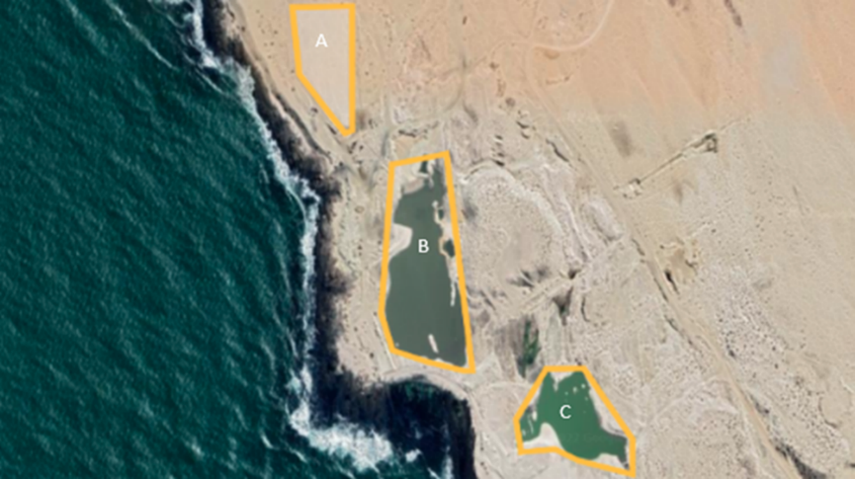
Proposed concept for Rietfontein

Slide 13
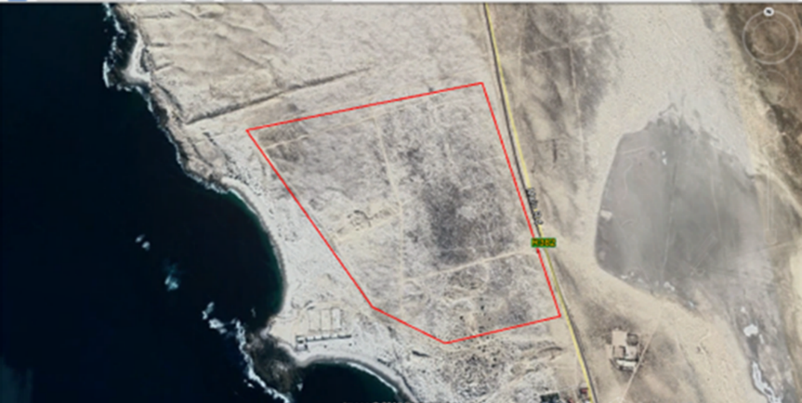
Proposed mariculture park site

Slide 14
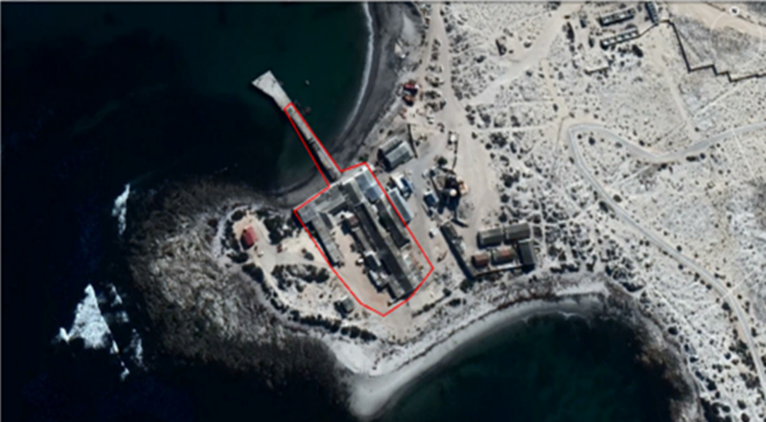
Port Nolloth harbour site

Slide 15
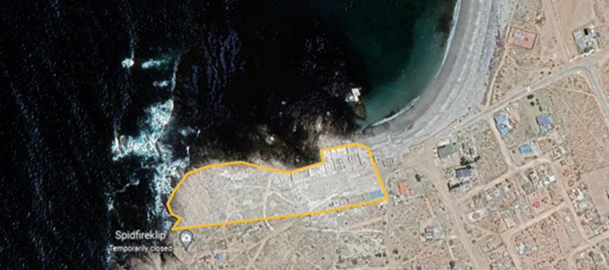
Proposed site Hondeklip Baai harbour

Slide 16
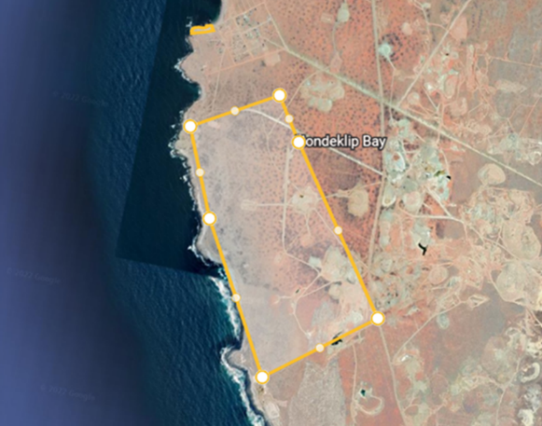
Proposed site Hondeklip Baai

Slide 17
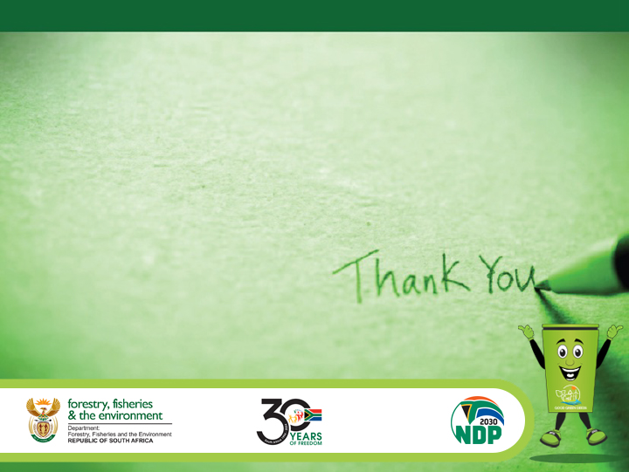
THANK YOU!
Mr Kishan Sankar
Operation Phakisa Delivery Unit
Chief Directorate Aquaculture Development & Freshwater Fisheries
Branch; Fisheries Management
Department of Environment, Forestry and Fisheries
Tel: 021 402 3631 | Mobile: 066 471 1356
Website: http://www.dffe.gov.za
Address: The Environment House, 473 Steve Biko Road, Arcadia, Pretoria, 0083

