Slide 1
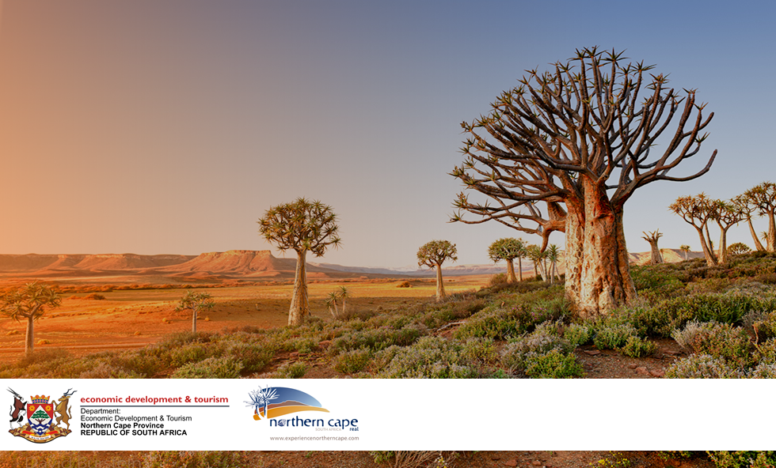
SUSTAINABLE OCEAN ECONOMY SYMPOSIUM
Presenter: T Mabija
Date: 11 OCT 2024

Slide 2
Overview
  Coastal Economy Research
  Development of Small Harbours

Slide 3


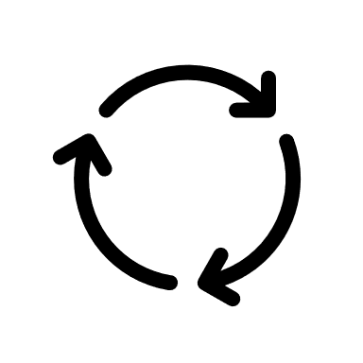



Coastal Economy Research
Preserve and sustainable utilize the natural resource
Restore the damage done by mining
Sustainable livelihoods from nature
Maintain natural, heritage and tourism assets
Fishing: coastal and long line
Fish processing:
Aquaculture: abalone, ranching, hatchery
Kelp
Tourism
Mining
Infrastructure/Construction
Culture, norms and values
HDI: education, life expectation
Gini Coefficient: Local ownership,
Participation
Social Infrastructure
Social

Slide 4
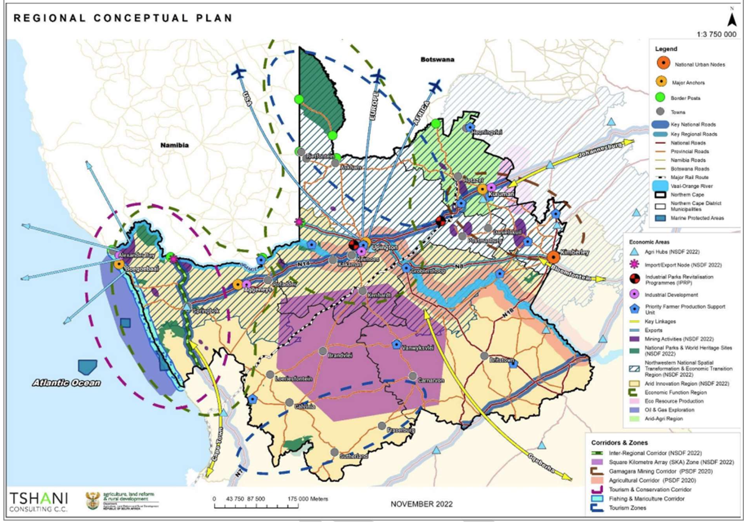
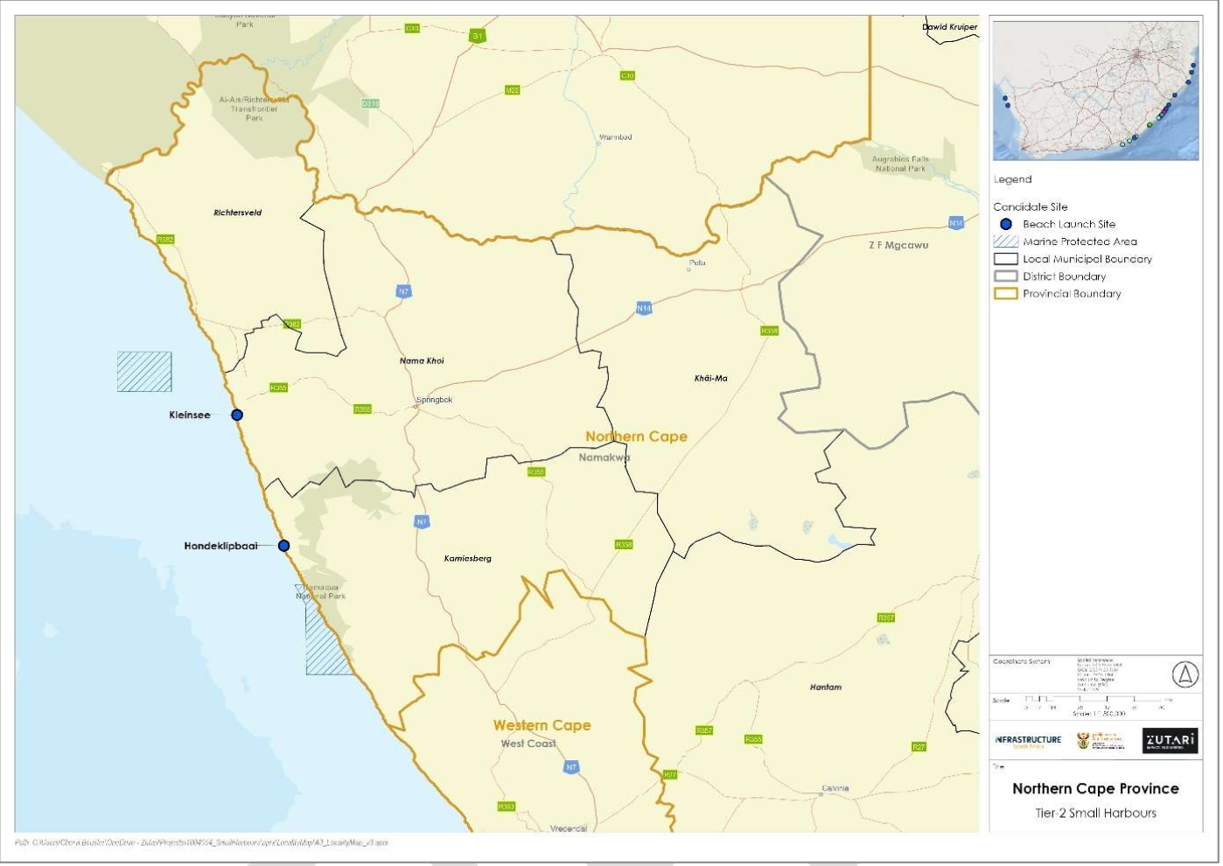




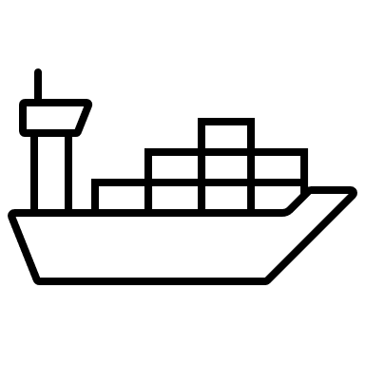


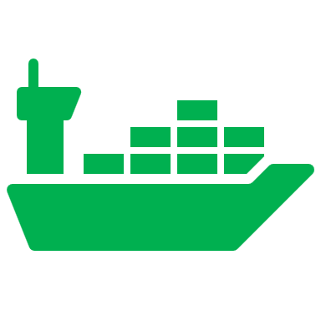
Development of Small Harbours

Slide 5
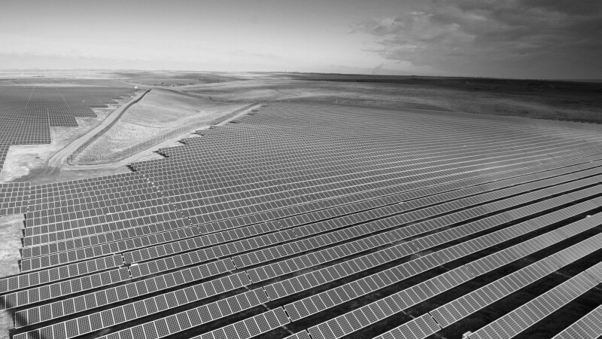



Thank You
www.northern-cape.gov.za/dedat/
+2753 839 4000
dedat@ncpg.gov.za

