Slide 1


International Panel for Ocean Sustainability
Towards an
Oceans Economy Symposium 16 October 2024
Tanya Brodie Rudolph
Centre for Sustainability Transitions

Slide 2
5 Key Questions
Why an IPOS
For What
What
How
What Next

Slide 3
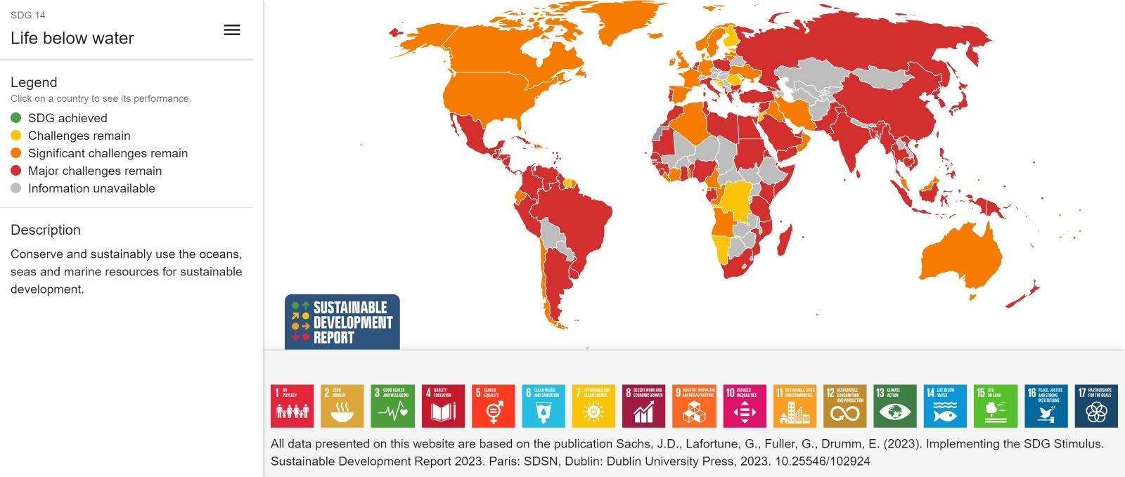
Why an IPOS
We are in an ocean emergency. We are far from achieving the targets agreed under SDG 14 and others. The international community is mobilizing around the blue agenda: a source of hope, but more needs to be done. One of the enablers is a better functioning science-policy interface.
Key challenge globally:
Balance of sustainability pillars
Better science-policy-society interface
Key challenge locally:
Accelerate blue economy strategies,
taking into account –
Capacity building
Need for adaptation
Continued need for mitigation

Slide 4

For Whom
States have a dual role:
to accelerate the implementation of their international commitments for a sustainable ocean; and
develop blue jobs, blue economies, build resilience in local communities
Existing evidence base:
Global knowledge (IPCC, IPBES, WOA, UN Decade…)
Regional and local science (Benguela Current, All Atlantic, Ocean Economy Master Plan, MSP Factsheet SANBI …)
But
We need to accelerate impact: policy makers need to seize the science to close the implementation gap
This is value proposition of the services to be provided by the IPOS
- to answer specific questions from States

Slide 5

What - 3 main services considered to date for the IPOS
Ocean
Action Requests
Target users: States and Intergovernmental organisations
Timeline for outputs: Up to 12 months after the request is prioritised by the IPOS
A
Ocean Rapid Response
Target users: States and Intergovernmental organisations
Timeline for outputs: Weeks
B
Ocean Sentinel
Target users: Non-State actors for the inputs, States for the outputs
Timeline for outputs: Report made to states every 6/12 months
C

Slide 6
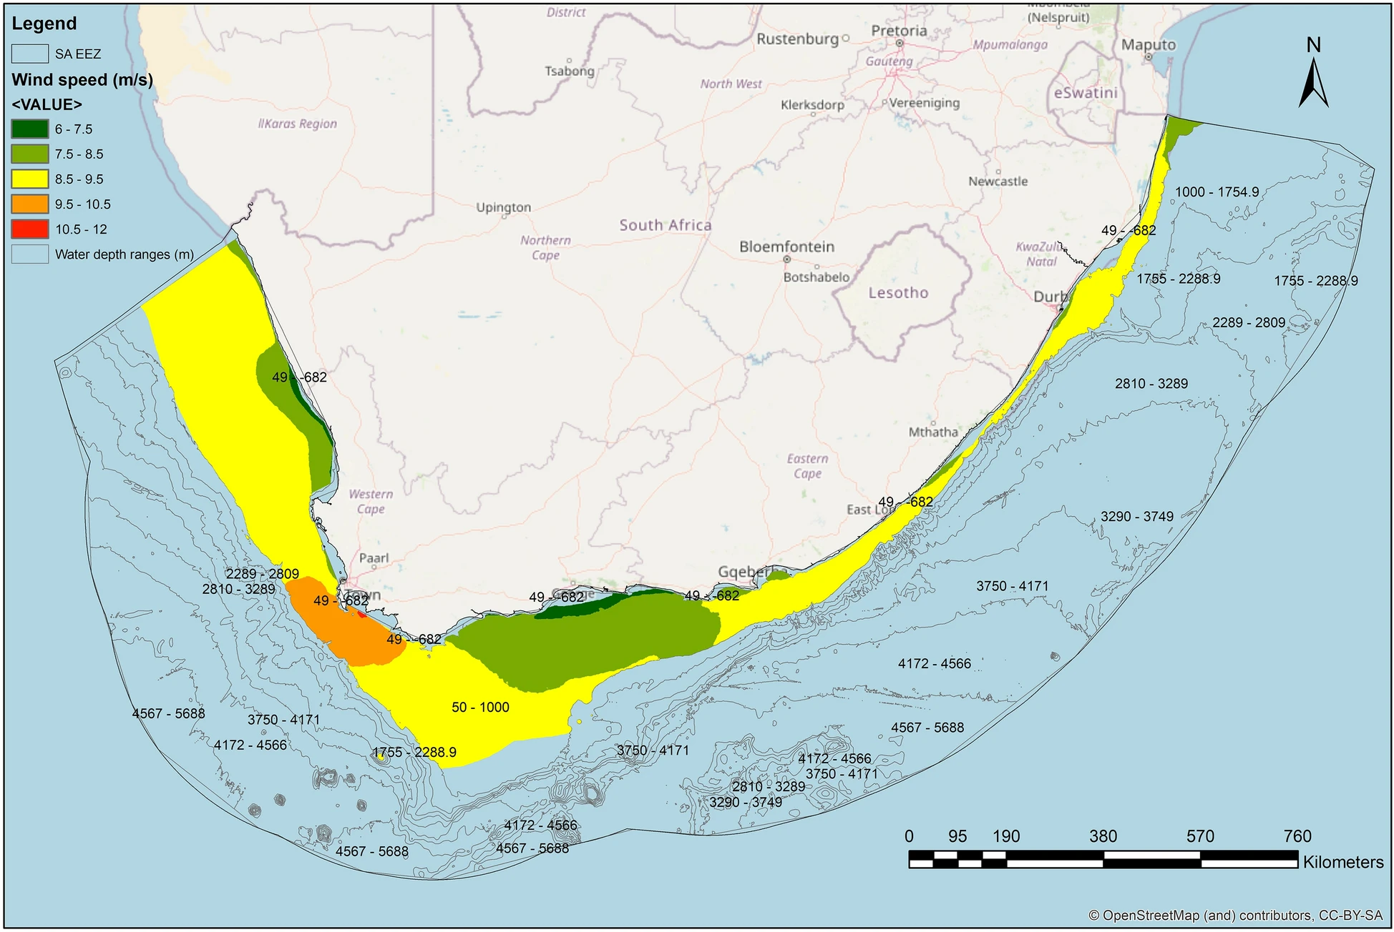
Example of an Ocean Action Request: Northern Cape
Provide a detailed roadmap to facilitate the implementation of offshore renewable wind in the province
Some considerations:
- Marine spatial planning
- Shipping routes
- Harbour capacity for support
- Manufacture and repair
- Supply chain
- Permitting process and policies
- Tourism impacts
- Capacity building
- Financial flows and equitable
distribution
- Funders

Slide 7
What: the answers to these questions will be:
Robust
Relevant
Systemic
Inclusive
Undisputed in terms of science
Geographically relevant
Ready-to-use documents and tools
Timely
Holistic, integrating land and sea considerations, biodiversity and climate
Include knowledge from the economic world, civil society and local and indigenous communities

Slide 8


























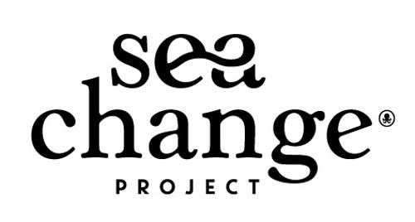
How?
Political support
Scientific support
Other organisations
France
European
Commission
China
Youth
Dialogues with :
Pacific Ocean Commissioner
Palau
Morocco
South Africa
USA
Canada
Brazil
Monaco
Communication
Target = 40 institutions by June 2024

Slide 9

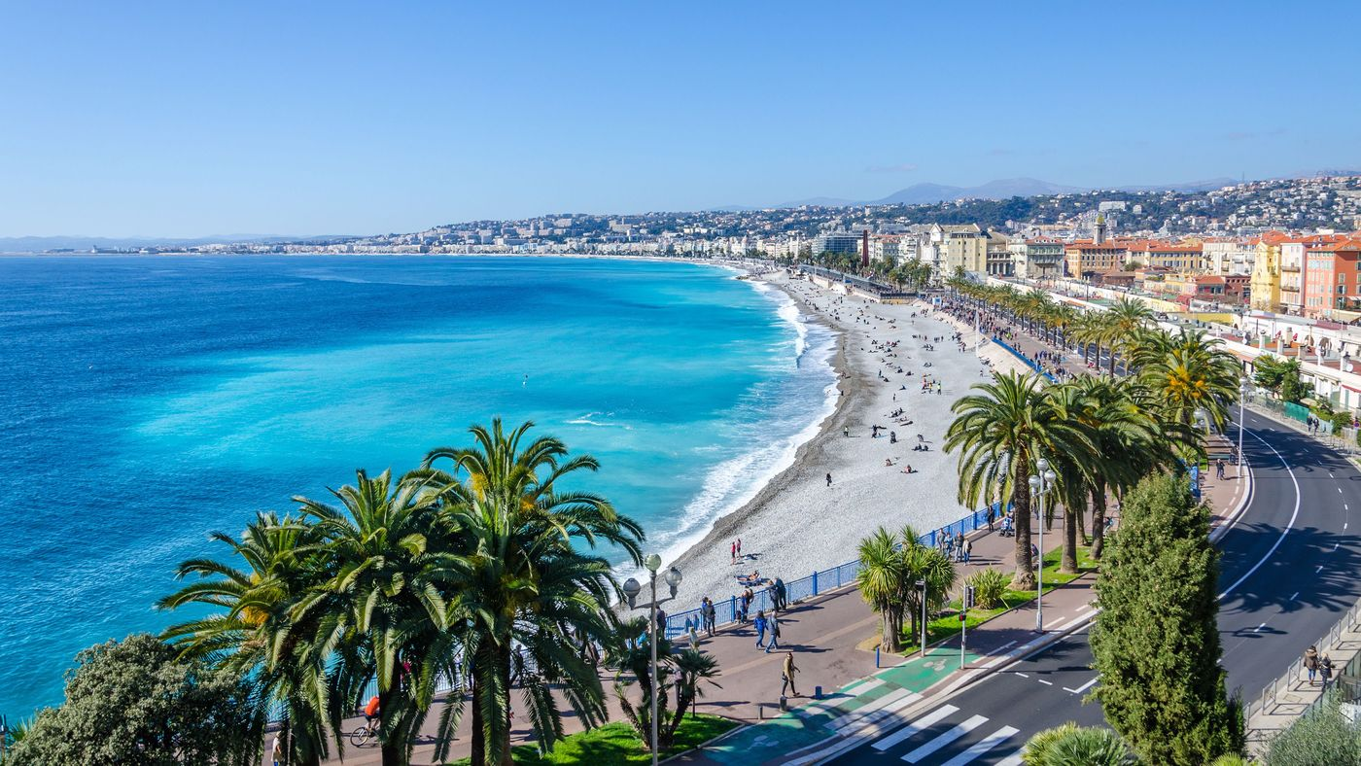
What next talks on the road to UNOC-3
Objective is to present the concept of the IPOS at UNOC-3, with a clear vision of:
What the IPOS will be
How it will work
What will be its governance
How it will be funded
Nice, France, June 2025

Slide 10


Questions and ideas?
Thank you!
www.ipos.earth
tanya.brodierudolph@ipos.earth

