Slide 1



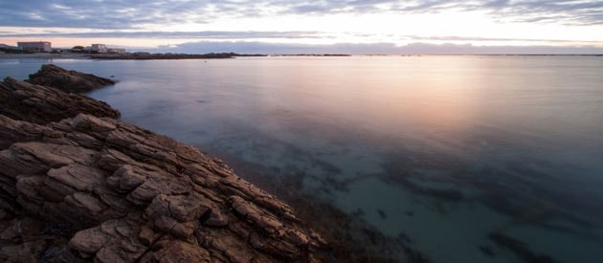
DEVELOPMENT OF SMALL HARBOURS
NORTHERN CAPE OCEANS ECONOMY SYMPOSIUM
16 OCTOBER 2024

Slide 2
1. BACKGROUND TO THE DEVELOPMENT OF HARBOURS IN SA
BACKGROUND:
Small Harbours Development classifies marine access points based on the some the below components:
  Proclaimed Fishing Harbours with associated maritime infrastructure
  Gazetted Public Launch Sites (PLS) with associated infrastructure
  Smaller launch sites with limited maritime infrastructure
No new public harbours were developed in South Africa since the development of the 12 Proclaimed Fishing Harbours (PFHs) in the 1950s and are exclusive to the Western Cape and how do we address the skewed development.
Only the PFHs have Spatial and Economic Development Frameworks (SEDFs) where other harbours in the Northern Cape, Eastern Cape and KwaZulu Natal only have basic research completed.

Slide 3
1. BACKGROUND TO THE DEVELOPMENT OF HARBOURS IN SA
The PMO: Small Harbours Development Unit (SHDU) completed its Operation Phakisa: Oceans Economy: Small Harbours Development Lab in 2018 where a total of fifteen (15) initiatives were developed across four (4) thematic workstreams.
The SHDU is further responsible for the implementation of ‘SIP 21m: Small Harbours Development: National’ and has aligned its work to the Operation Phakisa workstreams:
  Phase A: Harbour Precinct Revitalization (Workstream 2: Operation Phakisa) – Completed RAMP March 2023 and completed MVAP Typologies initiatives.
  Phase B: Development of new harbours in the Northern Cape, Eastern Cape and KwaZulu-Natal (Workstream 1: Operation Phakisa Lab) – Commencement of developing SEDFs for new harbours.

Slide 4
2. MARINE INFRASTRUCTURE DEVELOPMENT:
DEVELOPMENT OF NEW HARBOURS – TIER 1 PRIORITY HARBOURS
Overview: The collaboration between the Department of Public Works and Infrastructure (DPWI) and Infrastructure South Africa (ISA) involves developing Spatial and Economic Development Frameworks (SEDFs) for new small harbours across Northern Cape, Eastern Cape, and KwaZulu-Natal.
The project is divided into Tier 1 and Tier 2 harbour sites. The Tier 1 sites will go directly into the development of the SEDFs and the Tier 2 sites will first undertake a preliminary analysis of the 22 sites where 5 sites will progress to the next phase of SEDF development.
The project falls within the ambit of other coastal government initiatives including the District Development Model (DDM), Operation Phakisa: Oceans Economy and Provincial, District and Municipal Spatial Development Frameworks ensuring alignment with provincial priorities.
Tier 1 Harbours:
Sites: Port Nolloth, Port St Johns, and Port Shepstone.

Slide 5
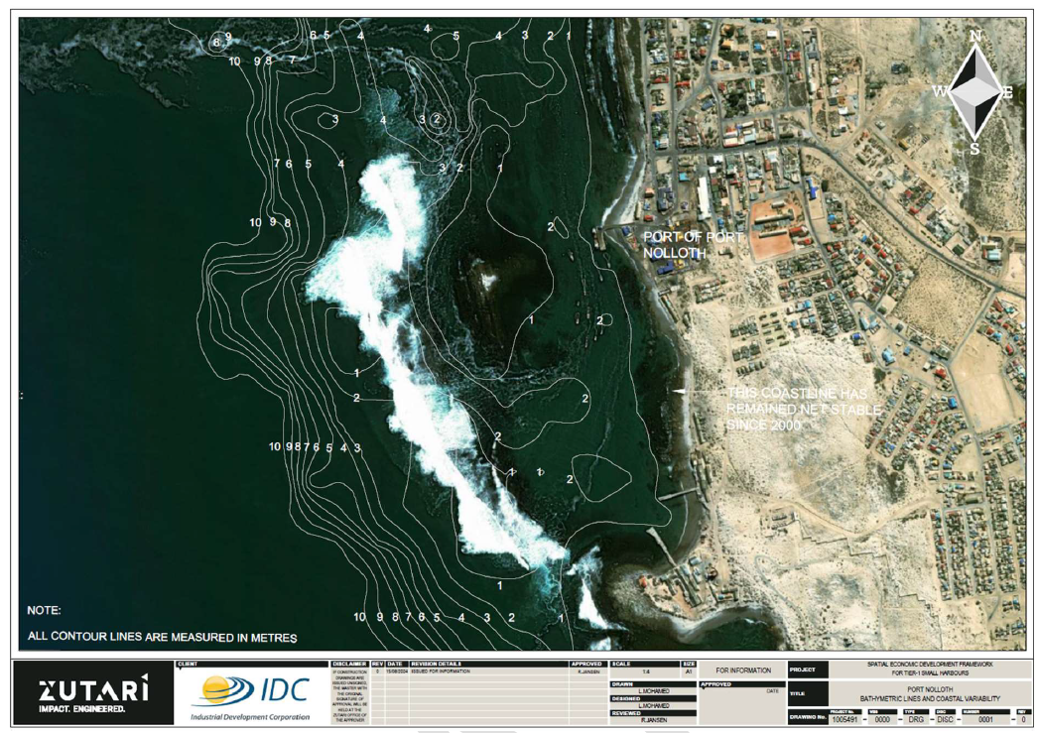
2. MARINE INFRASTRUCTURE DEVELOPMENT:
DEVELOPMENT OF NEW HARBOURS – TIER 1 PRIORITY HARBOURS
Port Nolloth: Bathymetric line diagram:

Slide 6
2. MARINE INFRASTRUCTURE DEVELOPMENT:
DEVELOPMENT OF NEW HARBOURS – TIER 1 PRIORITY HARBOURS
Activities:
  A site visit and stakeholder engagement took place on 30 July and 16 August 2024, respectively.
  Desktop analysis and preliminary assessments of the site has been completed.
  Desktop studies to assess technical and socio-economic feasibility are still to follow.
  Second round of government stakeholder engagement sessions and site visits to take place to brief local stakeholder and obtain insight of the development options.
  Development of spatial layouts and indicative capital cost estimates for Nolloth.
  The SEDF for Port Nolloth is expected to be completed by January/February 2025.
Progress and Way Forward:
  Completion of initial site visit and gathering of desktop and on-site data.
  Completion of first round of Government Stakeholder Engagement Sessions.
  Preliminary report on Port Nolloth has been completed with an options analysis being developed for further discussion.
  Present the options analysis at the end of October 2024 to the Northern Cape Stakeholders.
  Follow-up site visits scheduled for the first/second week of November 2024.

Slide 7
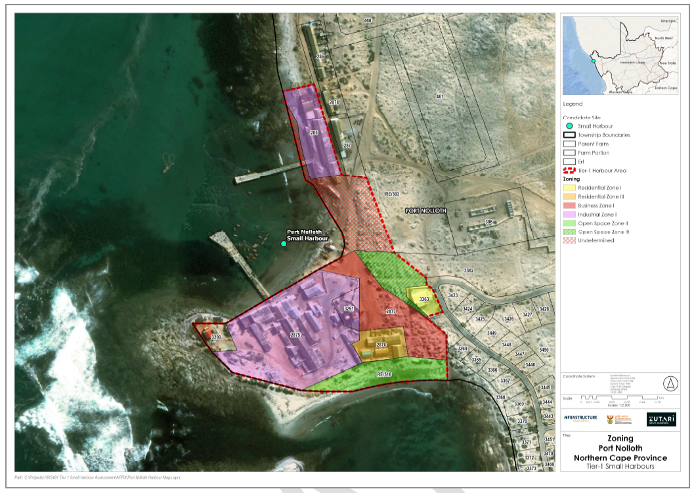
2. MARINE INFRASTRUCTURE DEVELOPMENT:
DEVELOPMENT OF NEW HARBOURS – TIER 1 PRIORITY HARBOURS
Identified site for Port Nolloth Harbour (Phased Approach):

Slide 8
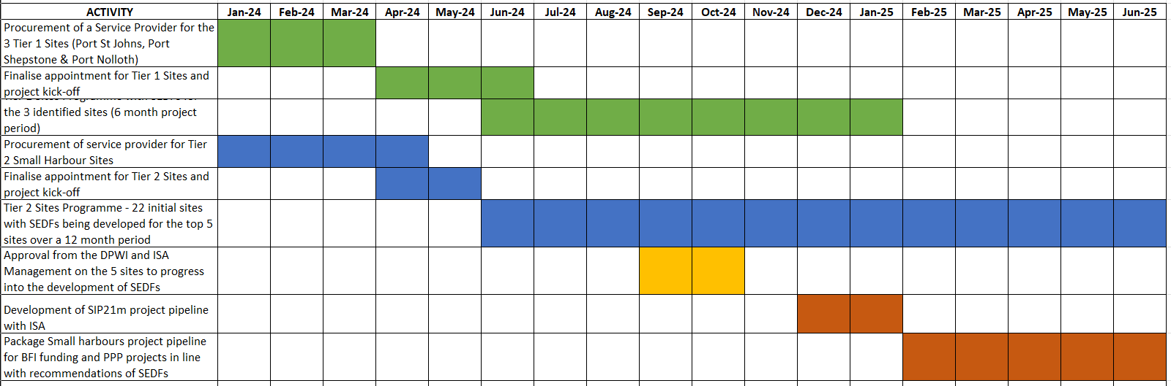
2. MARINE INFRASTRUCTURE DEVELOPMENT:
DEVELOPMENT OF NEW HARBOURS: TIER 1 AND 2 PROJECT PLAN
SMALL HARBOURS PROJECT PLAN FOR SEDFS IN THE NC, EC AND KZN:

Slide 9
2. MARINE INFRASTRUCTURE DEVELOPMENT:
DEVELOPMENT OF NEW HARBOURS – TIER 2 HARBOURS
Tier 2 Harbours:
Scope: Assessment of 22 additional sites in the NC, EC and KZN to identify the potential for small harbour developments or infrastructure upgrades.
Phases:
  Preliminary Assessment: Evaluates physical attributes, socio-economic potential, and other key factors.
  Concept Development: In-depth planning for selected sites, leading to the development of SEDFs.
Sites Considered:
  Northern Cape: Kleinzee, Hondeklipbaai.
Timeframe: The project has a duration of 12 months and is expected to be completed by June 2025.

Slide 10
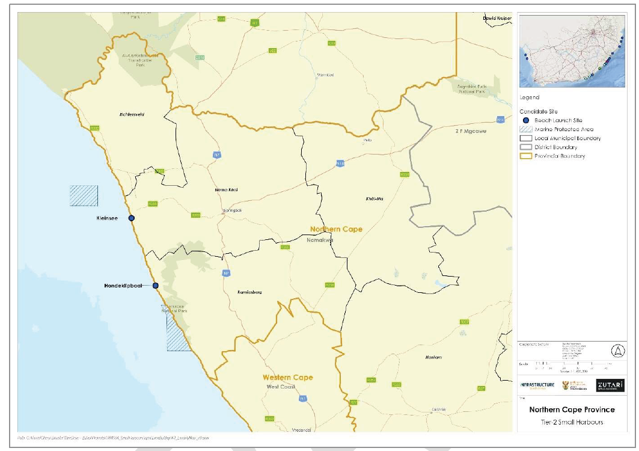
2. MARINE INFRASTRUCTURE DEVELOPMENT:
DEVELOPMENT OF NEW HARBOURS – TIER 2 HARBOURS
Tier 2 Northern Cape Harbours:

Slide 11
2. MARINE INFRASTRUCTURE DEVELOPMENT:
DEVELOPMENT OF NEW HARBOURS – TIER 2 HARBOURS
Tier 2 Harbours:
Deliverables: Master plans for phased development and detailed studies in the form of Spatial and Economic Development Frameworks (SEDFs) for additional sites across the Northern Cape, Eastern Cape and Kwa-Zulu Natal.
Timeline:
  First phase: Three months for preliminary assessments. A Multi-Criteria Analysis (MCA) will guide the selection of sites for further development and SEDFs which has been completed and submitted by 30 August 2024.
  Consultation Phase: One month for government to consult with provinces and proceed with the top sites (September 2024) – Currently running behind the project schedule
  Second phase: Eight months for detailed planning and concept development of the SEDFs.
Key Outcomes:
  The SEDFs will provide plans for the technical and socio-economic feasibility of potential harbour developments.
  Development options for the type of infrastructure that will be feasible for the new sites. The options analysis may state that certain sites may only require basic maritime infrastructure and not be developed into fully fledged small craft harbours.
  The project aims to boost regional economic development, enhance infrastructure, and provide opportunities for local communities.

Slide 12
2. MARINE INFRASTRUCTURE DEVELOPMENT:
DEVELOPMENT OF NEW HARBOURS – TIER 2 HARBOURS
Multi-Criteria Analysis (MCA) Process:
  The MCA tool was developed to shortlist and prioritise the candidate sites to the top sites that are most suitable for the development of a Small Craft Harbour or associated marine and land infrastructure.
  The MCA tool was developed in consultation with the DPWI and ISA where the following was in principle agreed upon:
    Sufficient criteria and sub-criteria
    Fair scoring scales across provinces
    Weighting of various criteria
  Prior to completing the MCA, all of the candidate sites were required to pass the Gate 1 Review, which tested the sites’ suitability for development based on 3 critical criteria:
    No-go Development Areas
    Land Availability for Investment
    Bulk Infrastructure Availability

Slide 13
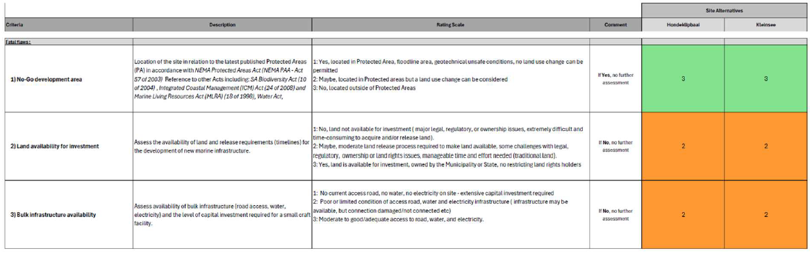
2. MARINE INFRASTRUCTURE DEVELOPMENT:
DEVELOPMENT OF NEW HARBOURS – TIER 2 HARBOURS
NORTHER CAPE MCA PROCESS:
The two (2) sites in the NC both passed the first gate within the MCA process as they did not fall within the identified high risk criteria:

Slide 14
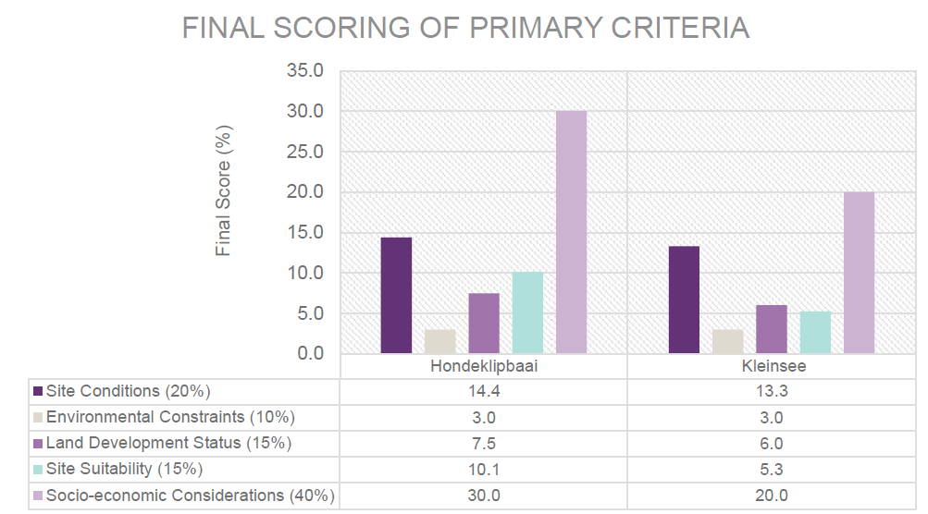
2. MARINE INFRASTRUCTURE DEVELOPMENT:
DEVELOPMENT OF NEW HARBOURS – TIER 2 HARBOURS
NORTHERN CAPE MCA PROCESS::
Northern Cape only had two (2) sites of which both passed the first gate of the MCA process and the outcome has been illustrated below against the various criteria for prioritisation:
# | SITE | SCORE
1 | Hondeklipbaai | 65%
2 | Kleinsee | 47%

Slide 15
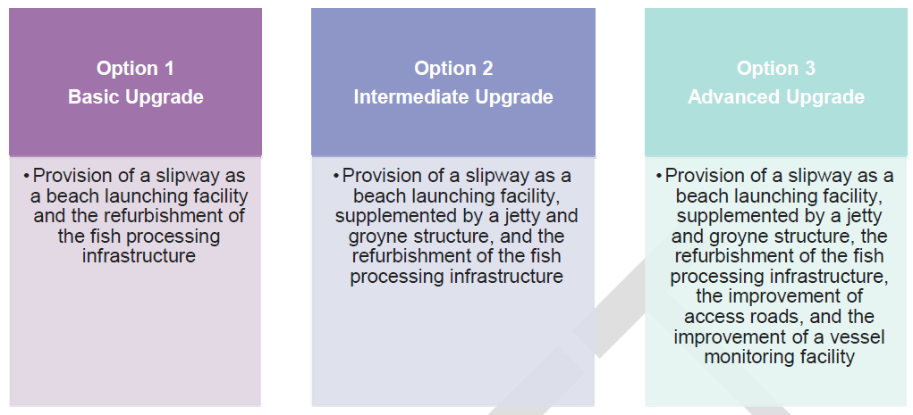
2. MARINE INFRASTRUCTURE DEVELOPMENT:
DEVELOPMENT OF NEW HARBOURS – TIER 2 HARBOURS
Next Steps and Way Forward:
  The proposed site for progression into the next phase of SEDF development under the Tier 2 harbours for the Northern Cape is Hondeklipbaai with the following options analysis as a phased development:

Slide 16
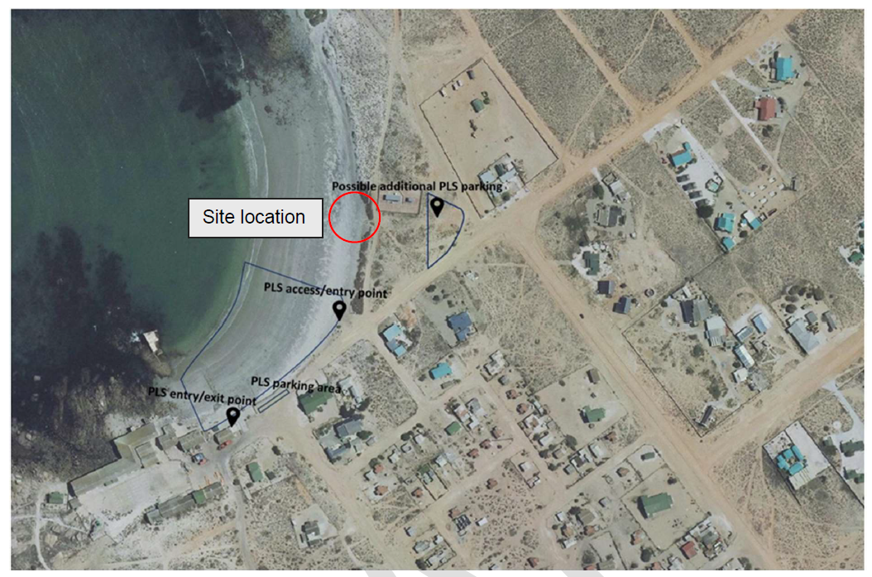
2. MARINE INFRASTRUCTURE DEVELOPMENT:
DEVELOPMENT OF NEW HARBOURS – TIER 2 HARBOURS
Proposed site location for Hondeklipbaai in line with the Kamiesberg Local Municipality IDP:

Slide 17
3. RECOMMENDATIONS AND WAY FORWARD
For the Northern Cape Oceans Economy to note the implementation plan and progress report on the parallel process for the development of new small harbours in the Northern Cape Province:
  The progress made with regards to the development of the SEDF for Port Nolloth as the Tier 1 Harbour site in the Eastern Cape; and
  For the Ocean Economy Symposium to note the endorsement of Hondeklipbaai as the site to progress to the next phase of SEDF development under the Tier 2 Small Harbours project for the Northern Cape.

Slide 18


END
National Department of Public Works and Infrastructure (DPWI)
Head Office: Public Works
CGO Building
Cnr Bosman and Madiba
Pretoria Central
Private Bag
X65
Pretoria
0001
Website: http://www.publicworks.gov.za

